Slide 1

TELEHEALTH & 6G:
PAPER
6G and Beyond Enabled Paradigm Shift in e/m-Health Services: Hope and Hype
TALK
Internet of Everything (IoE) Enabled Healthcare and 6G: Opportunities and Challenges
Dr. Muhammad Rehan Usman
Asst. Professor
Faculty of Engineering and Technology
The Superior University Lahore
Pakistan

Slide 2
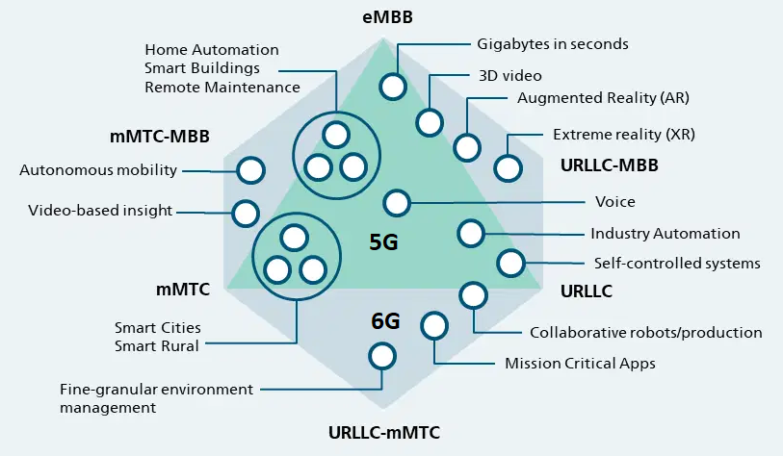
5G to 6G Use Cases:
6G Ready Use Cases, Fraunhofer: Online Available: https://www.6g-ready.net/700baaab964c055b

Slide 3
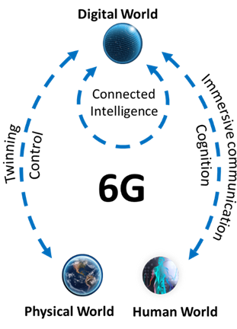
Hexa-X Project – Use cases still emerging

Slide 4
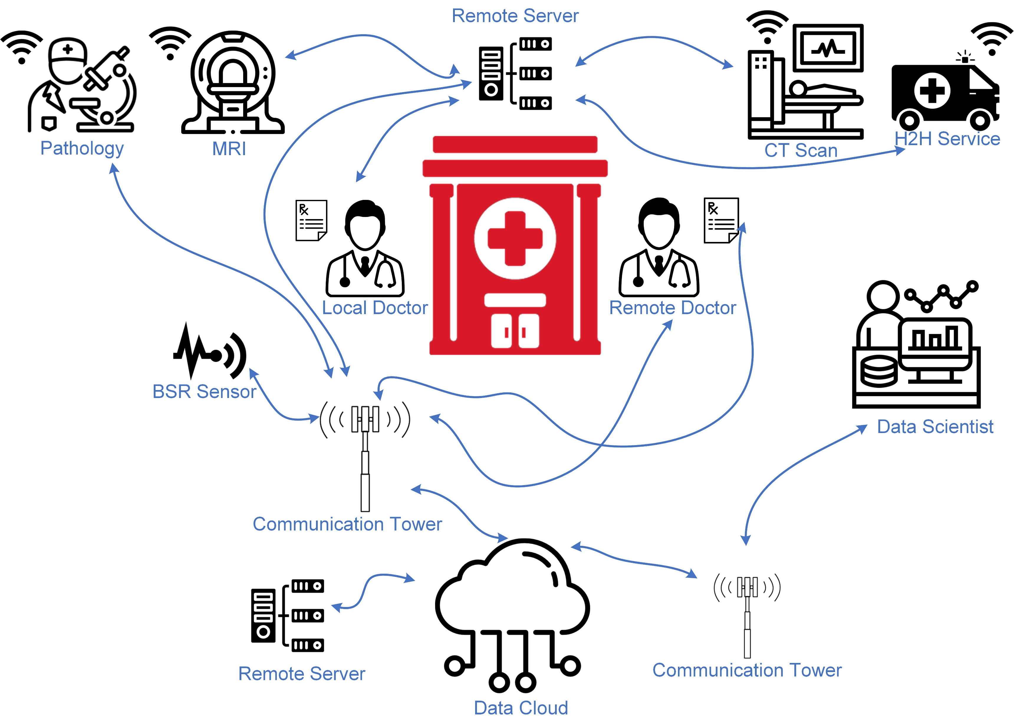
Telehealth &
5G

Slide 5
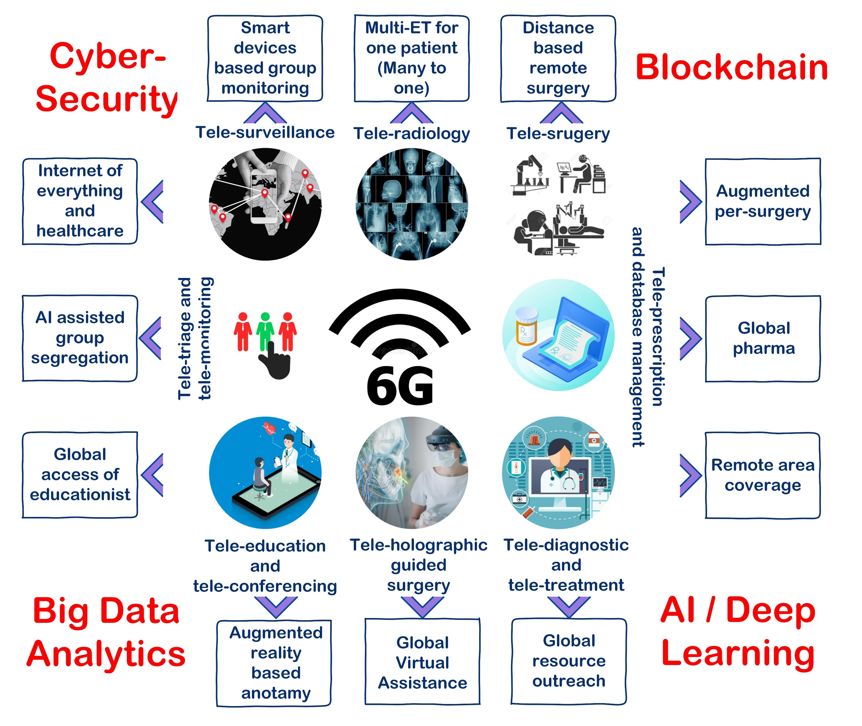
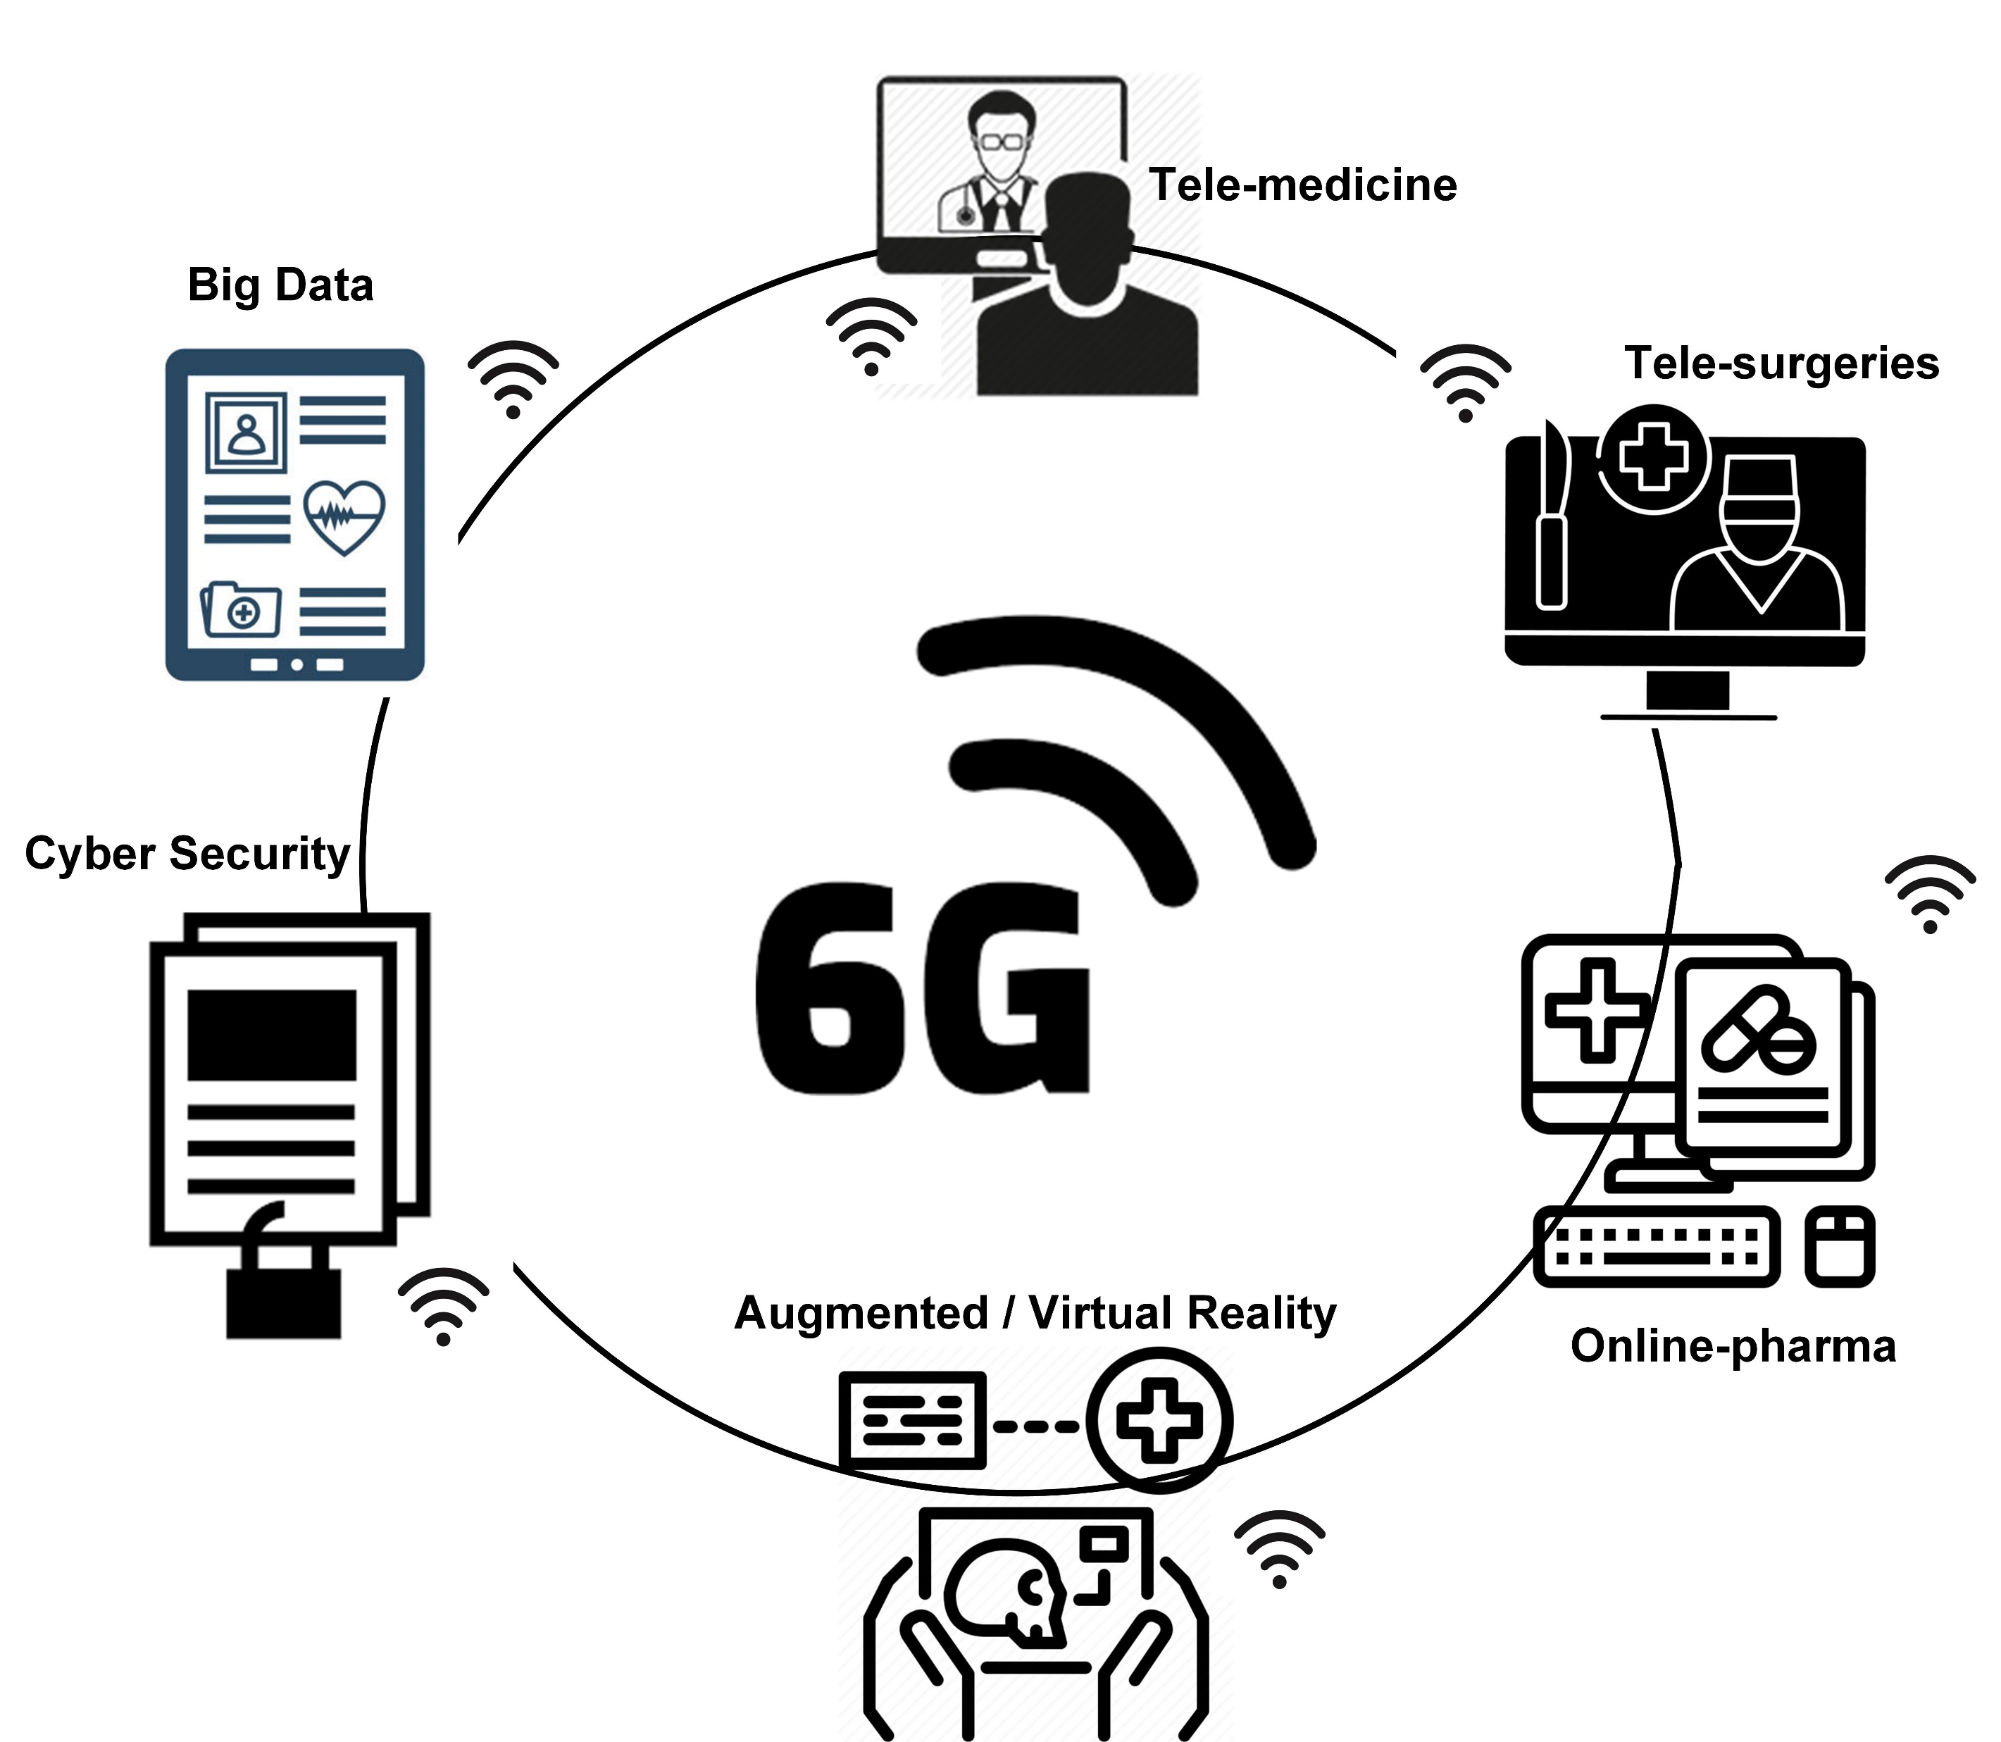
6G & Telehealth Evolution

Slide 6
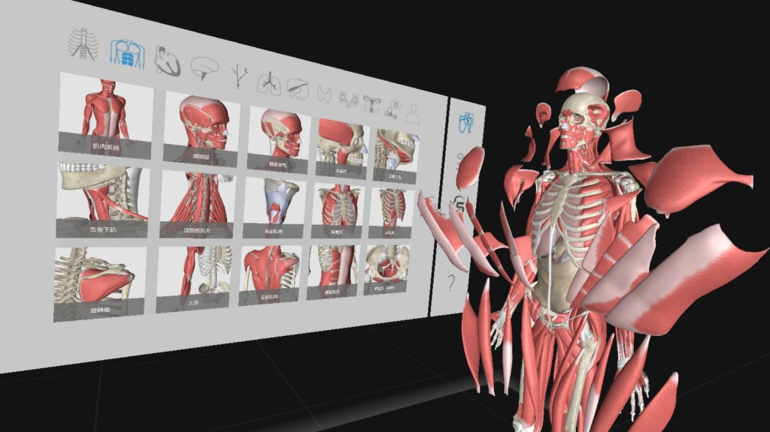

Slide 7
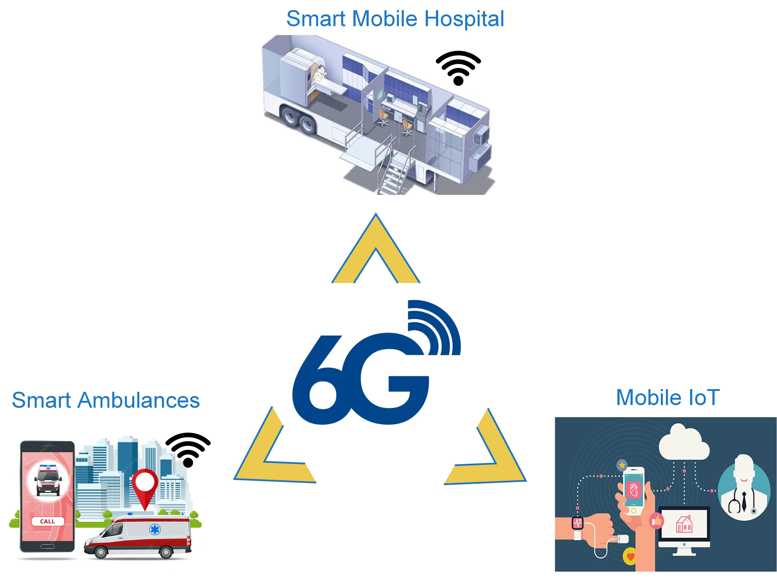
m-Health Evolution

Slide 8

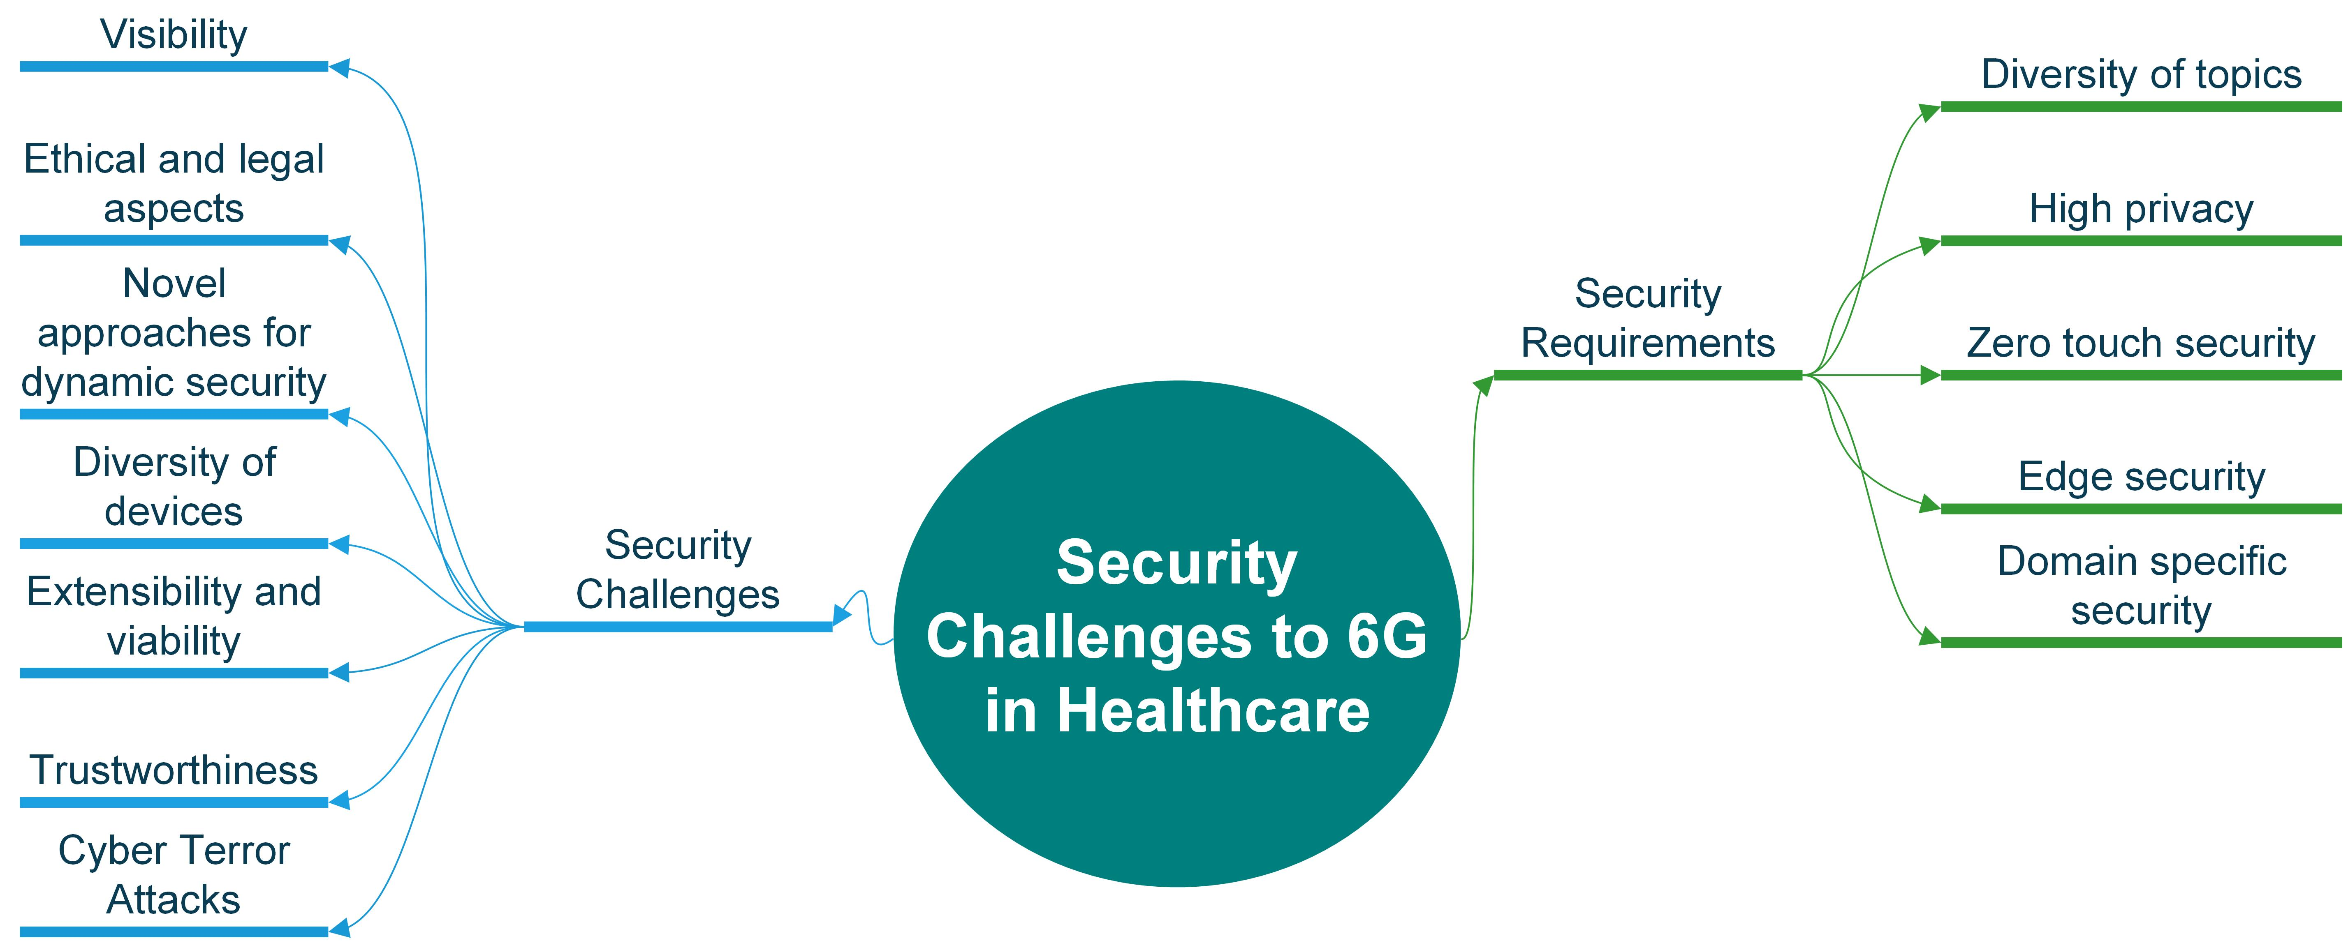
Virtual hospitals/wards
Wearable biosensors
Connected medication -> Connected inhalers
Smart watch monitoring
Automated insulin delivery (AID) systems
Assisting the elderly
Wearable device-based HVAC (private patients)(inhouse / in medical ward)

Slide 9

Challenges and Opportunities
New Govt. Policies and Regulations
Ultra low latency and reliability
Cyber Security
Bigdata
Teleeducation
Connected ambulances to connected hospitals
AI in Telemonitoring, Tele-triage
AR/VR/ER in Telehealth services
AI based Telepharma
Regulatory Issues, Reliability and Low latency
6G Global Shift
Privacy and Cyber Attacks
Management and Security
Low bandwidth with HD and Lossless transmission
Regulatory Issues, Data Handling, AI integration
????
Regulatory Issues, massive global data handling, Security etc.
Is it the END?

