Slide 1


Role of 5G and Beyond in the Context of Mobile Healthcare: Success Stories & Challenges
23rd June 2022
Presented by:
Dr. M Arslan Usman
Lecturer in CS| Kingston University London
System Architect | Pangea Connected UK

Slide 2
Flow of the presentation
What is pre-hospital healthcare?
What constitutes Mobile Healthcare?
5G Enabled Connected Ambulances: Progress and Challenges
Live Delivery of Ultrasound Imagery in Pre-hospital Healthcare
What’s next?

Slide 3
What is pre-hospital healthcare?
By Definition:
Pre-hospital refers to all environments outside an emergency department resuscitation room or a place specifically designed for resuscitation and/or critical care in a healthcare setting.
It covers:
Medical conditions: Ranging from minor illnesses and injury to life threatening emergencies.
Pre-hospital interventions: Ranging from simple first aid to advanced emergency care and pre-hospital emergency anaesthesia.

Slide 4

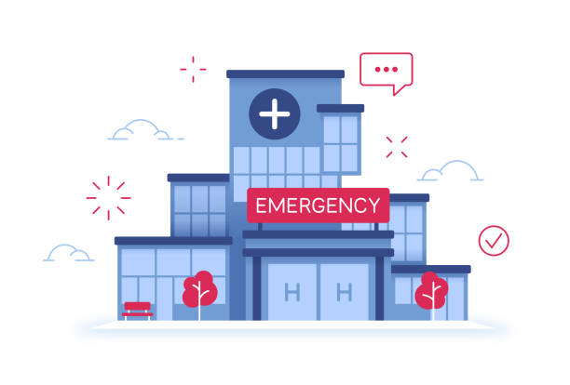
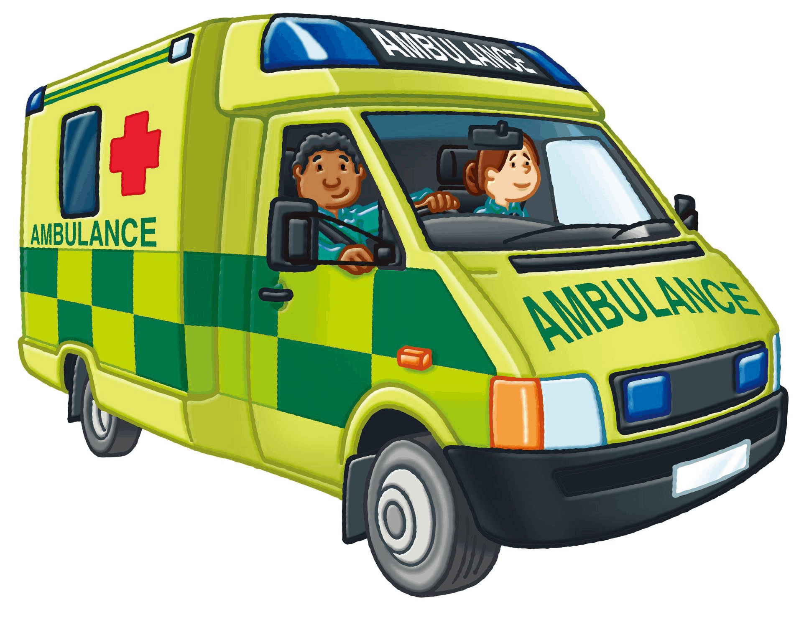
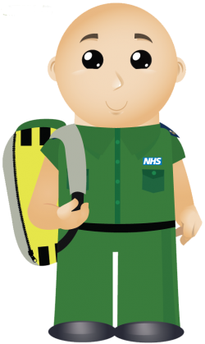
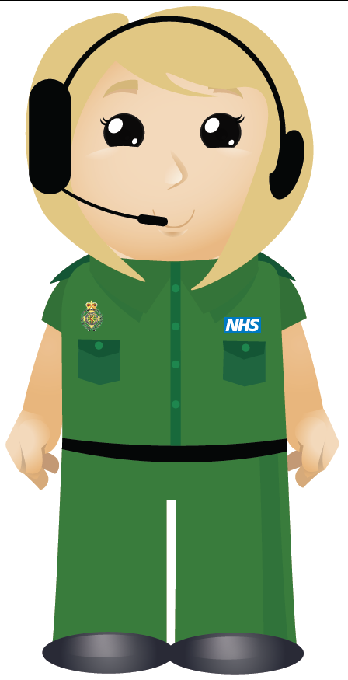
Continued …
Personnel involved in Pre-hospital Healthcare:
  Lay first responders
  Ambulance professionals
  Nurses or
  Physicians of varying backgrounds
Access to Unscheduled Care in the UK
  Call 999 or NHS Direct
  Walk-in, Urgent Care Centre
  Out of Hours Services
  Emergency Departments
  Social Care Services

Slide 5
What constitutes Mobile Healthcare?
Mobile healthcare (mHealth) constitutes:
-The use of mobile devices, such as cell phones and patient monitoring devices, in medicine.
-In short, mobile healthcare technology encompasses everything from healthcare apps to electronic healthcare records (EHRs) to home healthcare.

Slide 6
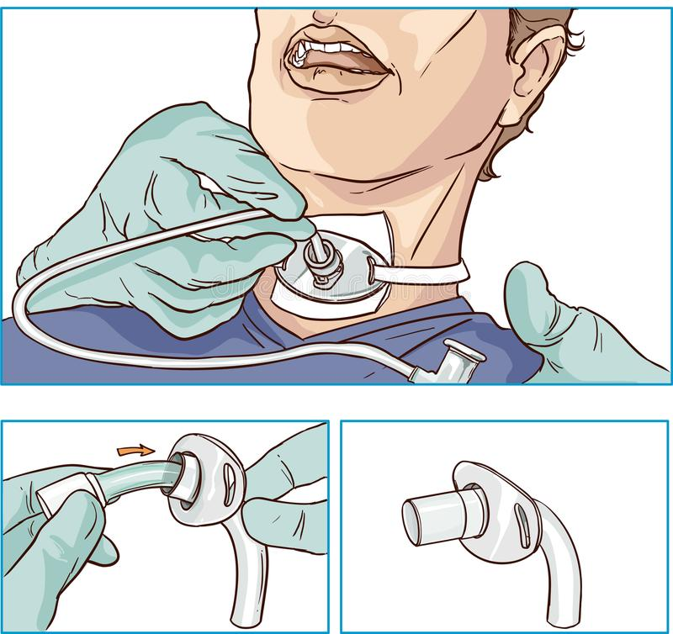
Why do we need Mobile Healthcare?
Cost savings associated with mobile care especially for the vulnerable
Providing readily accessible care to underserved communities.
Reduced logistics enabled by mobile healthcare eliminates access barriers for many low-income patients.
Research shows mobile healthcare improves
health outcomes
reduces avoidable emergency room use and
bridges trust between patients and the healthcare system.

Slide 7


5G Enabled Connected Ambulance Project
EMW workshop

Slide 8
Overall project
(Pilot Deployment)

Slide 9
Why 5G?
5G Network slicing
  User defined
  Saves network resources
  Highly scalable
  User has full access and control
eMBB (High Datarates + Low Latency)
Network Slice for Mobile Healthcare
URLLC (Reliability + Low Latency)

Slide 10
The Challenges
Paramedics cannot perform ultrasounds (some exceptions exist)
Limited radiographers (only 3000 in the UK)
Ambulances need to be stationary for a clear sonograph (Pre-ambulance care?)
Bandwidth consumption? ESN’s have their costs.

Slide 11
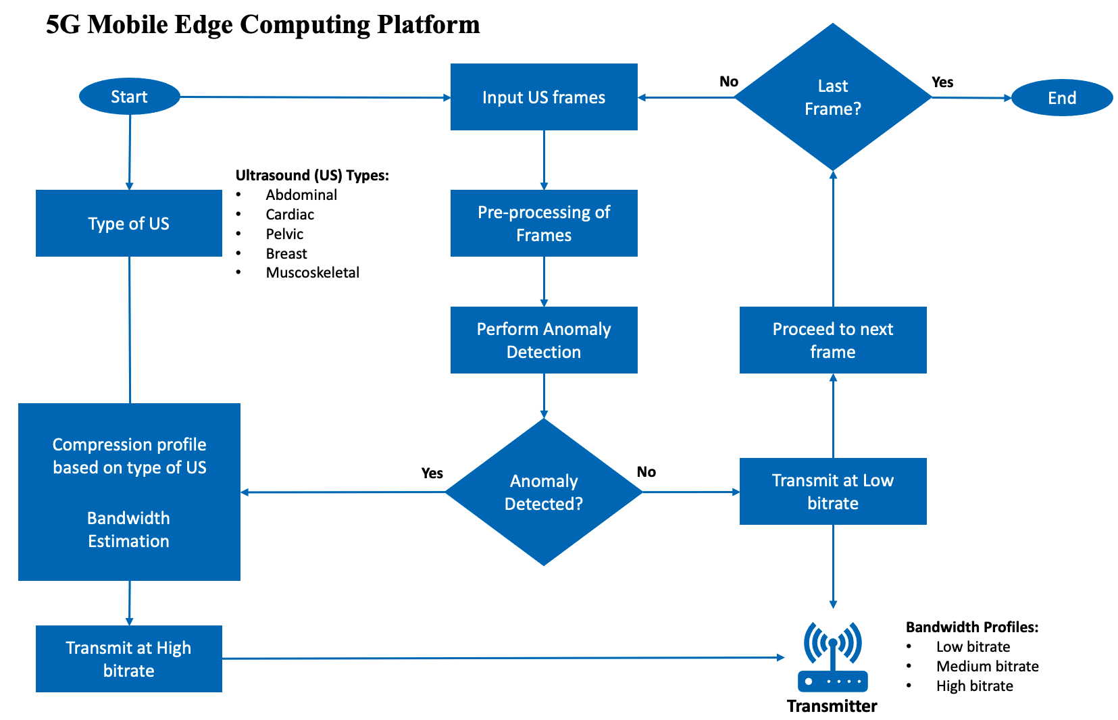
Work in Progress:
US Classification
US data is transferred from Ambulances to 5G MEC
EMW workshop

Slide 12
Two major Challenges
Strict GDPR → Ultrasound imagery datasets
How to train the paramedics?

Slide 13
A possible solution:
Free Walk-in 5G enabled e-health Truck for providing Sonography training to paramedics
Another challenge:
Limited Sonographers (Roughly 3,000 in the UK)
Bundles of anonymised data can be collected using this service

Slide 14
What’s next?
In-ambulance solutions:
  AI assisted CVD Classification using ECG readings (KU)
  CV based timely stroke detection (AUTH)
  Vital Signs based AI-Driven doctor (KU)

Slide 15
The way forward
Policy changes for including AI-assisted solutions
Recent success stories in the UK:
  AI 'outperforms' doctors diagnosing breast cancer¹
  VF UK: 5G Enabled Telesurgery trials a success²
  Source¹: https://www.bbc.co.uk/news/health-50857759
  Source²: https://healthjournal.vodafone.co.uk/connected-health-journal/telesurgery-trials-a-success

