Slide 1


Reconfigurable Intelligent Surfaces: Real-World Demonstration and Implementation Challenges
Dr. Mohsen Khalily
Senior Lecturer in Antennas and Propagation

Slide 2

RIS
RIS are typically composed of a large metasurface sheet.
Each individual scatterer or a cluster of unit-cells can be tuned in such a way that the whole surface can reconstruct EM waves.
The tunability may be performed by using liquid crystals, graphene, varactors, microelectromechanical systems (MEMS) or PIN diodes.
Transmissive / Reflective / STAR
The static RIS requires no input power
1

Slide 3
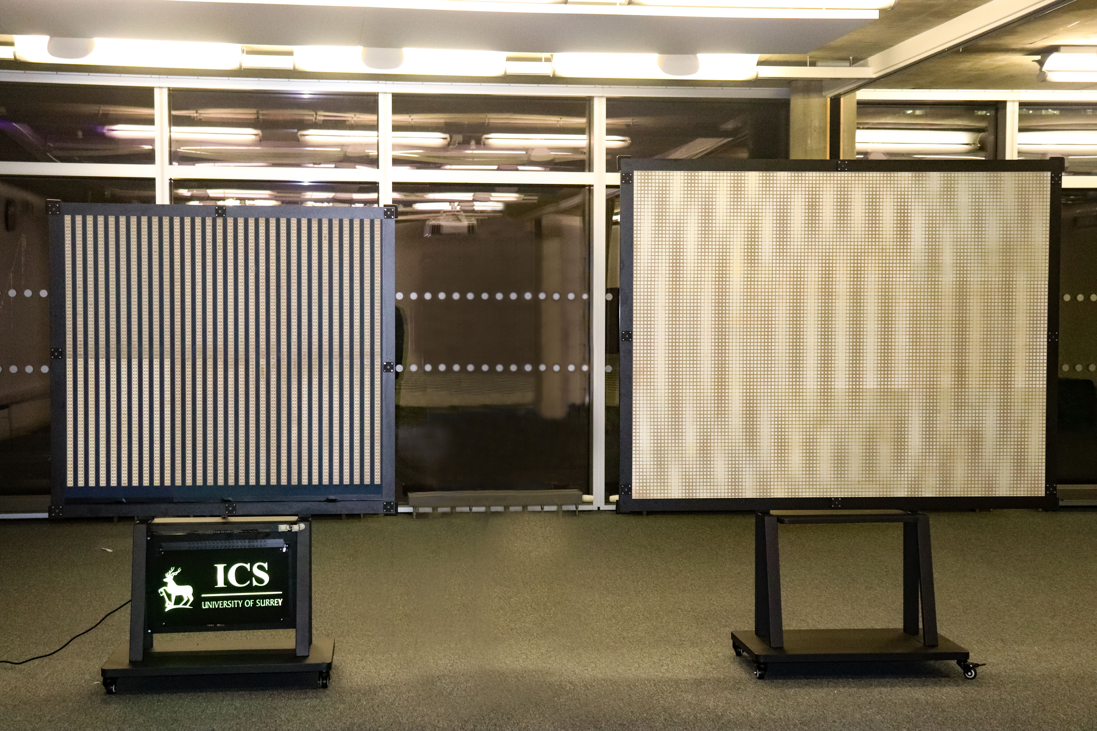
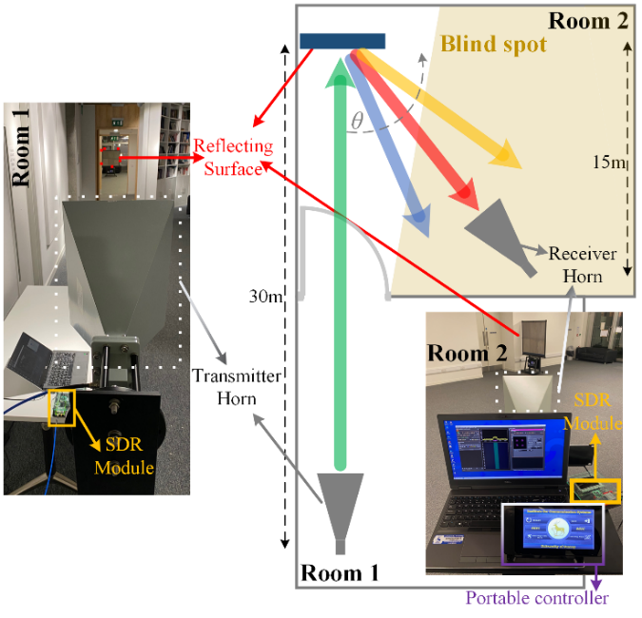
RIS (Reflective)
Dynamic RIS Static RIS
2

Slide 4
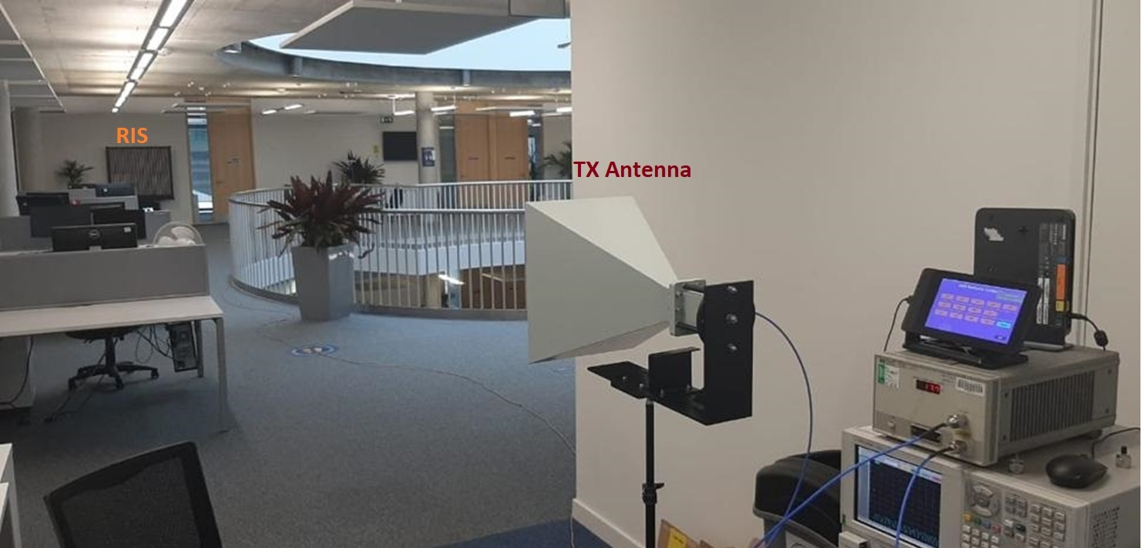
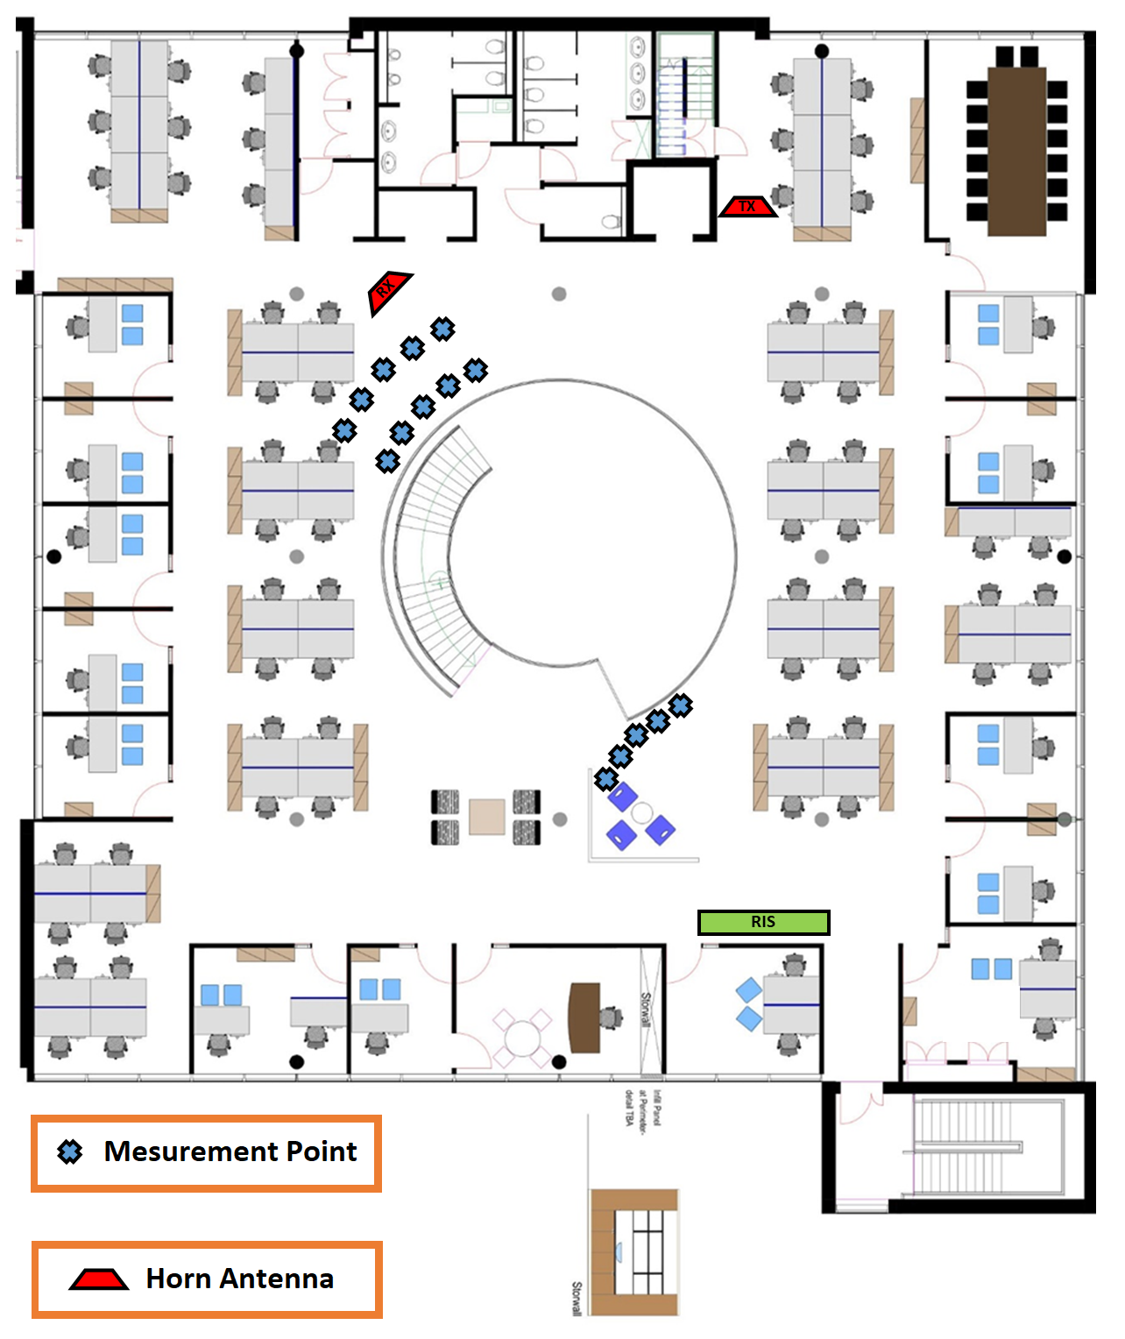
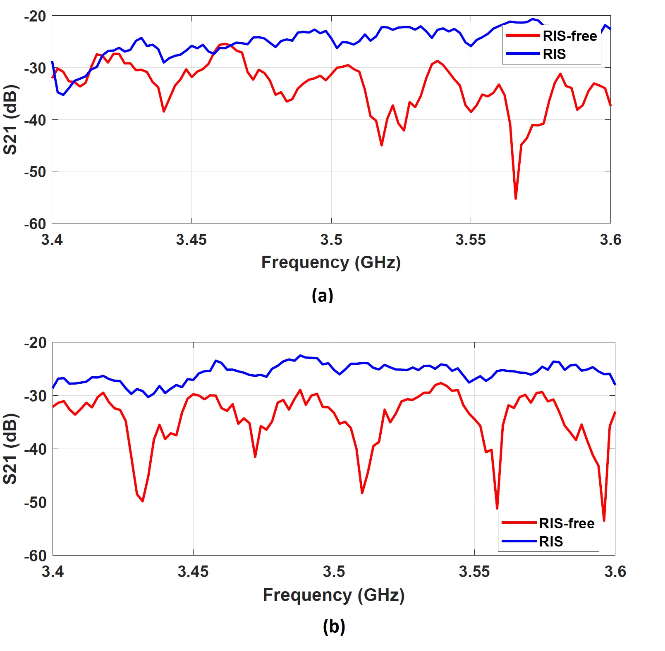

Indoor Channel Measurement
3

Slide 5
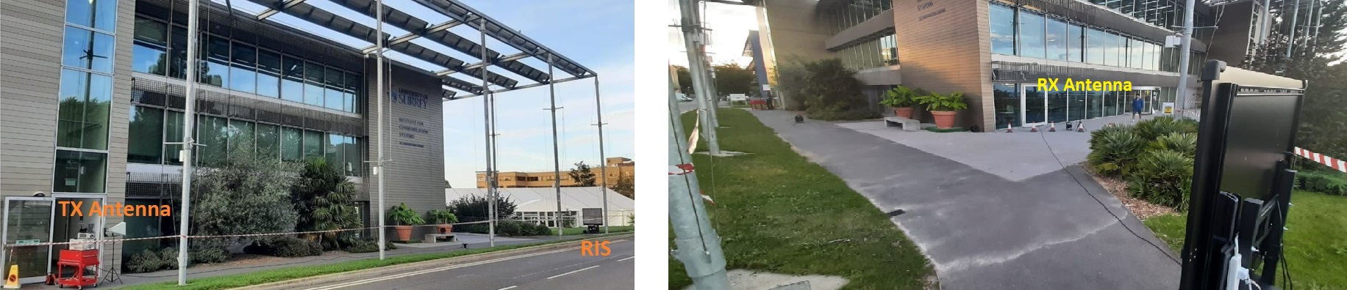
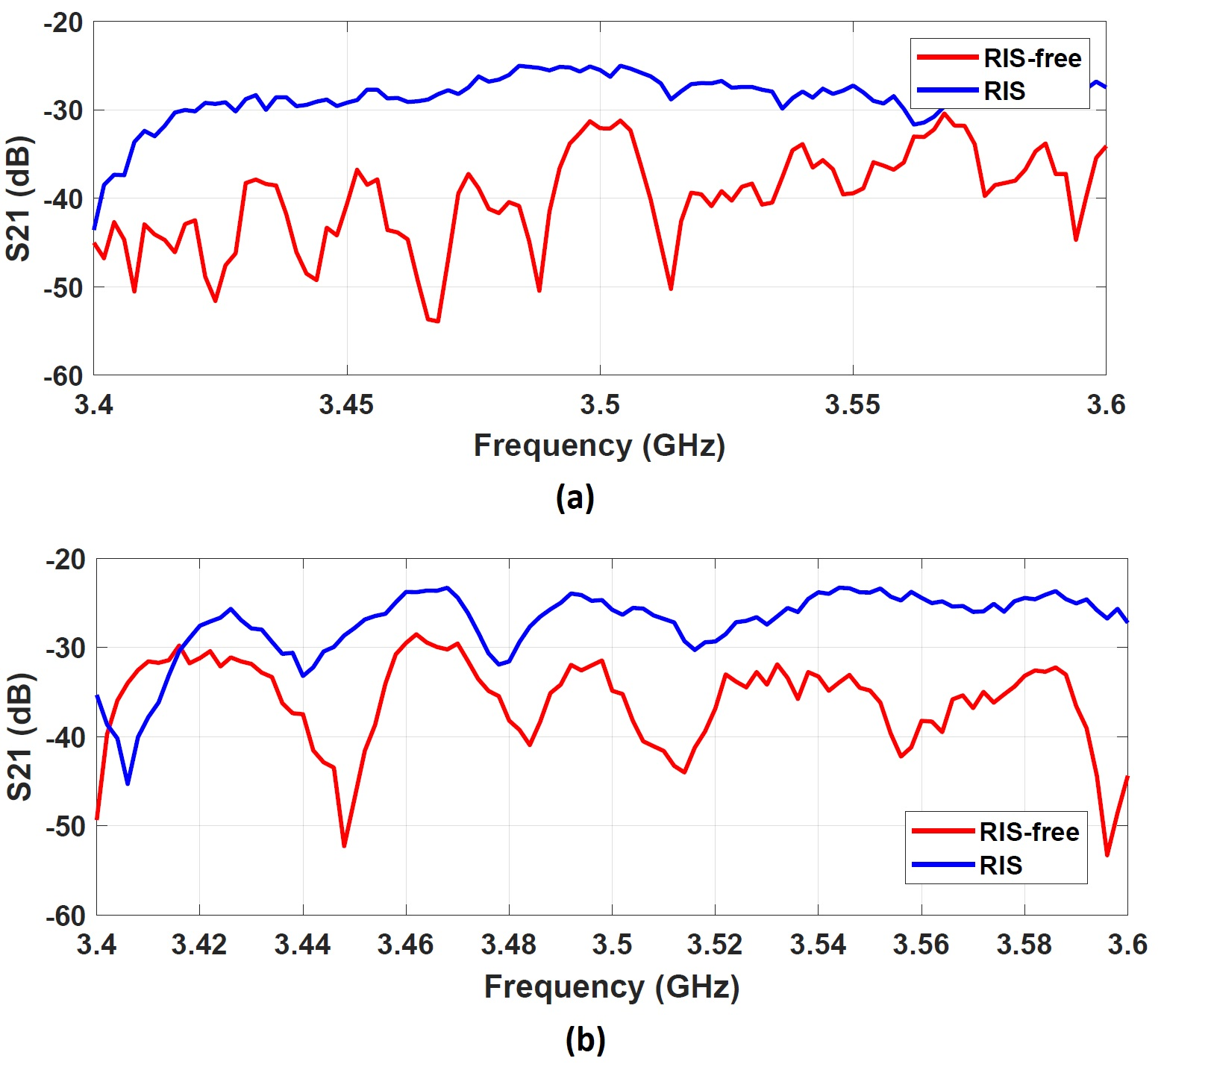
Outdoor Channel Measurement
4

Slide 6
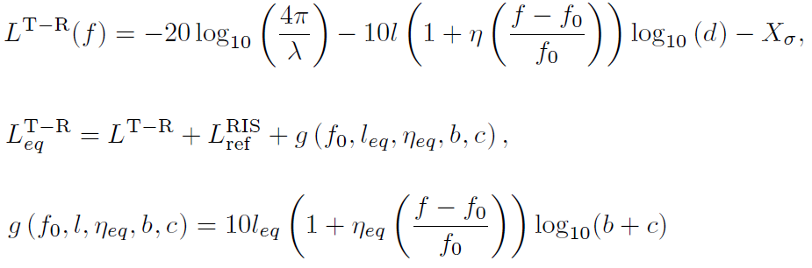
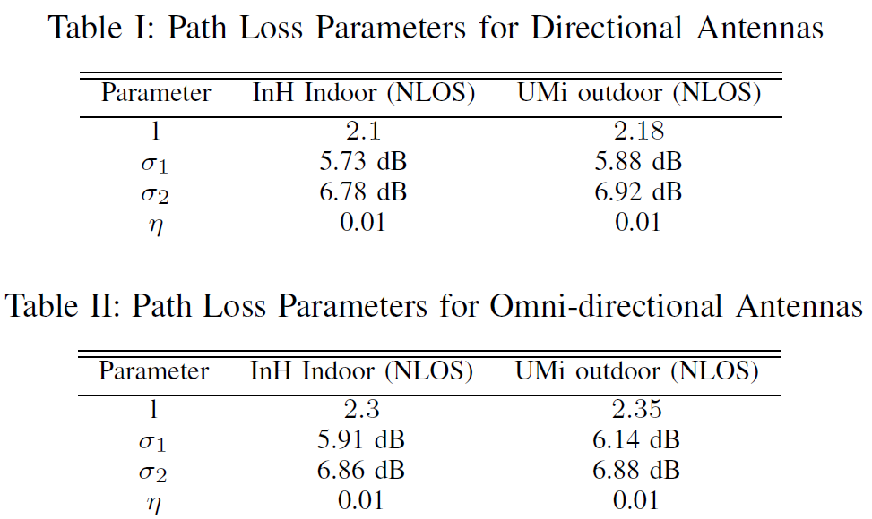
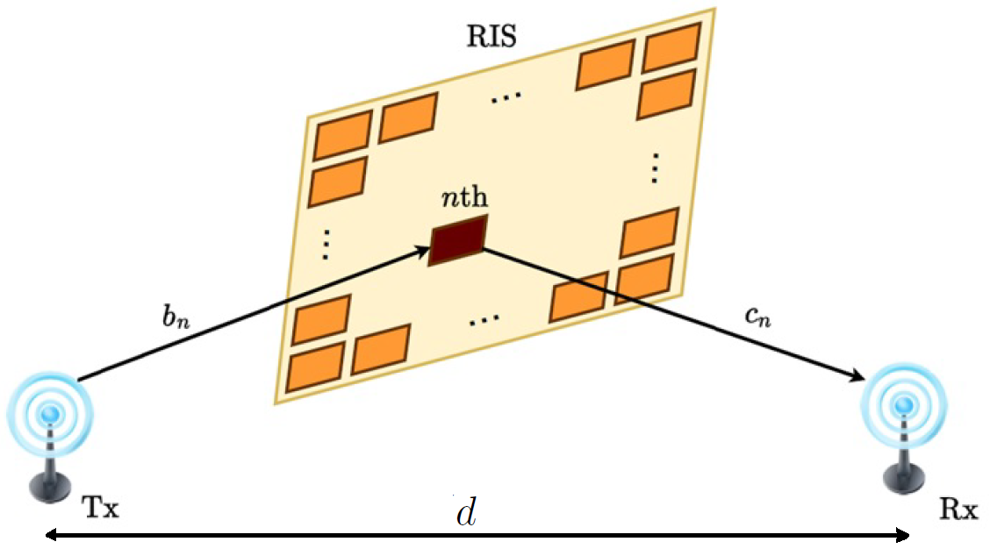
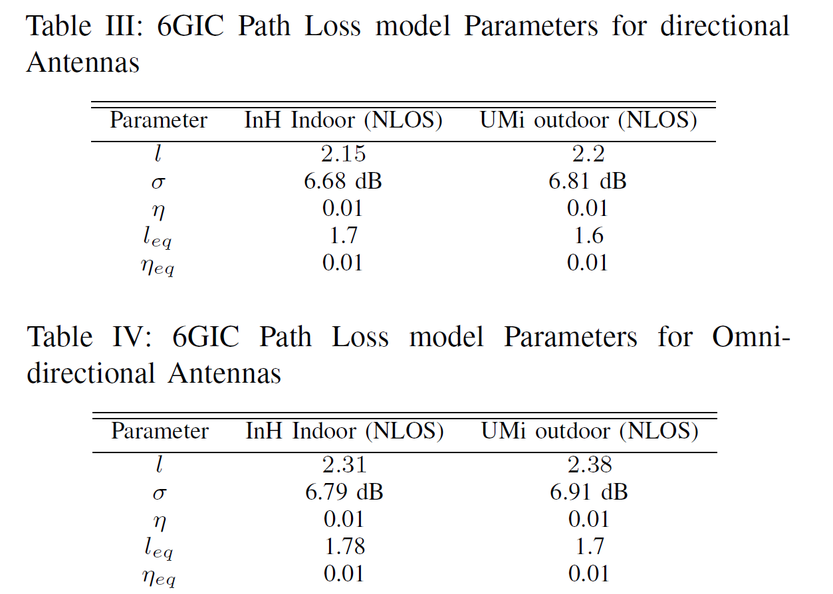
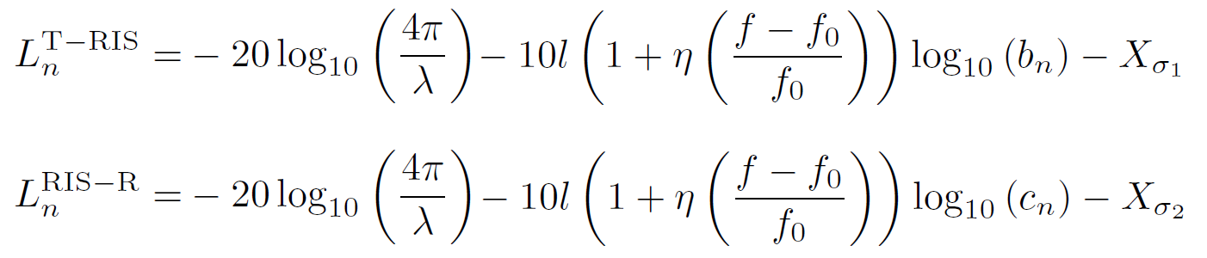
Reconfigurable Reflecting Surface
Indoor / Outdoor Path Loss Model
5

Slide 7
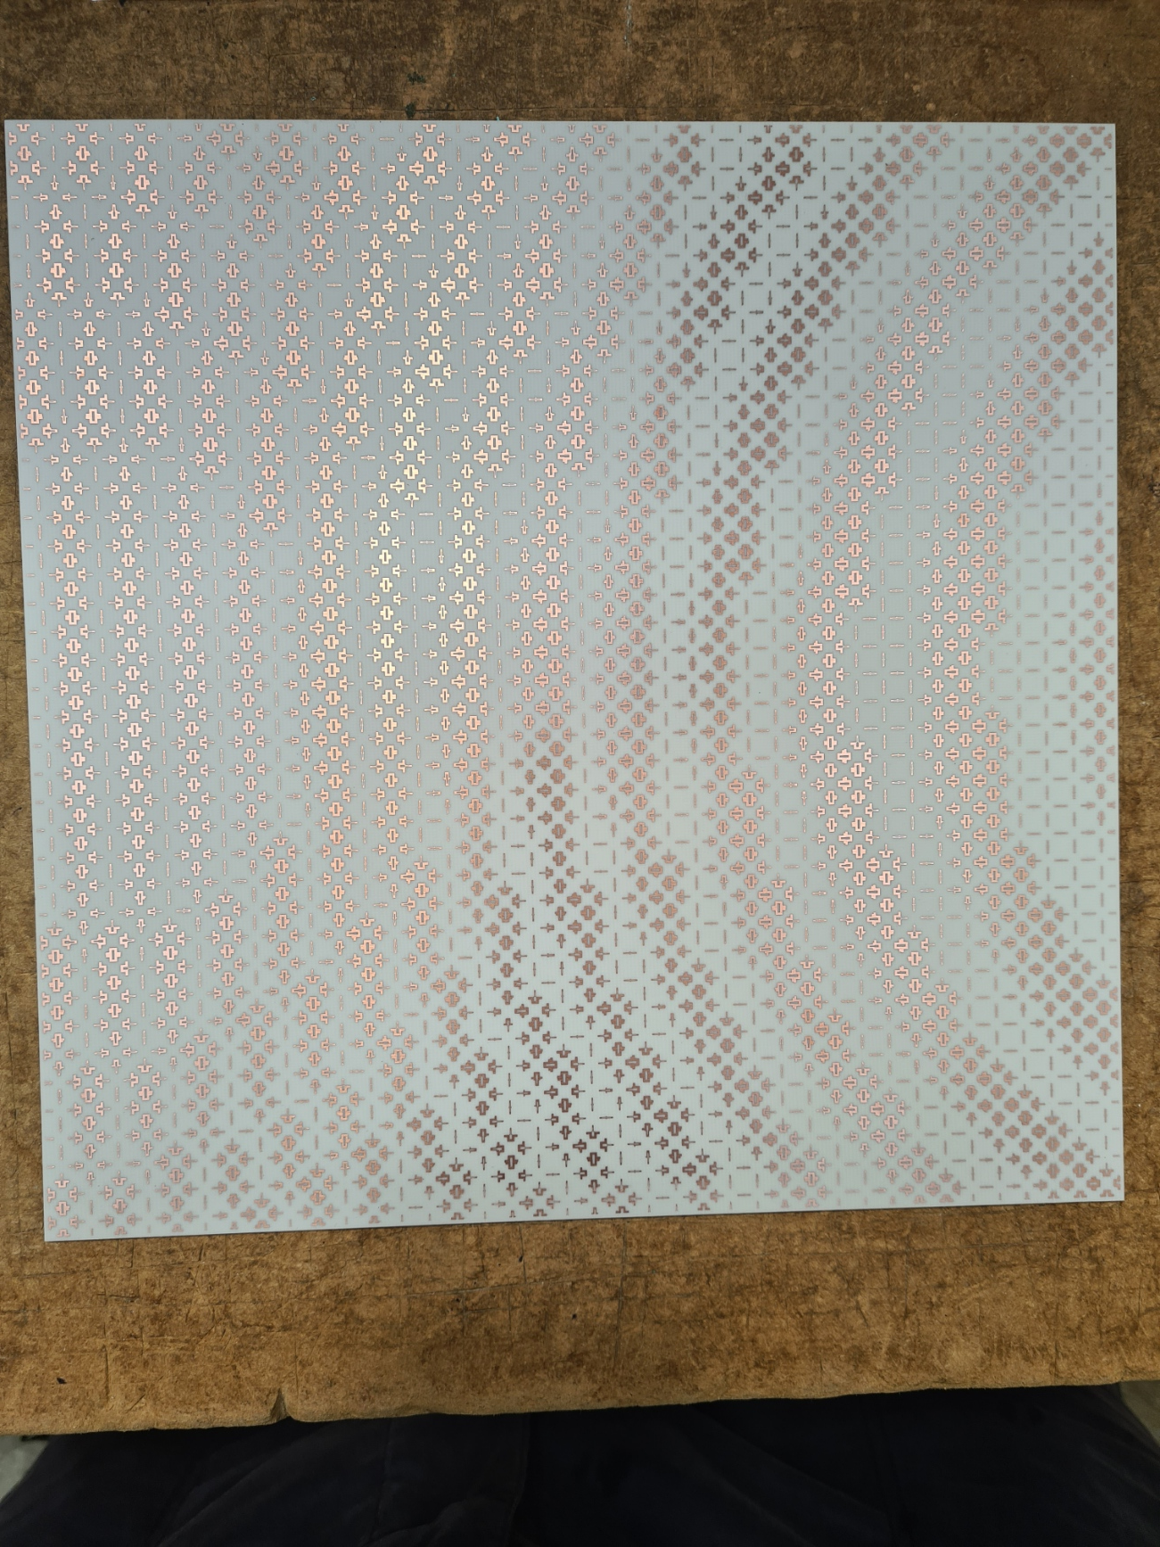
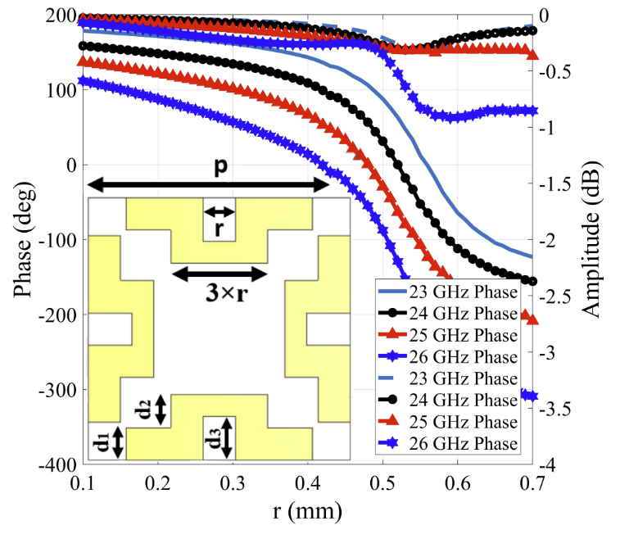
RIS (mmWave Reflecting Surface)
Polarisation Insensitive
340 degree phase range
Static RRS
23GHz to 27GHz
6

Slide 8
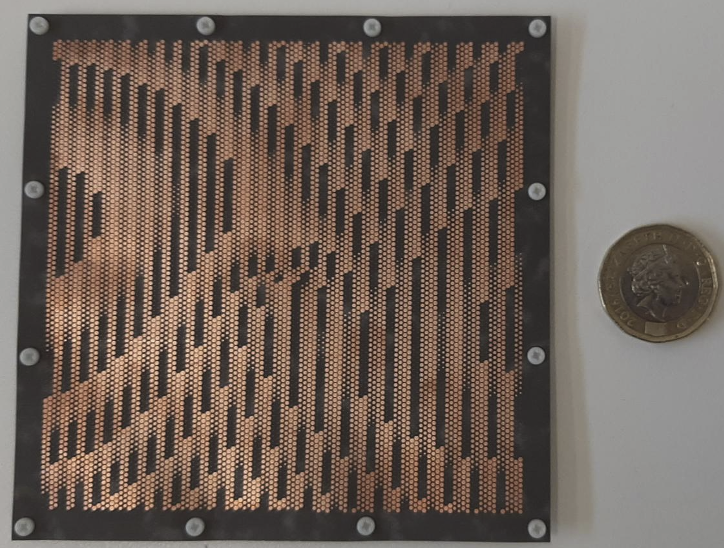
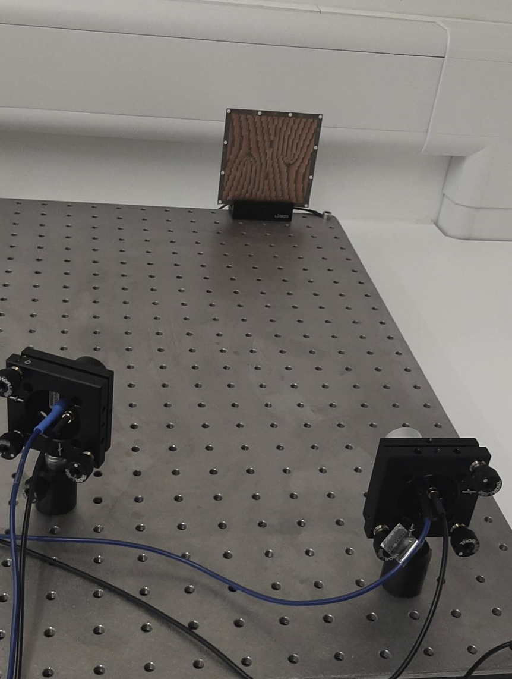
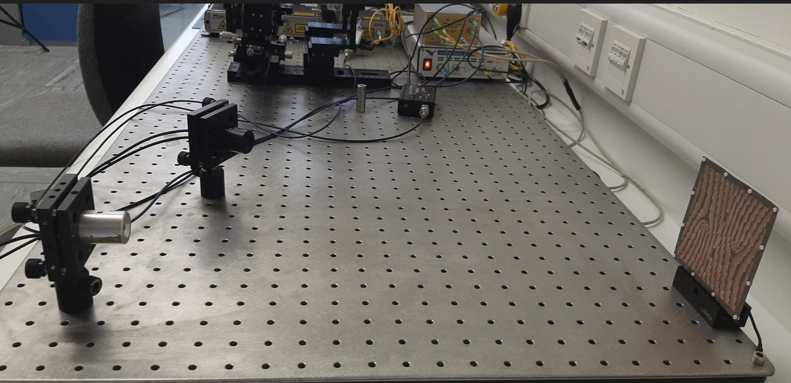
RIS (THz Surface with OAM beams)
RIS with tilted OAM beams
90-110 GHz
High spectral efficiency
Low cost
Static RRS
7

Slide 9
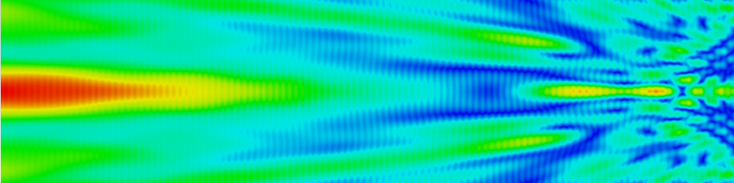
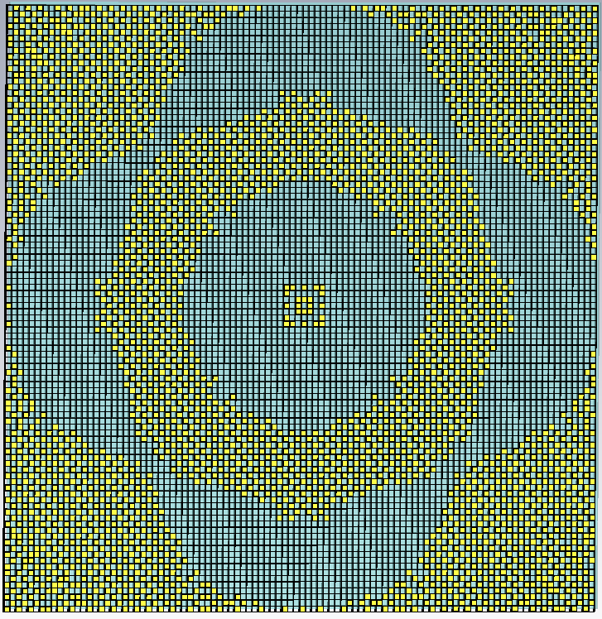
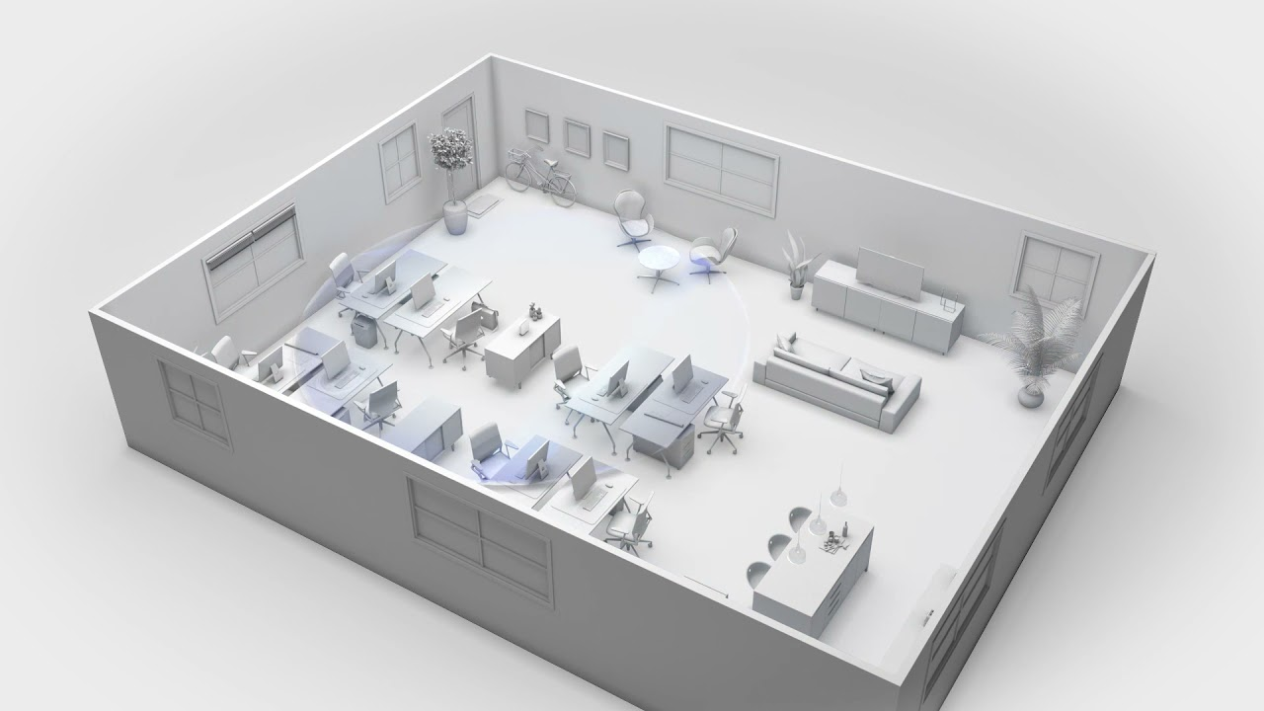
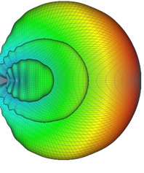
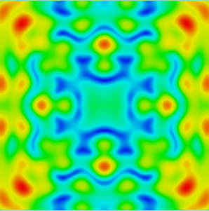
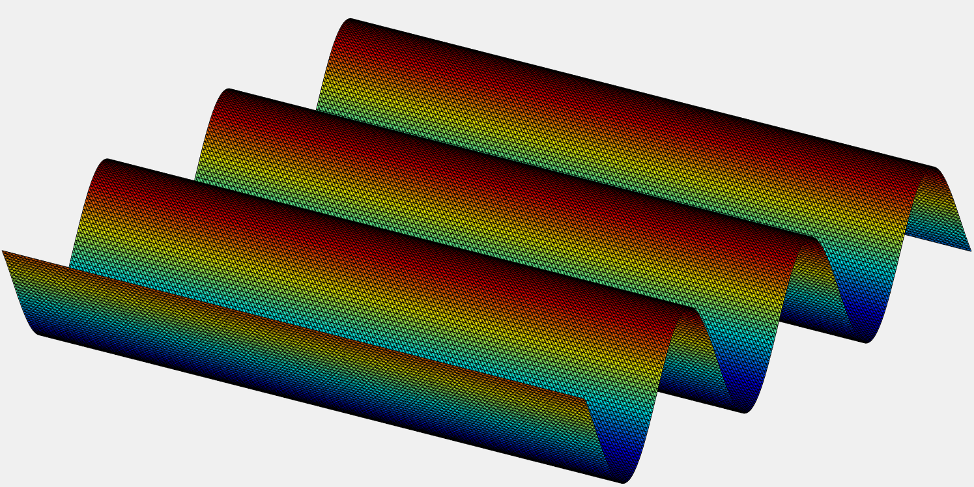

RIS (Transmissive)
  Optically transparent metasurface
  Construction of a contour beam inside the room
  Interrogating 3.3~3.7 GHz from outdoor
  Polarization insensitive solution
  Wide incident angle insensitive
  Passive and small ($\sim 15λ×\sim 15λ$)
  Easy to implement
  Capable of Arbitrary coverage pattern
8

Slide 10

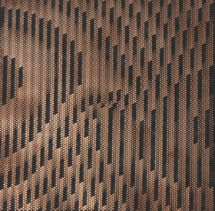
Practical Challenges
Low phase range for transmissive surfaces
Complicated phase control network for 3D beam steering
Polarisation Insensitive
Wideband
AoA estimation
Wide incidence angle
Specular Reflection
9

Slide 11
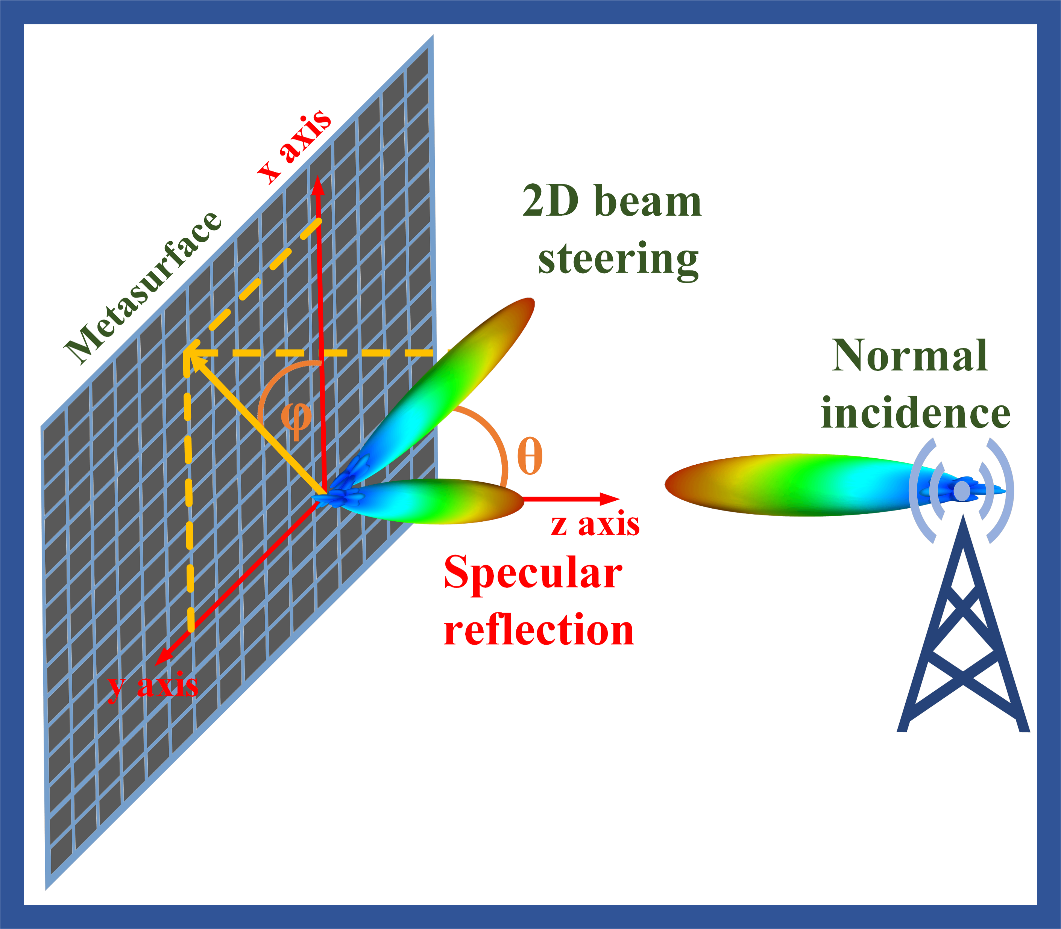
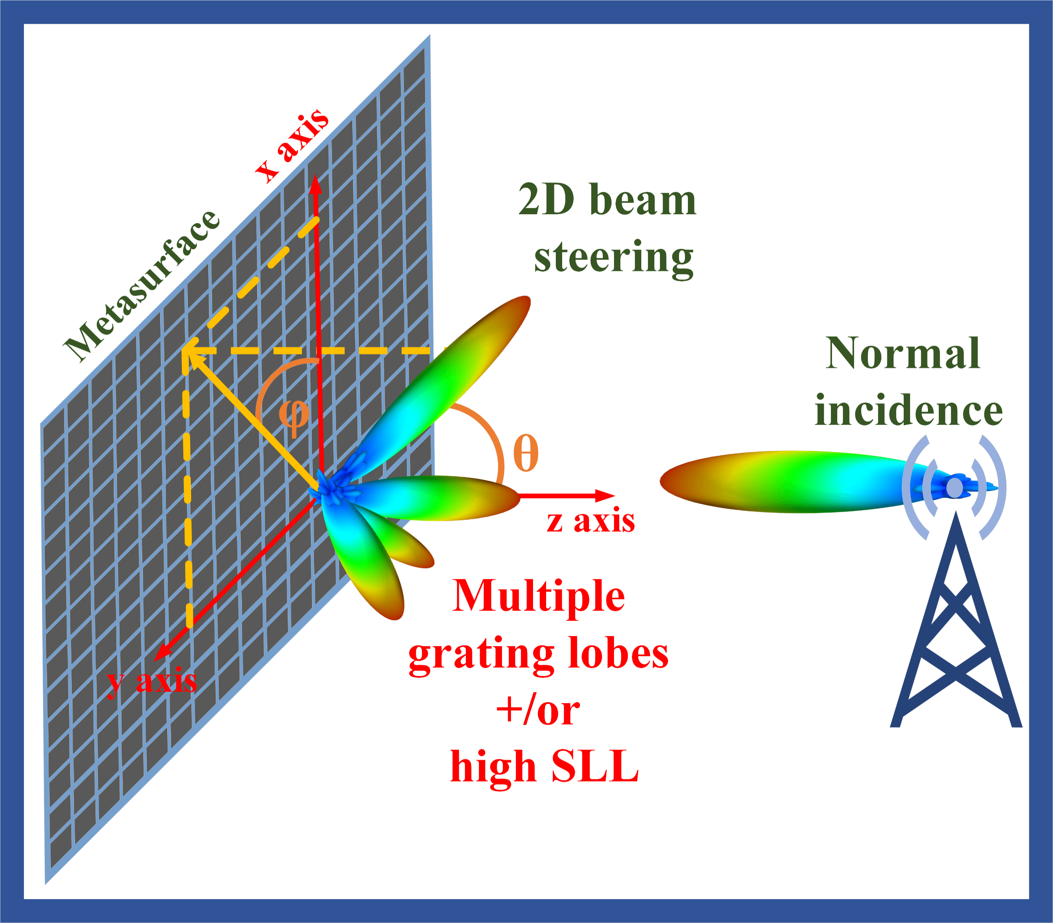
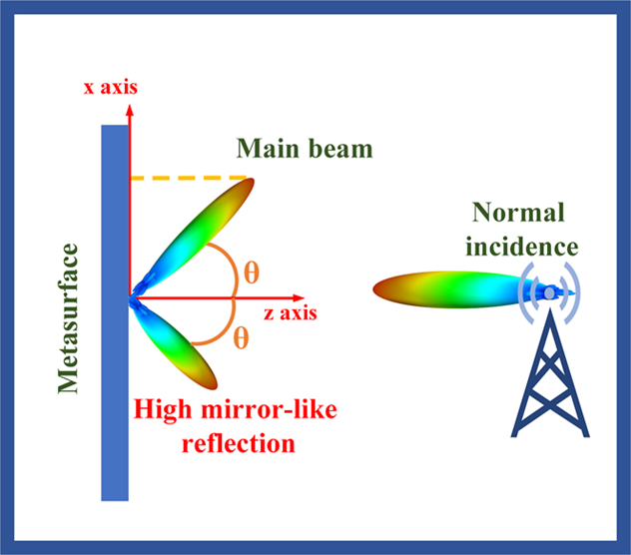
Practical challenges
Low efficiency
High specular reflection
Unwanted mirror reflection
Low efficiency
10

Slide 12
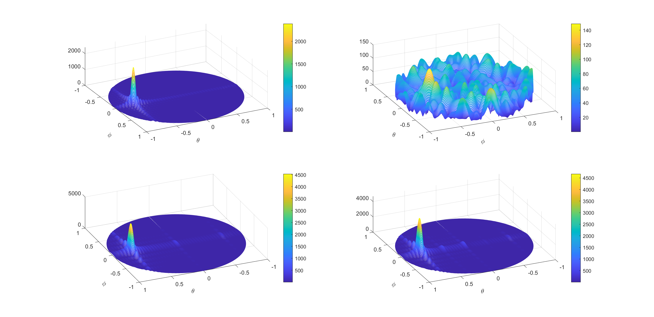
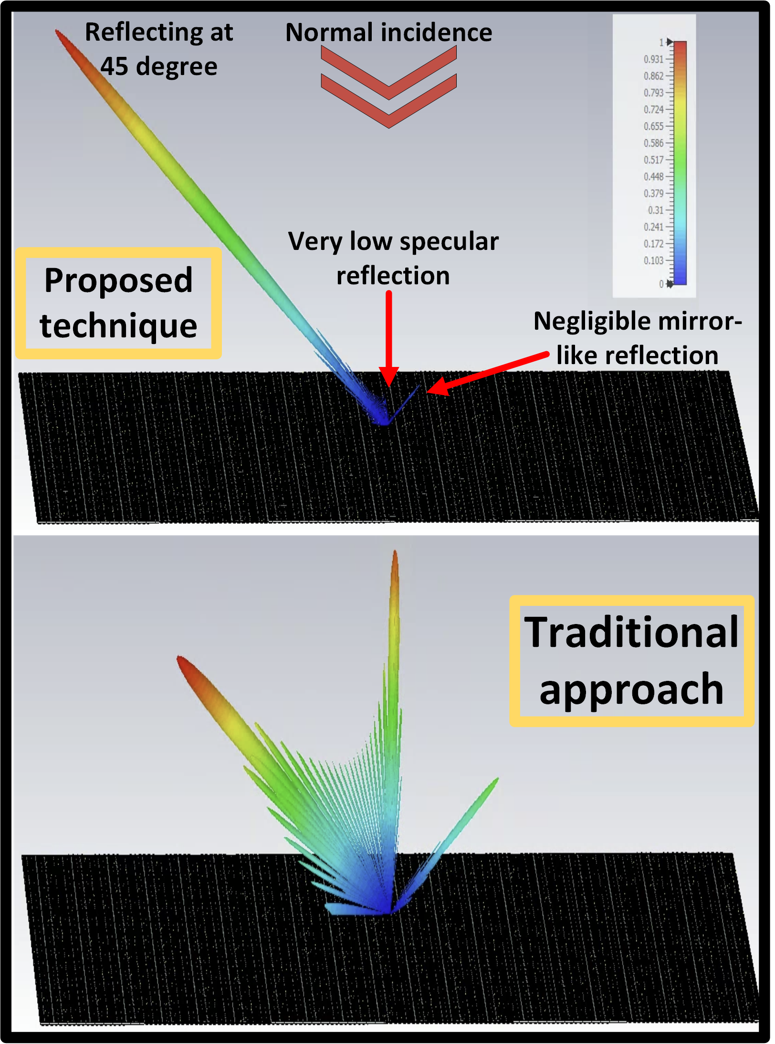
6GIC Proposed Solution
Same element spacing
Same Aperture size
11

Slide 13
RIS Workshop
12

Slide 14
Thank You m.khalily@surrey.ac.uk / khalily@ieee.org

