Slide 1


Umbrella Testbed and real world deployment of energy-efficient IoT networks
A living lab at the heart of innovation
Presented by:
Dr. Yichao Jin, Programmer Leader
Bristol Research & Innovation Laboratory, Toshiba Europe Limited.

Slide 2
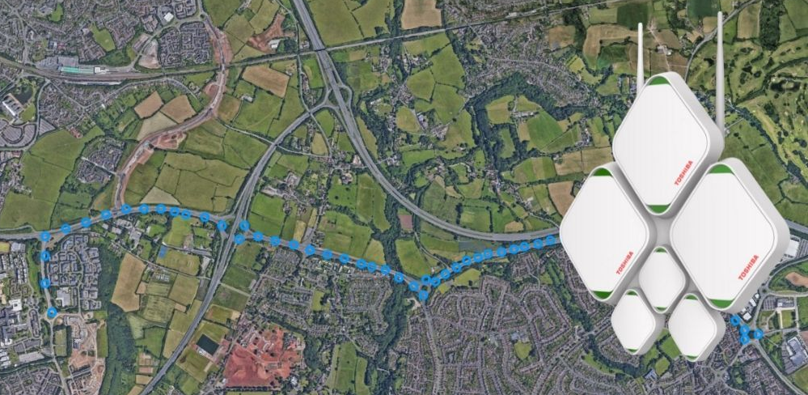
What is UMBRELLA?
A joint project between South Gloucestershire Council and Toshiba Bristol Research & Innovation Laboratory.
One of the largest, world-leading programmable Industrial Internet of Things (IIoT) network within South Gloucestershire that joins the five innovation hubs in the region.
A large scale, real world testbed that enables technical and application developers from across society to de-risk solutions and the industry of tomorrow to explore new business models
Industrial diversity in the region has allowed the connection of 5 disparate innovation hubs to a single IIoT platform.

Slide 3
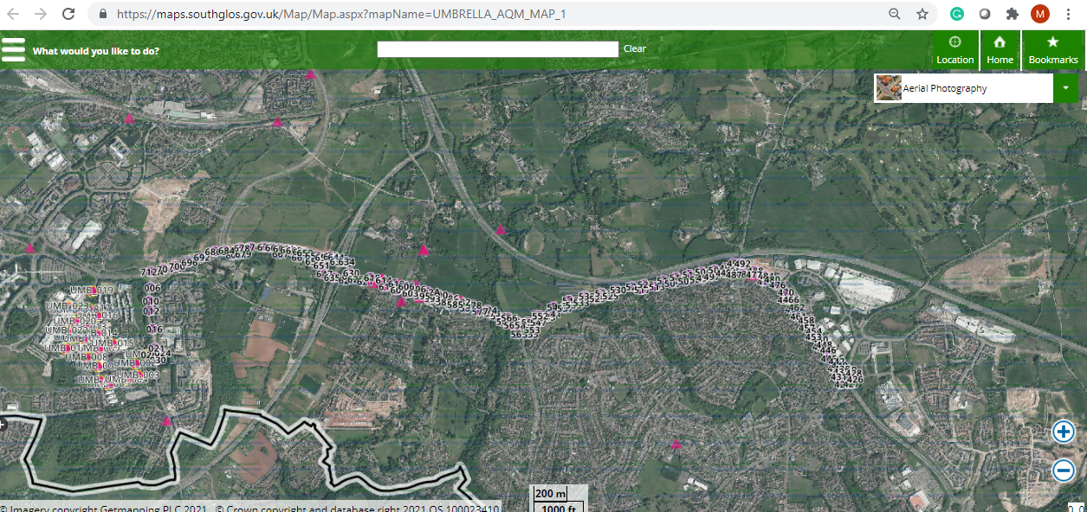
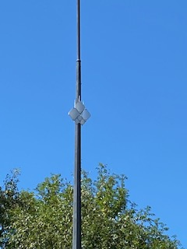
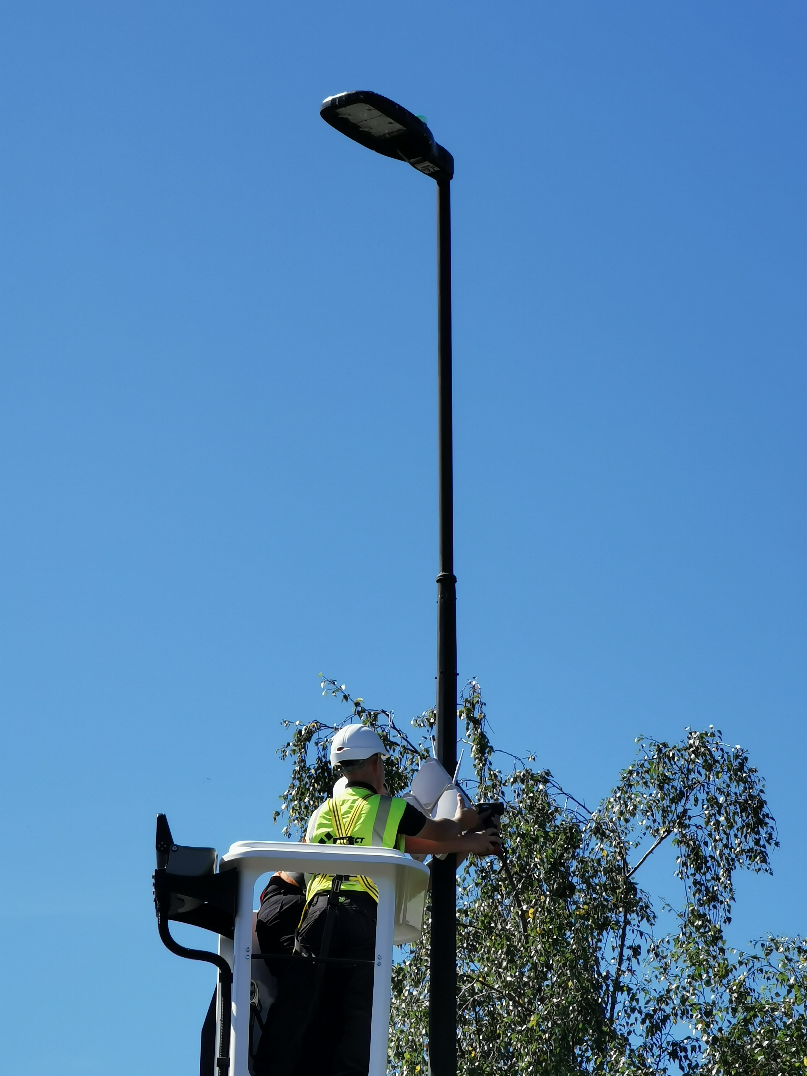
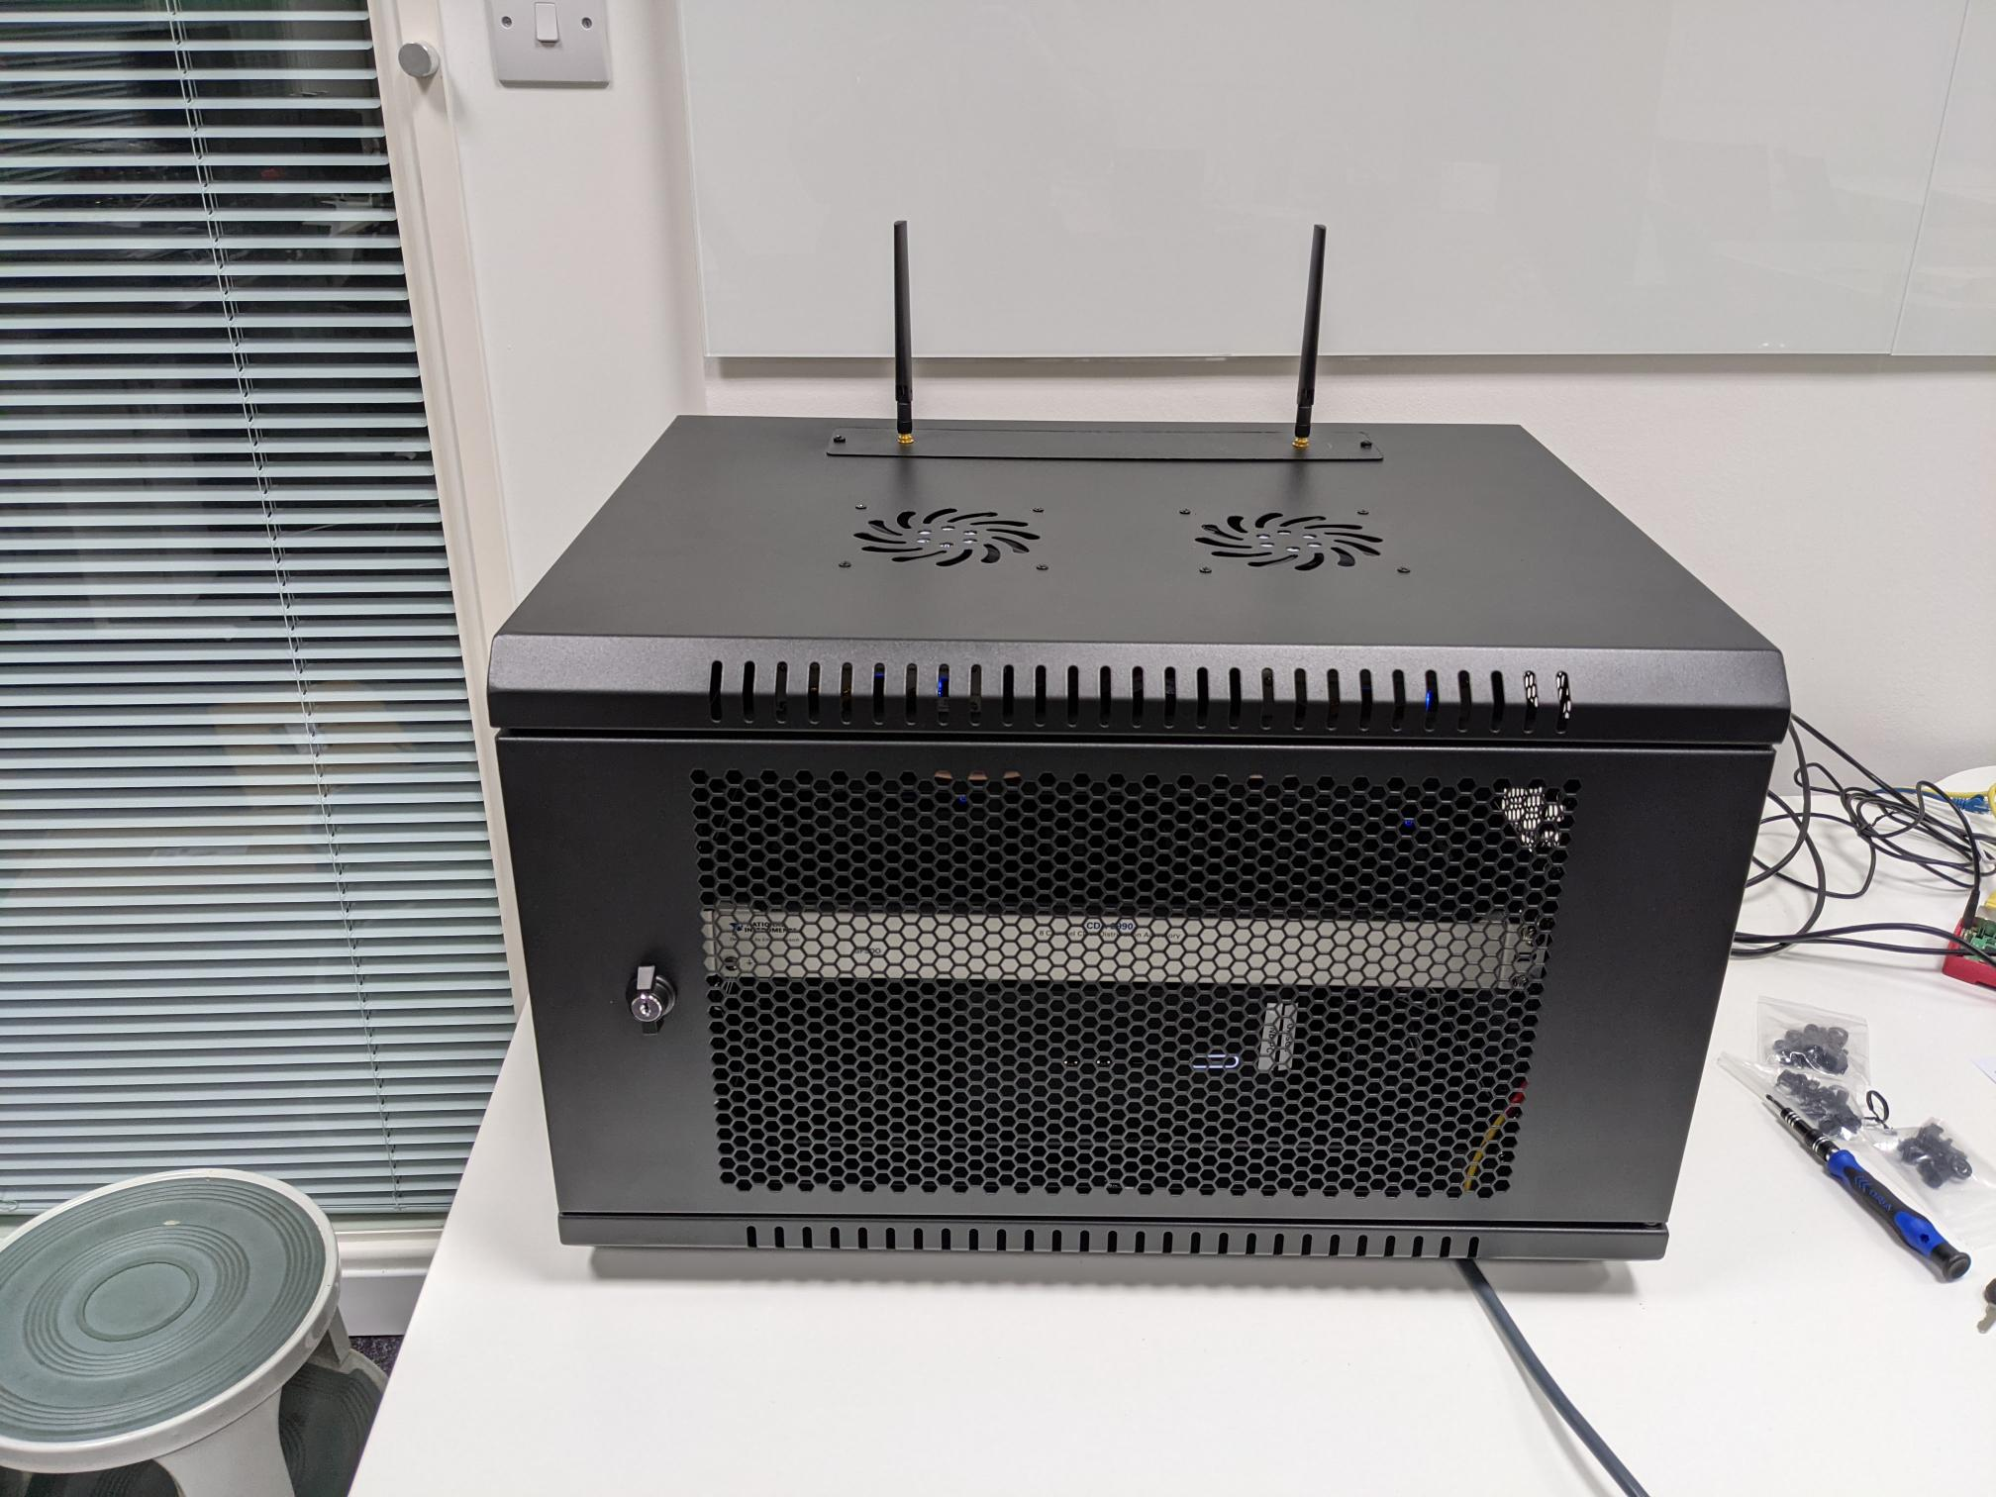
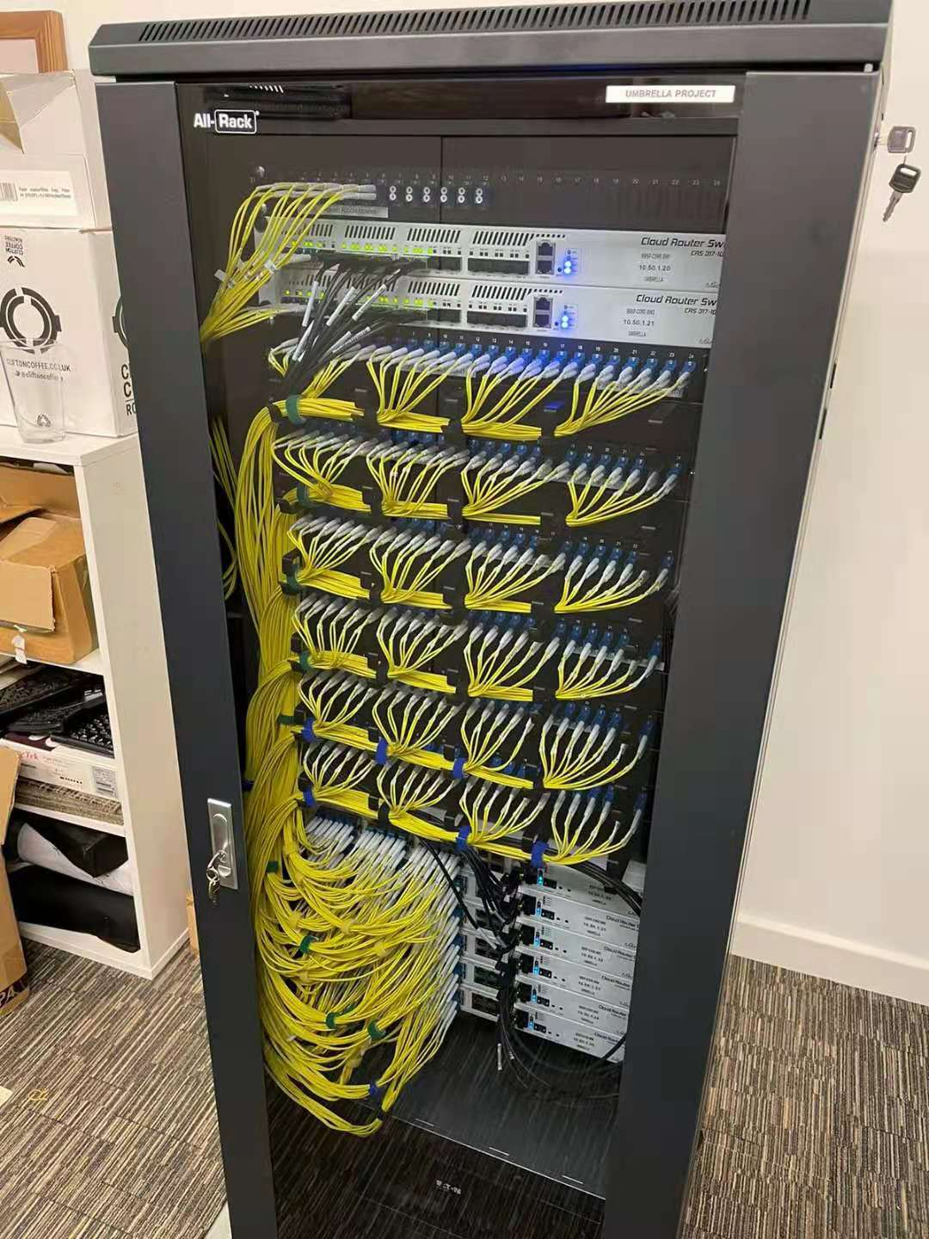
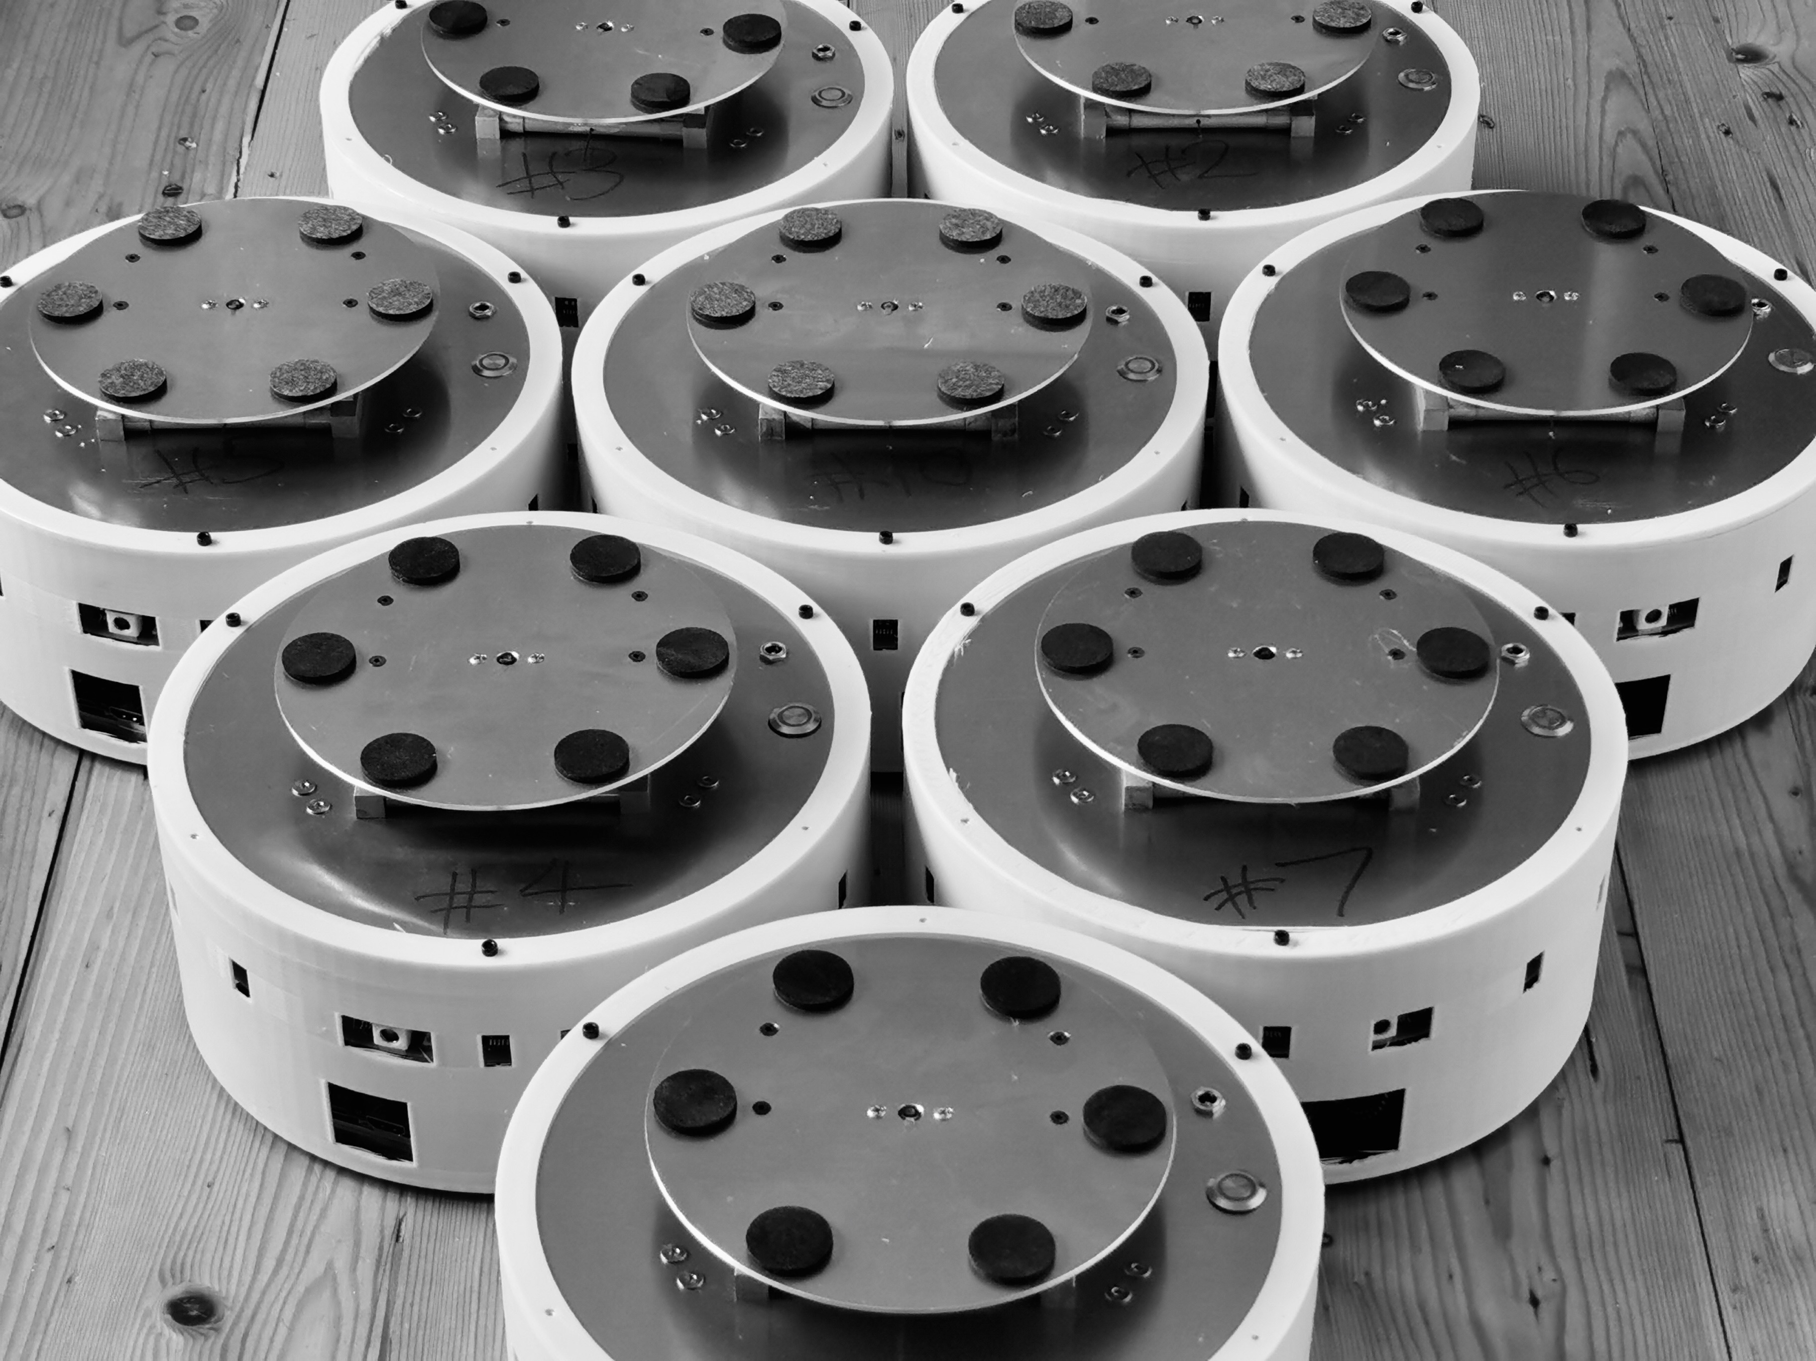
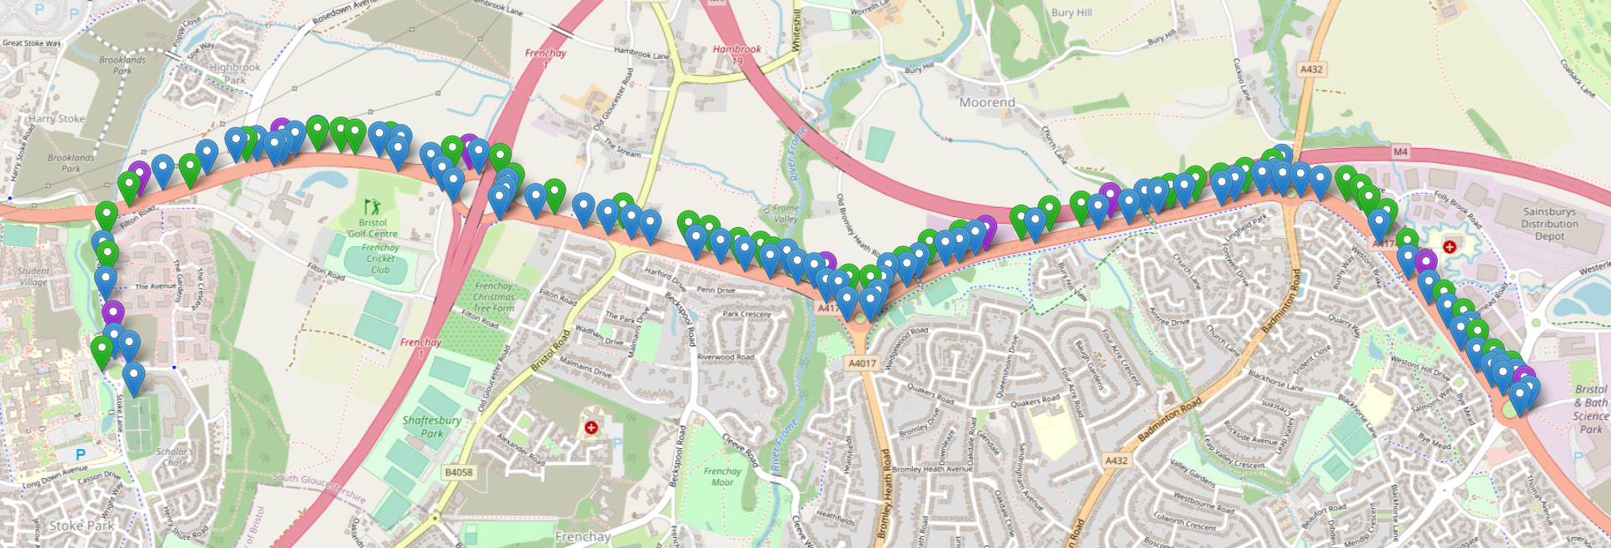
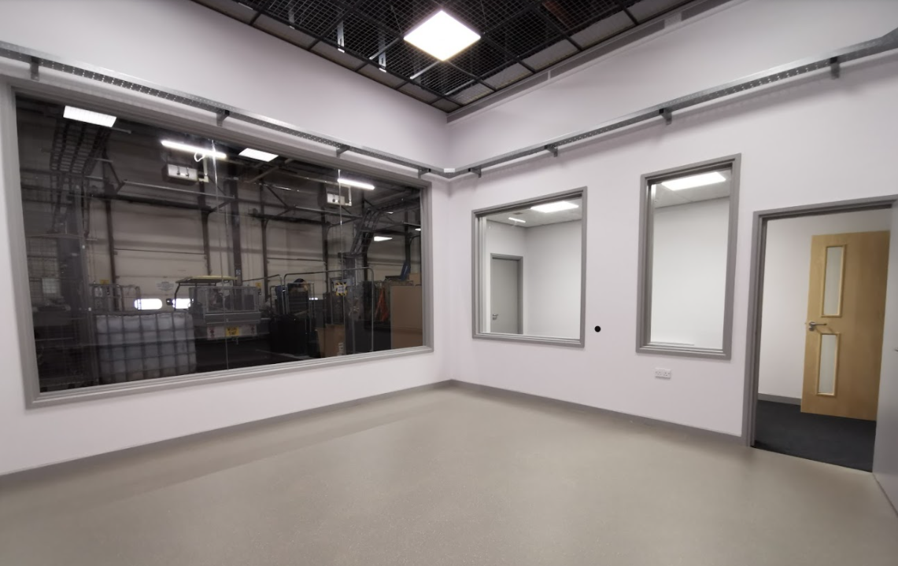
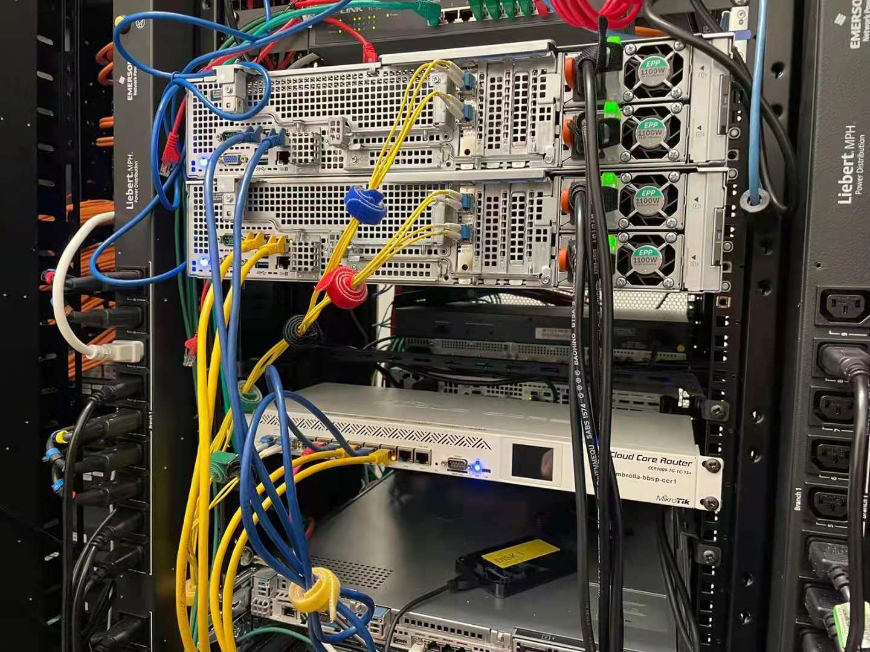
Umbrella Network
3 Testbeds, 22Km Fibre, 180 Nodes, Dedicated Server
180 node installed.
22km length of Fibre laid.
82 nodes will be fibre connected.
2 X 5G Node
UMBRELLA Node
UMBRELLA Fibre Switches and Servers
Robotics Arena
Swarm Robots

Slide 4
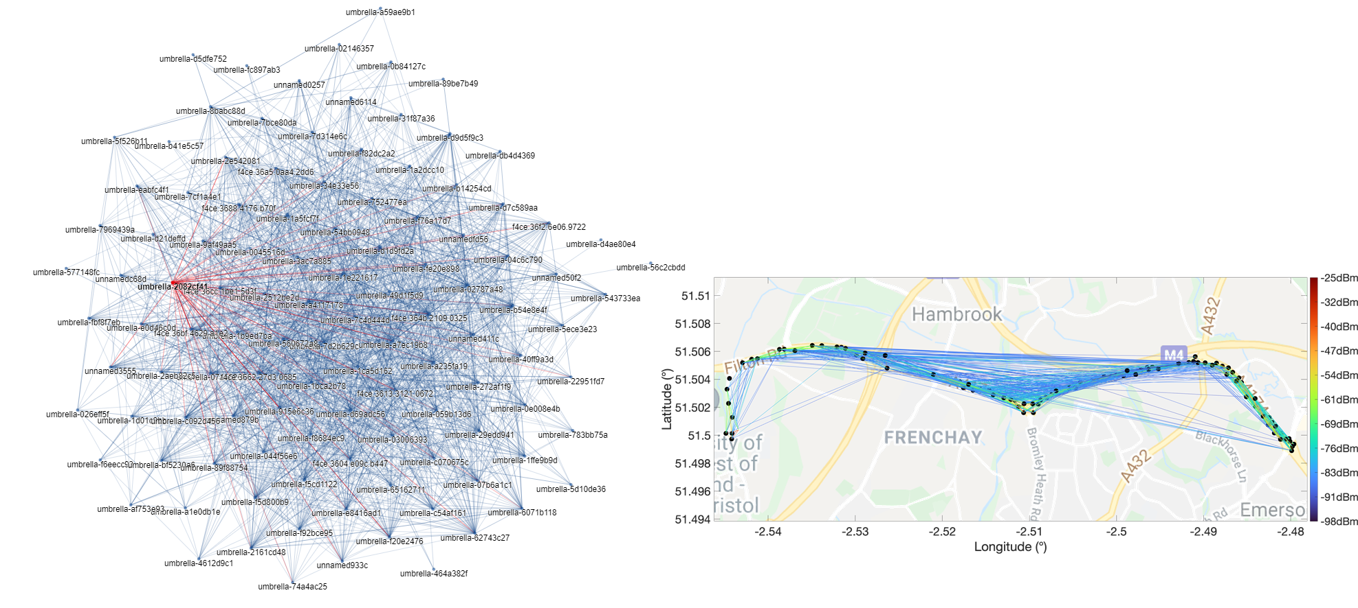
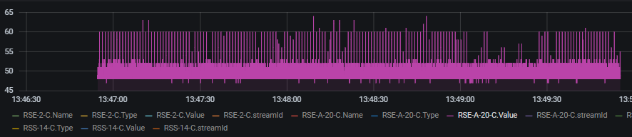
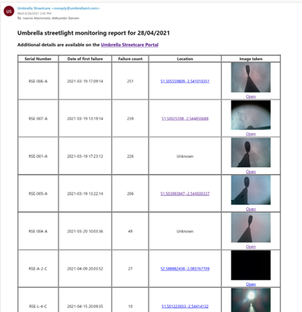
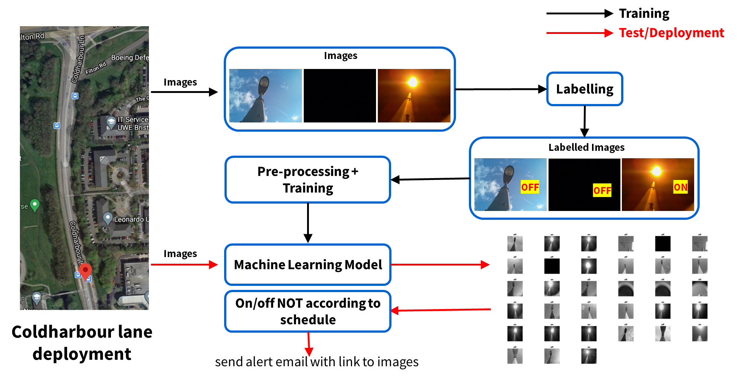
Largest Deployed Edge AI and wireless network
Multiple options for data communication in a centralized or decentralized manner. Fibre, Bluetooth, WiFi, IEEE 802.15.4, LoRa and many more
X 80 JETSON NANO devices connected in real-city deployment.
Remotely programable - Edge Computing and Energy Consumption Profiling.
Energy consumption profiling
Wireless Mesh connectivity
IMPACT
One of the largest deployed programmable multi-radio wireless testbeds.
Largest deployed and connected Edge AI networks known.
AI based Street light remote maintenance application already used by council.

Slide 5
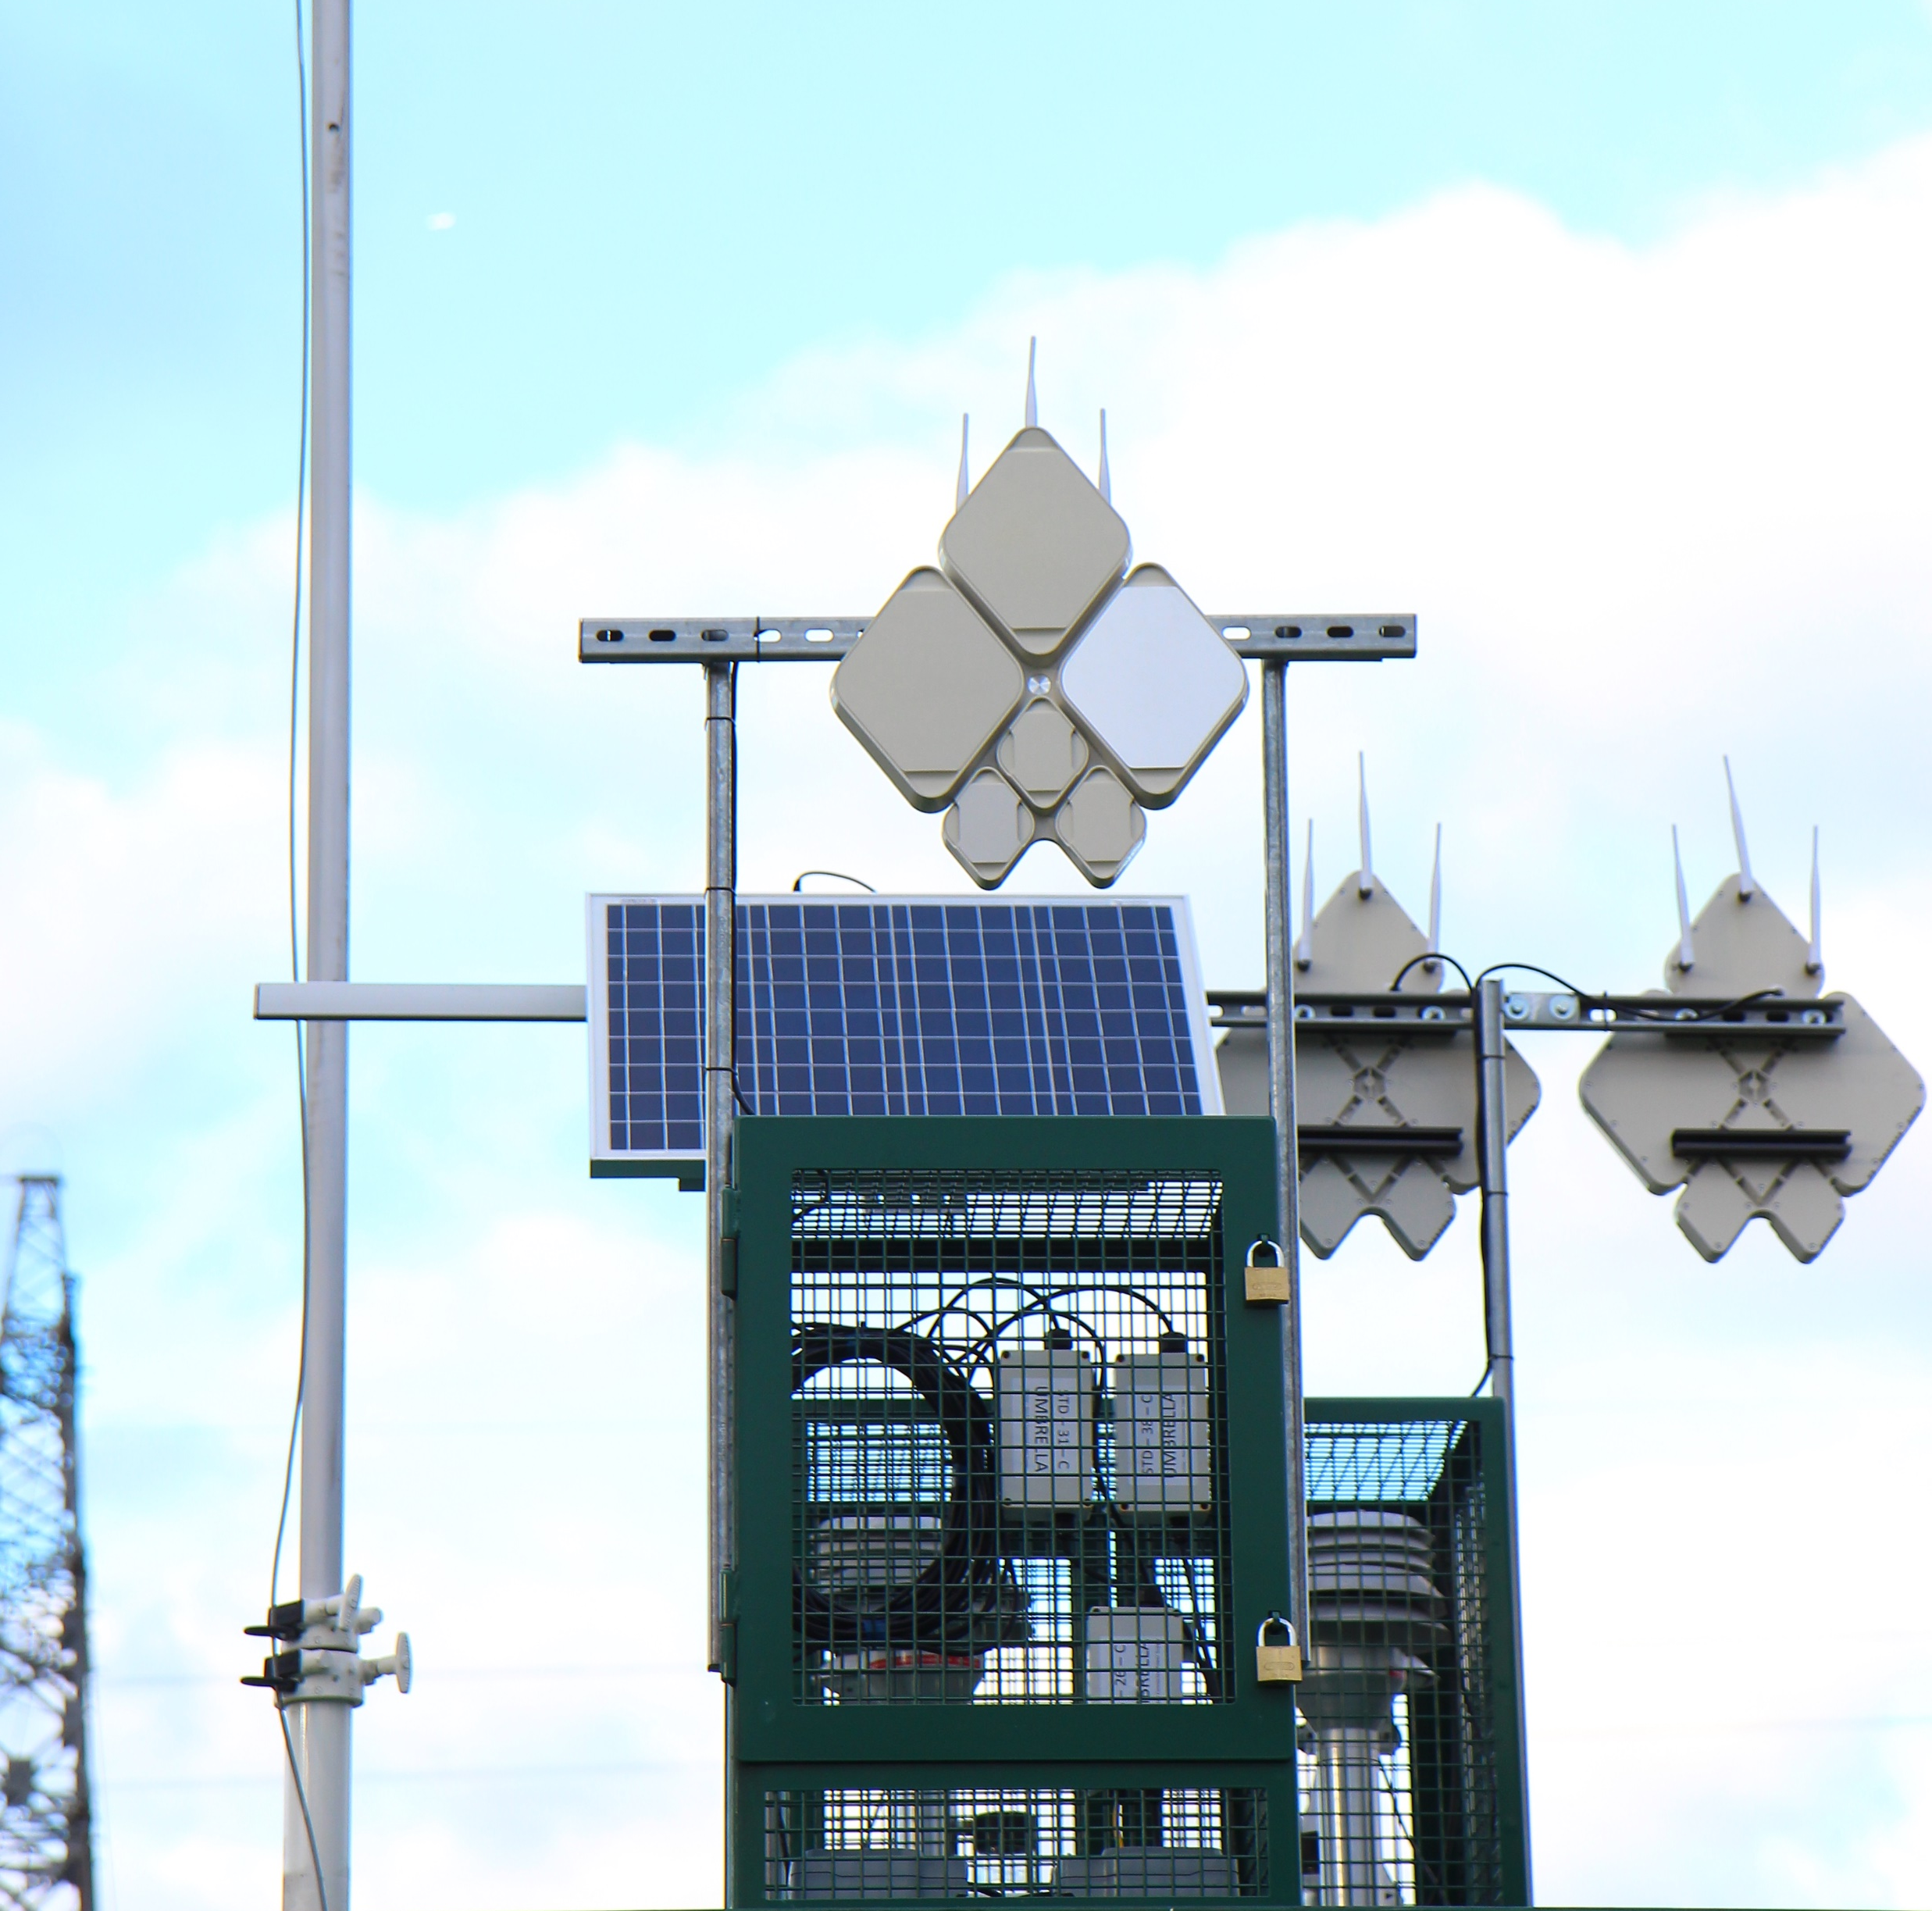
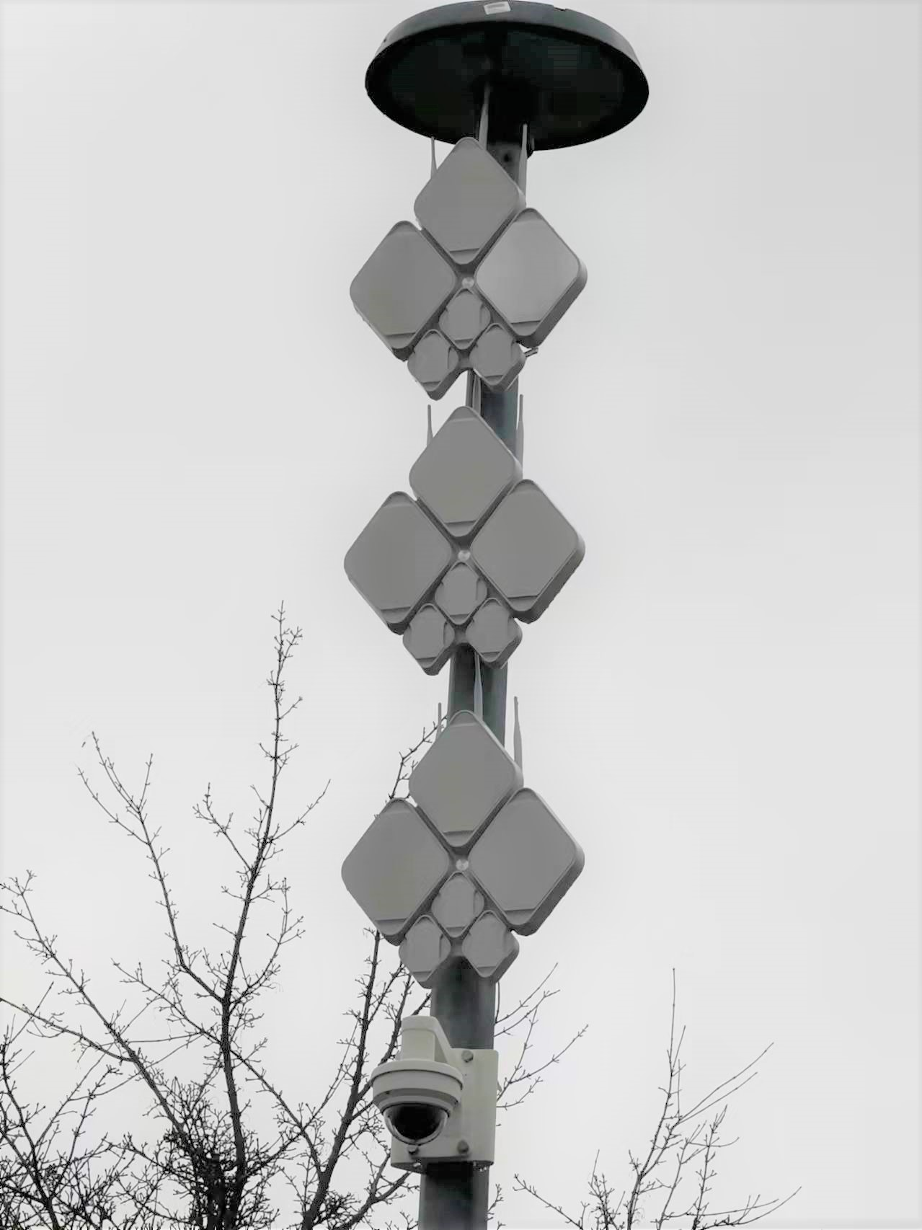
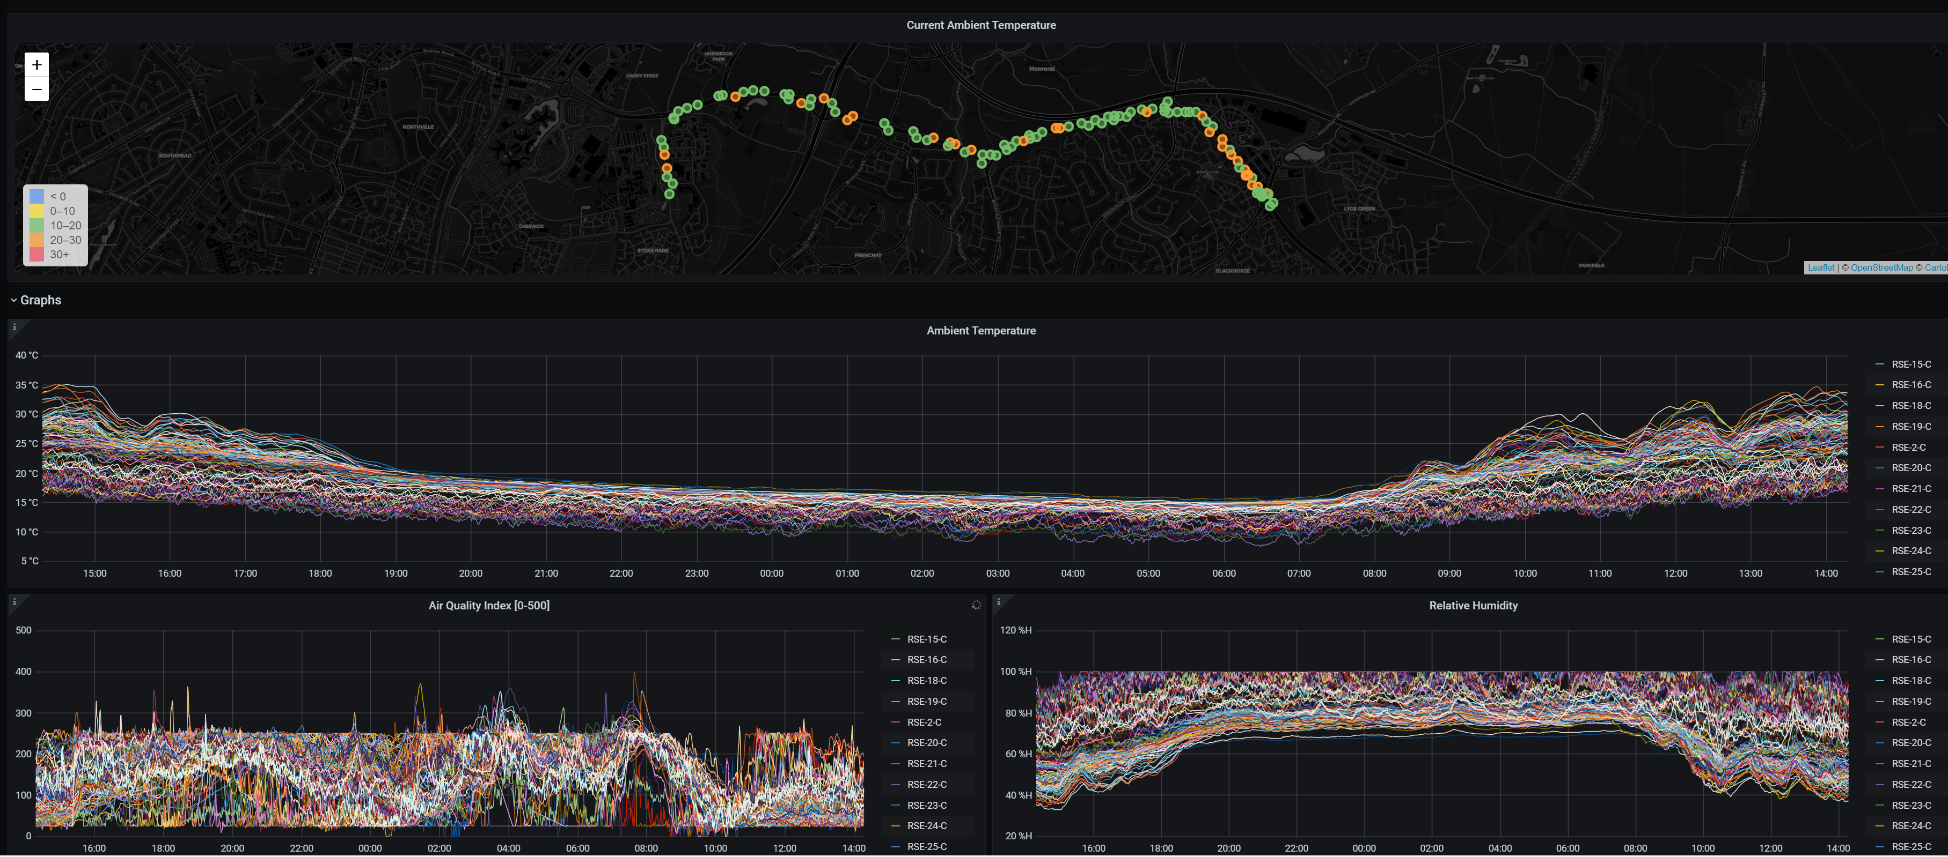
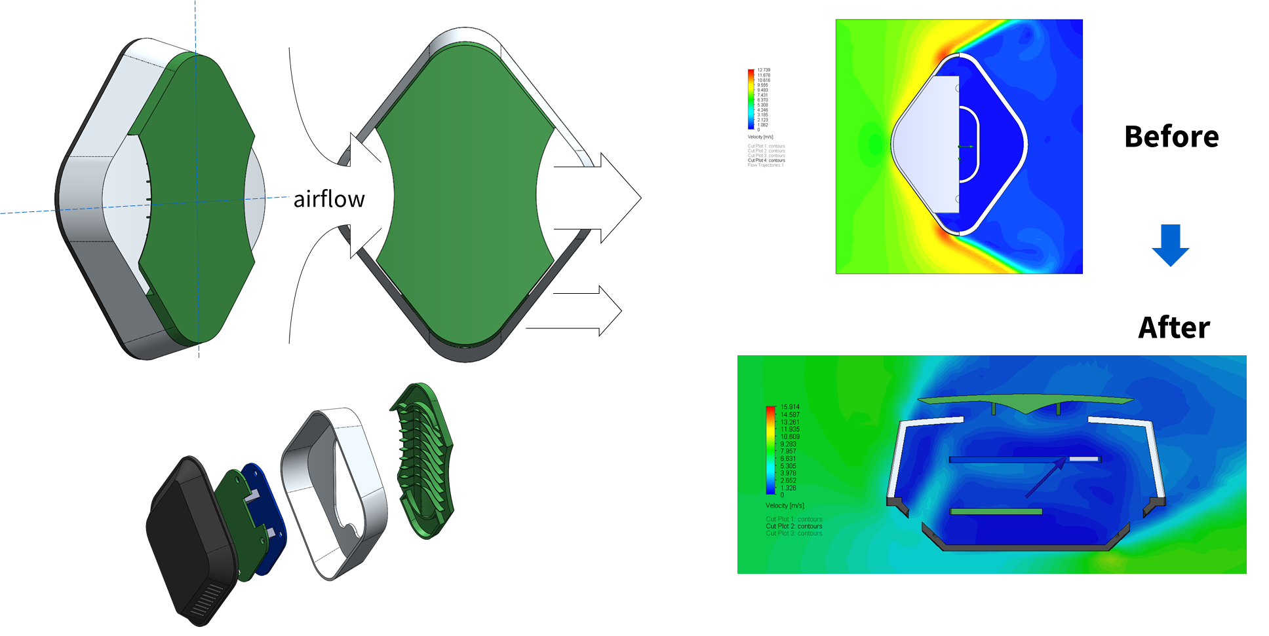
Cost Effective Air Quality Monitoring
Making
Possible
Cost effective, wide-area, high density, real-time, auto-calibrated* 3-Tier Air Quality monitoring system:
X 1800, low cost sensors with low maintenance and large coverage for key junctions and roundabouts.
X 8 Medium Cost AQ sensors with some maintenance for comparison study.
X1, High Cost Automated Monitoring Station for sensing calibration
IMPACT
Unique open sensing infrastructure providing support for academia, business and councils.
6 million data samples taken daily.
  Used by AI researchers, Traffic Management & Transport team, Environmental Science researchers.
Developing project to implement smart control of traffic signals based on air quality *
Co-located Units for data correlation and improved Sensing accuracy.
Over 6M sensing samples per day !
* Work-in-progress

Slide 6
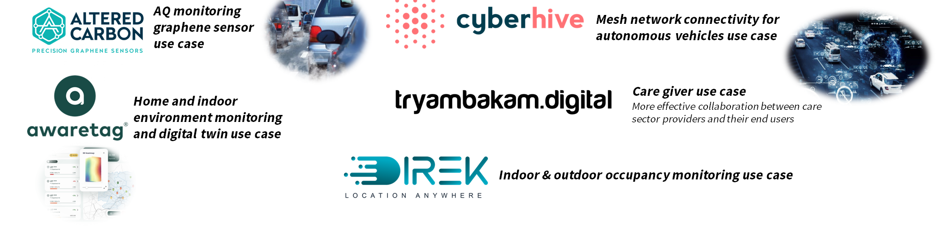
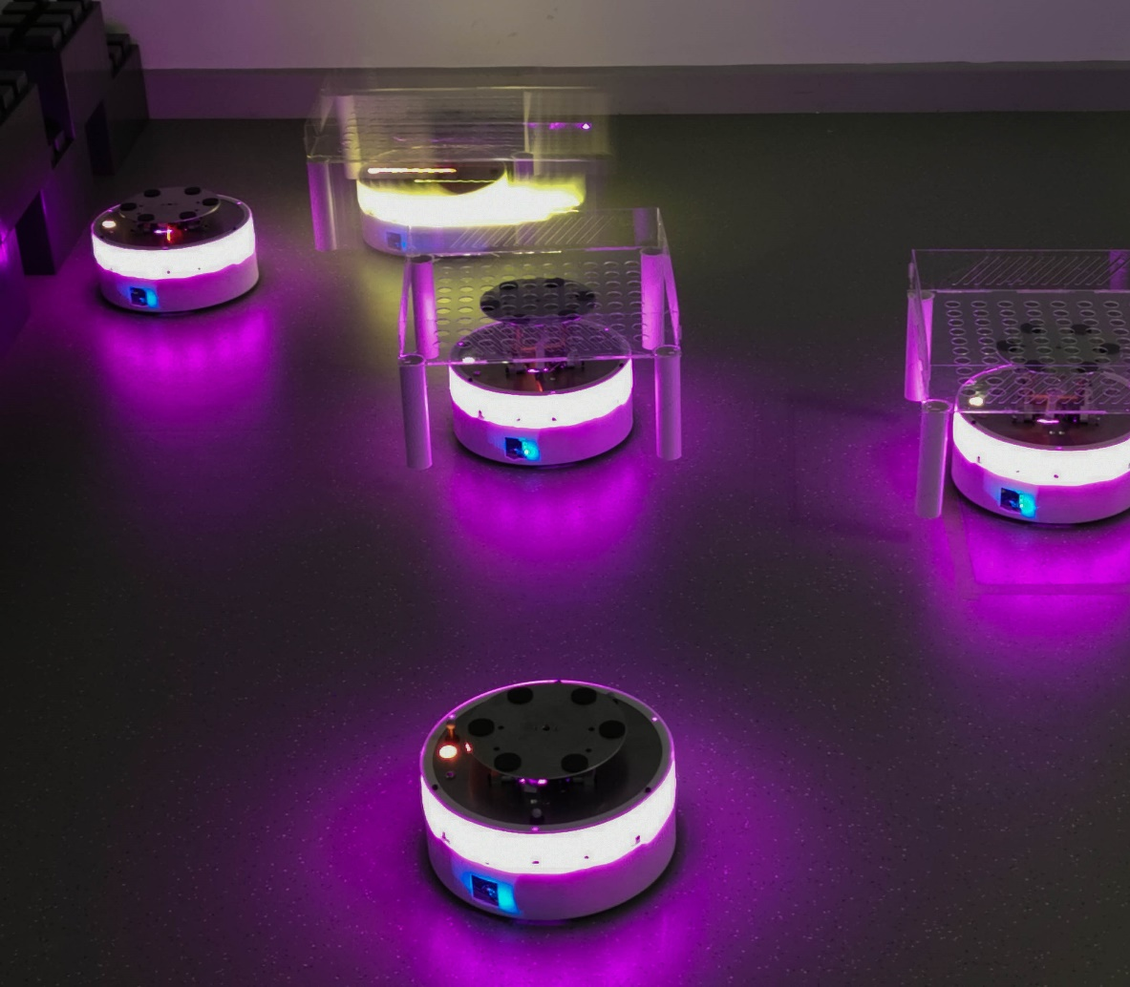
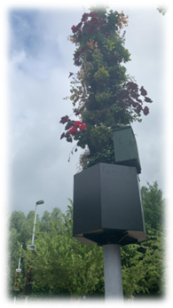
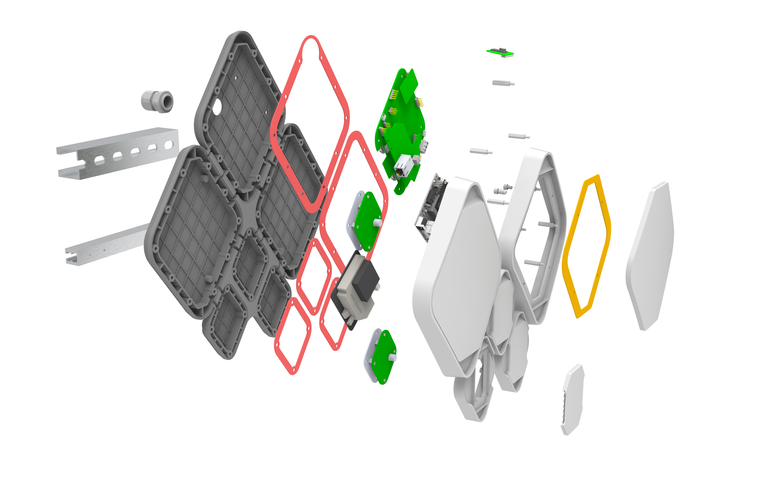
One-stop-shop for IoT Technology Needs
A plethora of different technologies all accessible via a single, open and programmable platform.
Address the global business challenge of pilot purgatory.
Reduce barriers to innovation
Sector Agnostic use cases – Air Quality, Robotics, Cyber security, Energy, Traffic, Retail, industrial 5G, Building, Health Care
IMPACT
3 local SMEs successfully used the system for real world testing and validation – one SME raised £2m capital as a direct result of this.
10 UK SME businesses currently running projects on the network – to fast track their products to market.
World first: Remote experimentation on most advanced swarm robotics testbed in the region: International robotics competition held attracting 90 participants from around the world during pandemic.

Slide 7
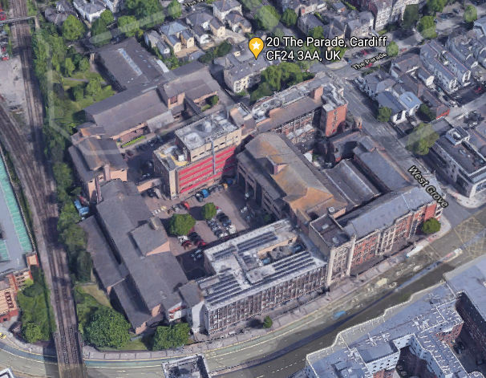
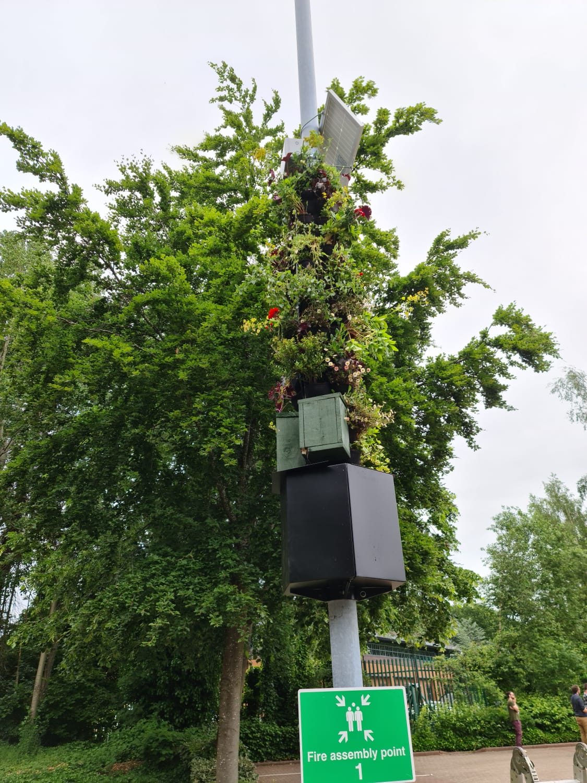
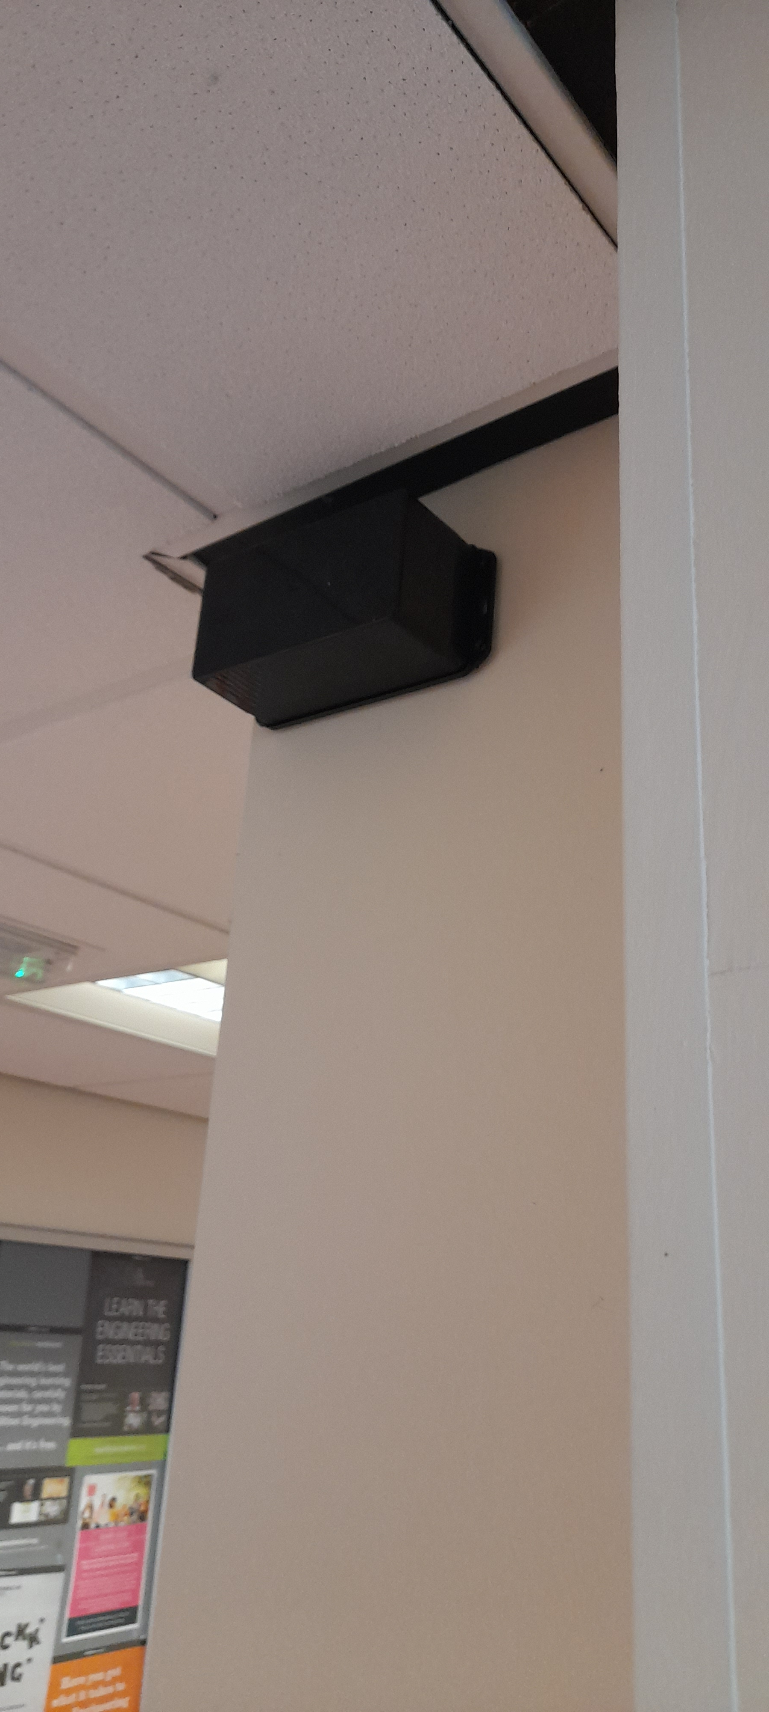
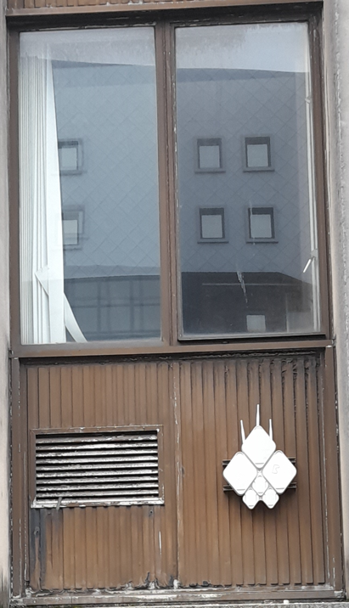
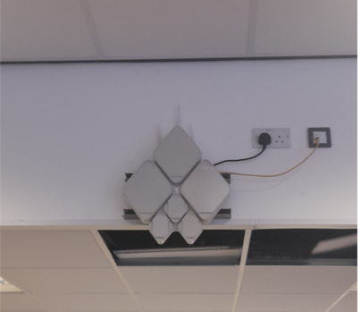
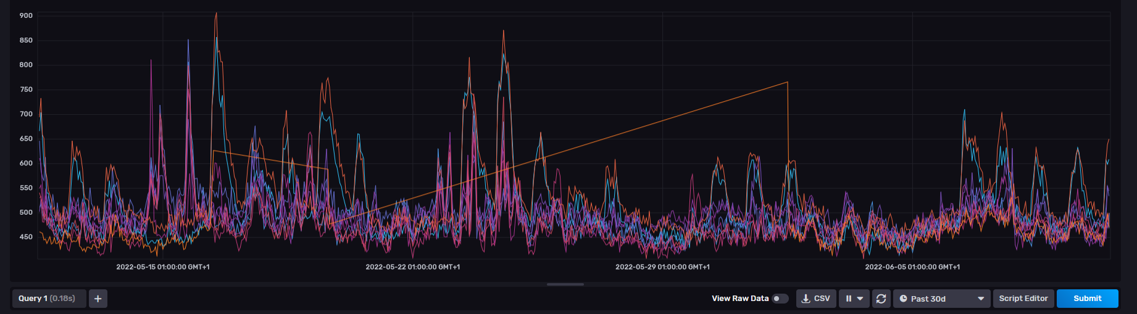
Other Real-life Deployments
UMBRELLA node locations
Remote node locations
Building monitoring solution
Understand the level of sensing needed required to positively influence building performance.
Understand the lifecycle cost assessment of various strategies implemented within the building.
Use of sensor data to optimise building comfort for occupants and to understand their environmental impact of occupancy and draft a plan towards net zero.
Green Lamppost Project
Smart City AQ sensing solution.
Reduce City Carbon Footprint.
Sustainable self-watering plant pot.
Full solar powered solution with Duty cycling without loosing sensor data granularity during radio sleeping time.
Solar Panel
Plants
Sensors, control units, and radios
Water reservoir
@ Cardiff
@ Manchester
Energy efficient IoT sensing and communication solution - self sustainable via Solar PV.
Enabling low power mode of your embedded device.
Buffering and processing sensing data before transmit.
Heavy duty cycled radio comms to save energy.

Slide 8
UMBRELLA Video
UMBRELLA Video on Vimeo
yichao.jin@toshiba-bril.com

