Slide 1
Wireless World Research Forum Meeting 47
22 June 2022
Freyja Lockwood
Digital Transformation Programme Manager, West of England Combined Authority
Notes:
Thanks for the intro Dimitra. Welcome to the West of England. Excited to Join you today

Slide 2
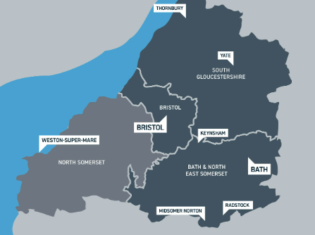


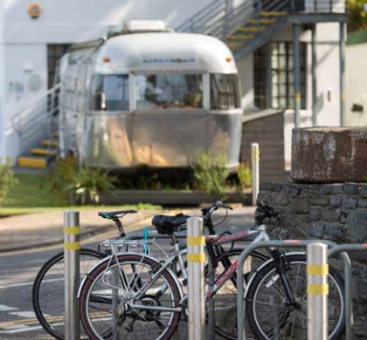
Welcome to the West of England
We are a region where creativity and collaboration lead to successful new ideas that improve people’s lives
We bring businesses, organisations, and communities together to tackle society's biggest challenges
Our plan for digital transformation focuses on building connectivity and capability
This way, we will achieve our digital objectives around infrastructure, inclusivity and innovation
Together, we’re creating a better, greener future for all our residents
Notes:
Digital Transformation Lead for the Combined Authority my remit covers the whole of the West of England – Bristol, Bath & North-East Somerset, South Gloucestershire and North Somerset.
From Brunel and Concorde to the latest developments in virtual reality, the West of England has long been at the cutting edge of technology and innovation. Thriving tech cluster, with amazing universities. A place where ideas flourish and businesses grow.
In post just over a year and my focus is on developing our Digital Strategy in collaboration with the region’s Local Authorities and key partners, including the telecoms industry.
Prior was Bristol City Councils Smart City lead heading up their City Innovation Team drawing on over 15 years’ experience delivering research and innovation in the private sector.
I’m strategist, but grounded by background in human factors – sadly I don’t have a snappy description of what that is!
It’s about understanding about people, the spaces we live and work in, the things we interact with and using that knowledge to design better experiences and outcomes
Means I come to the smart / digital tech space with a strong people focus on user-centred design and strategic transformation. For me tech is not the destination, it’s an enabler for us to do better things
I’ve learnt innovation works best when you’ve an outcome in mind. What’s the challenge or the opportunity you’re trying to address?
Our regional Mayor Dan Norris set out priorities, we’re looking at how we focus strategic innovation to improve people’s lives.
So how we use digital infrastructure, like 5G or 6G?!, to address the digital divide, support inclusive growth and become a more sustainable resilient region.
We’re in the middle of reframing and building up our digital capabilities so I don’t yet have a digital strategy or a bunch of use cases to share.
Instead going to set the scene for digital transformation in our region and why we’re fast tracking infrastructure roll-out and tell you a little about a project that is changing the way local authorities and operators work will help speed up the roll-out of digital networks that local people need and deserve.

Slide 3


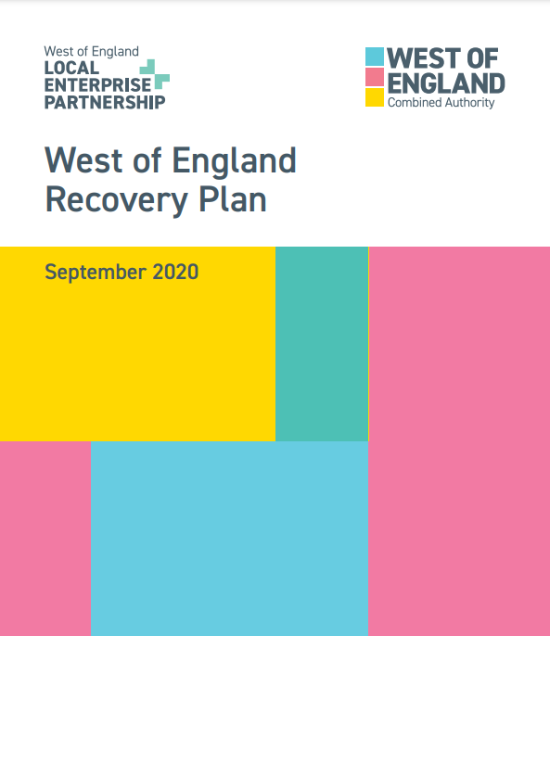



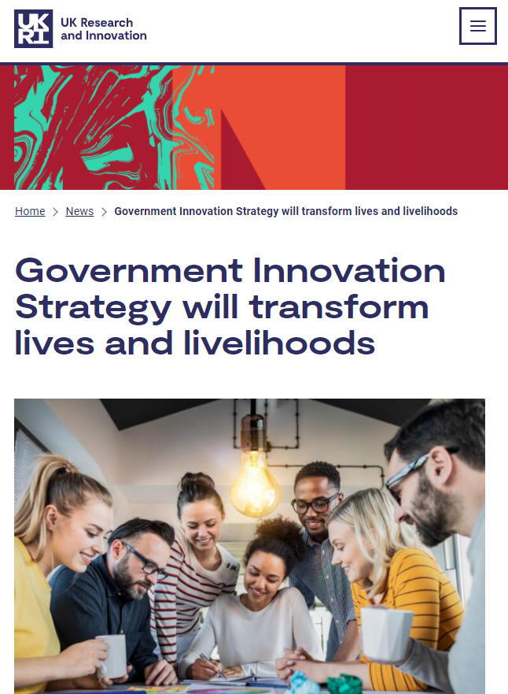

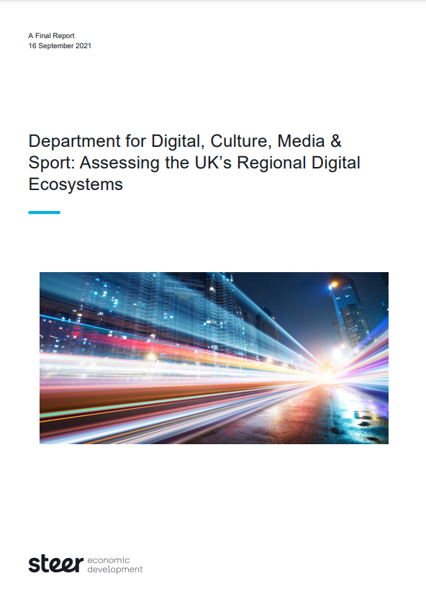
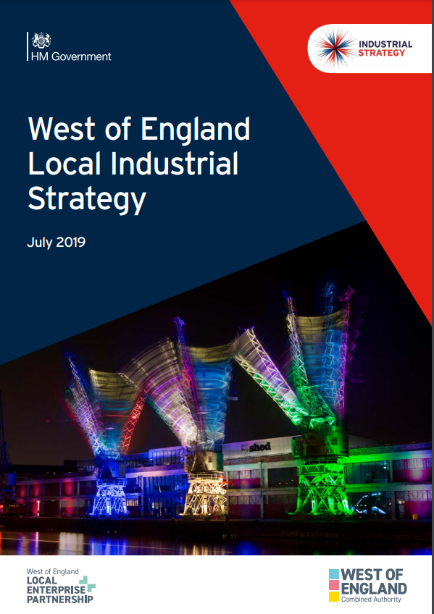


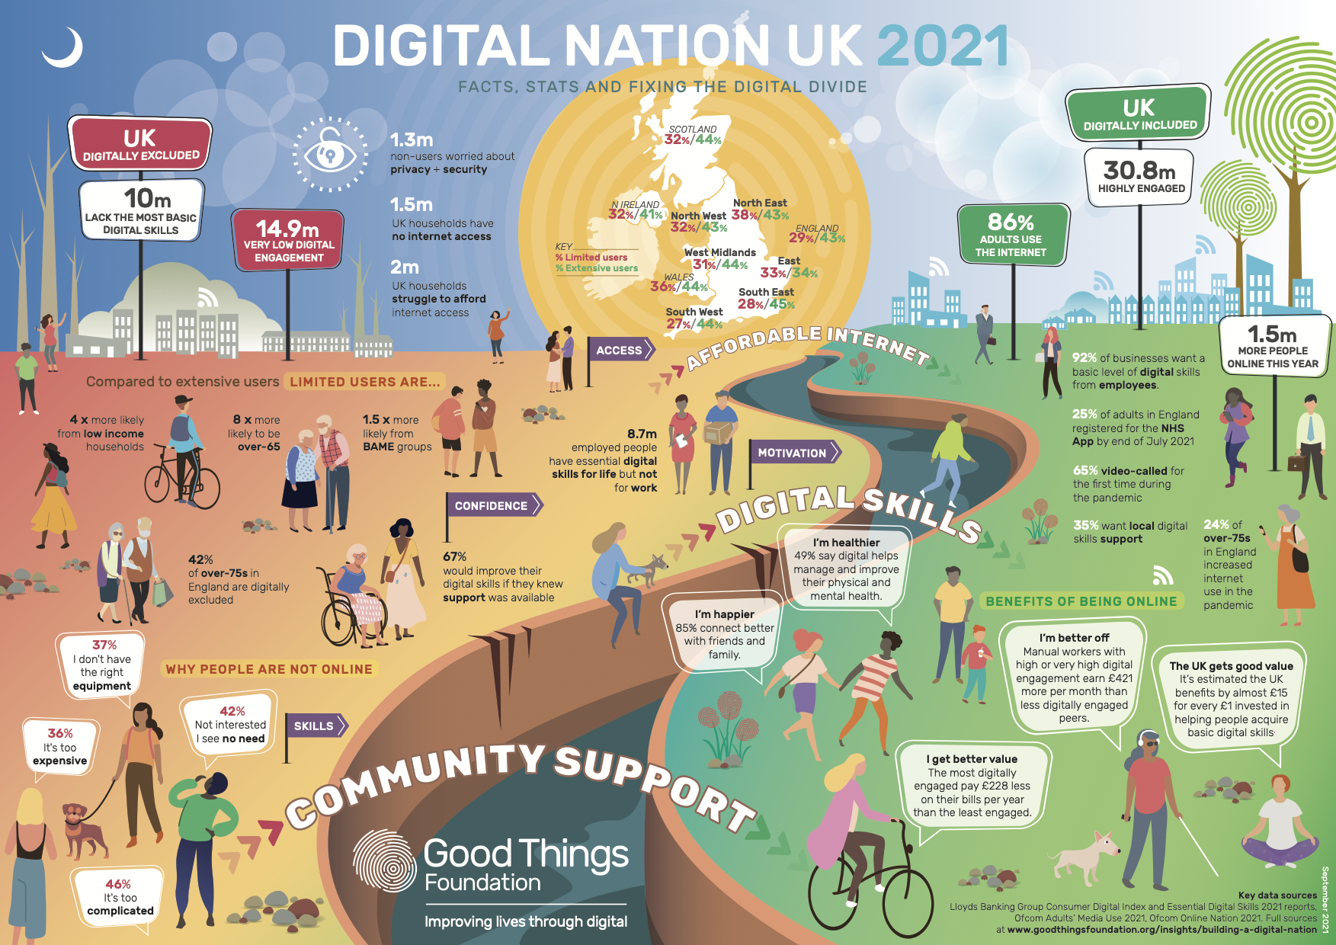
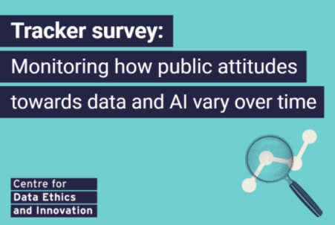
Digital supports our shared ambitions
LOCALLY
NATIONALLY
Create West of England Sustainable Transport
Tackling the climate and ecological emergency
Secure decent jobs and training
More affordable places to call home
in communities people are proud of
Put the West of England on the map for national and global success
Notes:
We are in a time of challenge and of opportunity. Over the past couple of years, digital connections have been a vital lifeline for many homes and businesses.
Looking forward digital underpins many, if not all, our ambitions.
From tackling the climate and ecological emergency, developing new and better ways of moving people and goods, to widening access to good jobs and training, and new ways of connecting communities. Digital has a big part to play.
Improving regionally connectivity is the foundation. Better mobile connectivity is especially important for our more rural and hard to reach areas.
It’s also potentially game-changing for our world-class innovation cluster.
Through our work with DCMS, we’re already demonstrating that 5G has the potential to transform sectors (e.g.) tourism, logistics. And we’re seeing elsewhere how 5G is reshaping the future of manufacturing, construction, and other important industries (see https://dcmsblog.uk/2021/07/5g-transforming-manufacturing/)
We’re looking forward to embracing the opportunities created by DCIA and wider roll out of 5G and mobile.

Slide 4
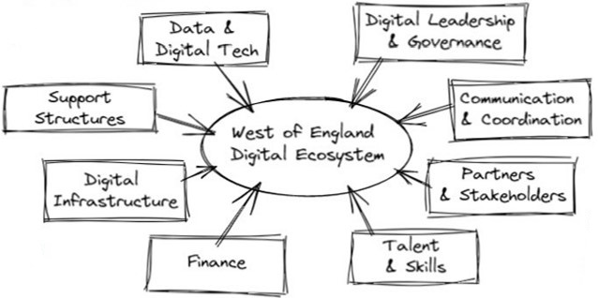
Different Digital Pathways to impact
Slide deck – heavy quickly – provide BLUF and slow reveal…
Systems approach – how to do.
Shared vision & ambition
Clear digital policies & strategy/roadmap
Digital Champion(s)
WofE Digital Plan
Digital Advisory Board???
Regional open data & data hubs
IoT networks
Digital Twins & AR/VR
Regional Transport Data Hub (FTZ)
UMBRELLA & OPCR
Start-up spaces, incubators & accelerators
Enhance business support capacity
Test-beds & living labs
Business Innovation Fund
Future Transport Zone
Digital Hyper Hubs
Stakeholders & coalition of the willing
Joint funding bids
Regional coordination & project delivery
Market engagement
WofE Digital Office
Fixed, mobile & wireless connectivity
Data & content centres
Internet exchanges
Public assets & regional scale
WofE DCIA Pilot
Local residents & businesses
Academia, private & third sector
Government
Community Groups
DCIA Market Supplier Forum
Inward investment
Government funding
Leverage public sector assets
DCMS Grants & Influence Fund
Project Gigabit Investment
Digital skills & inclusion
Local digital talent; attracting new talent
Encouraging entrepreneurship
Digital Skills Investment Partnership
Smart people and places - learning, adapting, responding - better outcomes
*Adapted from: Blueprint for cities and regions as launch pads for digital transformation
Notes:
Digital transformation isn’t simply rolling out the latest tech. It’s about creating a vibrant digital ecosystem that delivers better outcomes for businesses and residents
Helps drive an inclusive regional economy
We need holistic action across these different areas.
We’re already doing great work, for example Digital Skills Investment Programme, 5G Logistics, Future Transport Zone.
But infrastructure is the keystone to all of this. Closely followed by a need for leadership, clear vision, effective coordination and partnering – we have some work to do here.
What makes a place ‘smart’? Mostly it’s the people and tech and data can help us learn, adapt, respond. But all not about high-value tech.
Also about the everyday. Like small businesses, every charity having what they need for everyday stuff, e.g. good connectivity, keeping data safe, good digital leadership, access to the right skills, etc.

Slide 5
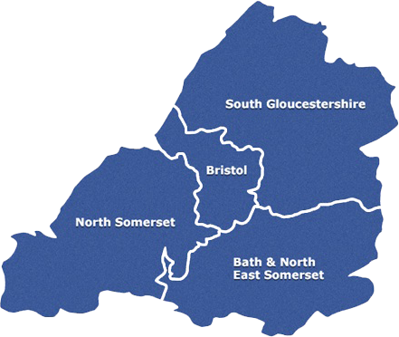
Putting in the foundations
FOCUS AREA
AMBITION
Digital Infrastructure – Everyone in the region is digitally connected, with access to world–class digital infrastructure that is fast, secure and reliable | Universal Connectivity
Post-code lottery – access to decent broadband depends on location; impact greater in deprived areas
If you live in the Bournville Estate (Weston-super-Mare), Frampton Cotterell (South Gloucestershire) or Stockwood
in Bristol you’re loosing the lottery*
Developing a Digital Infrastructure Roadmap to fast-track roll-out of better broadband across our region (fixed, mobile and wireless)
Aiming at 95%, then universal gigabit-capable coverage
Emerging levelling up issue - B&NES and NCS risk being left wrong side of the gigabit digital divide
*Source: Digital Exclusion Risk Index

Slide 6

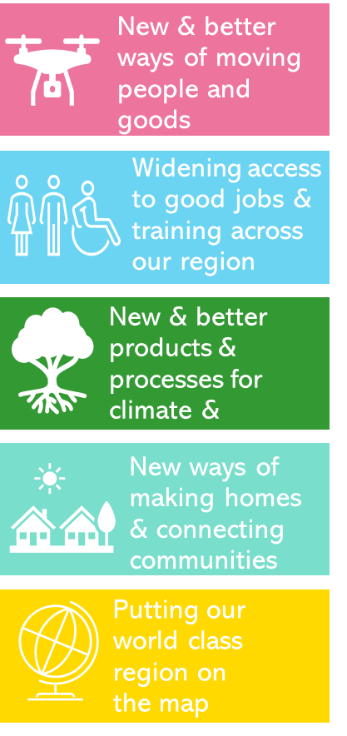


DCIA, digital and transformation
Regional Innovation Priorities
Digital Plan
Barrier busting & better ways of working
Wider rollout of wireless networks
New ways of working
Better Access to Broadband
WofE Digital Office
Faster, cheaper, easier for everyone
DCIA
More collaboration & stronger alliances
Less Digital Exclusion
Better visibility of public sector assets
Doing these things to make it easier to roll-out wireless networks
More Digital
Innovation
Notes:
DCIA – DCMS funded. We’re 1 of 8 regional pilots…
motivation for being involved in DCIA. A shared desire to improve connectivity. To make sure we have fast reliable connectivity for everyone.
For us DCIA more than just a pilot – this project is bringing us together as a region and forming the future foundations of our regional approach to digital transformation.
It is helping to build our digital know-how and increasing our capacity to help make it easier and faster to roll-out digital infrastructure.
We’re working hard to support the delivery of Digital Infrastructure that will enable Digital Inclusion and Digital Innovation.
For us this is all not leaving people behind, using digital and 5G to tackle our big regional challenges like the climate emergency, like green, inclusive growth…
Our ambition is universal connectivity – where everyone in the region is digitally connected, with access to world–class digital infrastructure that is fast, secure and reliable
With more people working, studying, shopping and playing online, better connectivity is more important than ever.
The DCIA project will help speed–up 5G roll–out across region, including rural areas and ‘not spots’. Better 5G and mobile connectivity will be a real step towards making sure everyone across our region can get connected. Especially for rural and hard-to-reach communities currently lacking decent access to the internet and online services.

