Slide 1
6G: From Digital Transformation to Socio-Digital Innovation
Prof. Dimitra Simeonidou FREng, FIEEE
Director Smart Internet Lab, Co-Director Bristol Digital Futures Institute
University of Bristol, UK

Slide 2
Future Networks Research @ University of Bristol
Smart Internet Lab: Holistic approach to end-to-end networks
  200+ academics and researchers at University of Bristol
  Combined expertise across optical, wireless, IoT and cloud technologies
  Enabling technologies, systems and networks, services and applications
  Extensive expertise on hardware, software and co-design
  Real world deployments and large-scale experimentation
The Bristol Digital Futures Institute (BDFI)
  Developing in-depth understanding of sociotechnical methodologies to drive the creation of digital technologies for inclusive, prosperous and sustainable societies.
  Established in September 2019 and draws expertise across all the University’s Faculties
  Working with 27 partners from industry, government and civil society
  Supported by £100m RPIF PPP co-investment and £16m from philanthropy

Slide 3
Recent Examples of E2E Network Research
#1–Multi-access (Radio + LiFi + Fibre) & Mobile Edge Computing
Integration of Edge Compute and Network Edge (programmable hardware)
AI and processing at the edge – Addressing disaggregation and scale
#2 Wireless, Fibre , Satellite, IoT convergence
With use-cases for smart cities, transport logistics, manufacturing and rural deployments
#3 – SDN, NFV, Network Slicing & Service Orchestration
Dynamic network slices, multitenancy, protection and prioritisation of services
End-to-end intelligent service orchestration-multi-technology & multidomain, Zero Touch
#5 – User Experience
Use cases relevant to the industry and communities: cities, transport, health, creative etc.
Co-creation: Users Involved in the innovation Cycle
#4 Open Networking
Starting with OpenRAN – x/r Apps developments
End-to-end: RIC + NWDAF monitoring and AI/ML tools for optimisation

Slide 4
Innovative Use Cases
Creative Media & Arts
Tourism
Port s &Logistics
City Data
Manufacturing

Slide 5




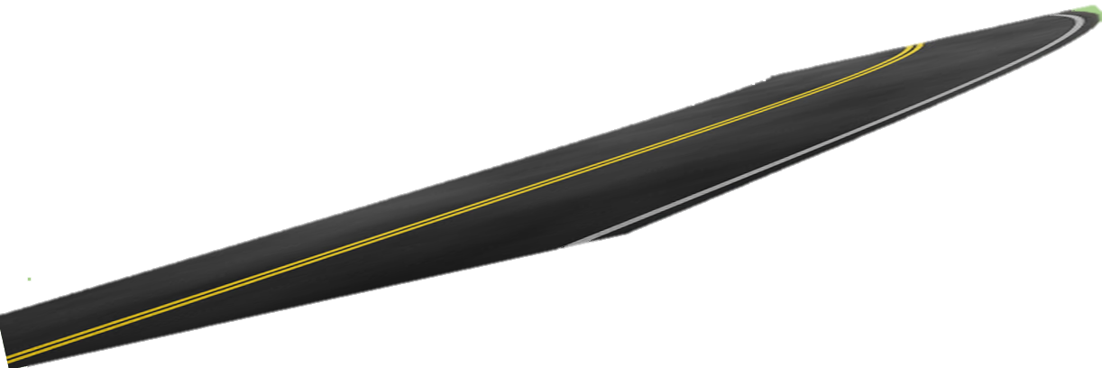
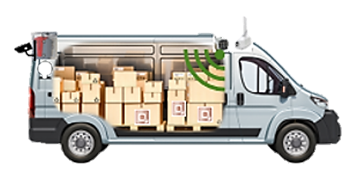


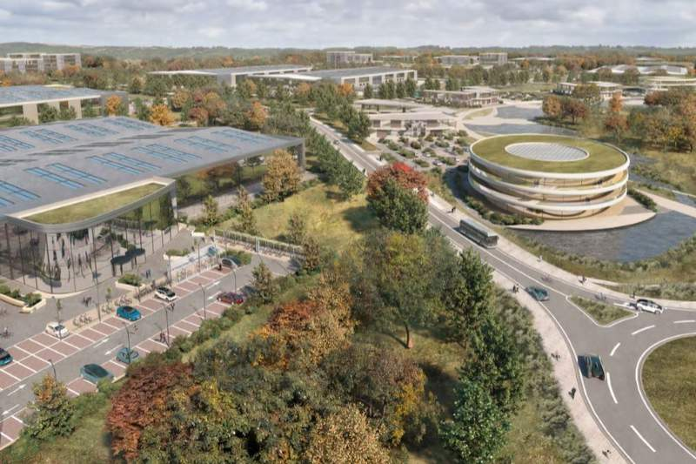
User-Driven Innovation: 5GLogistics, the First Open RAN Testbed in UK
Autonomous port police drones
Freeport
Freezone
Security
Traceability and tracking of goods within and across extendable virtual boundaries and…
Between private and public networks
Smart junctions

Slide 6
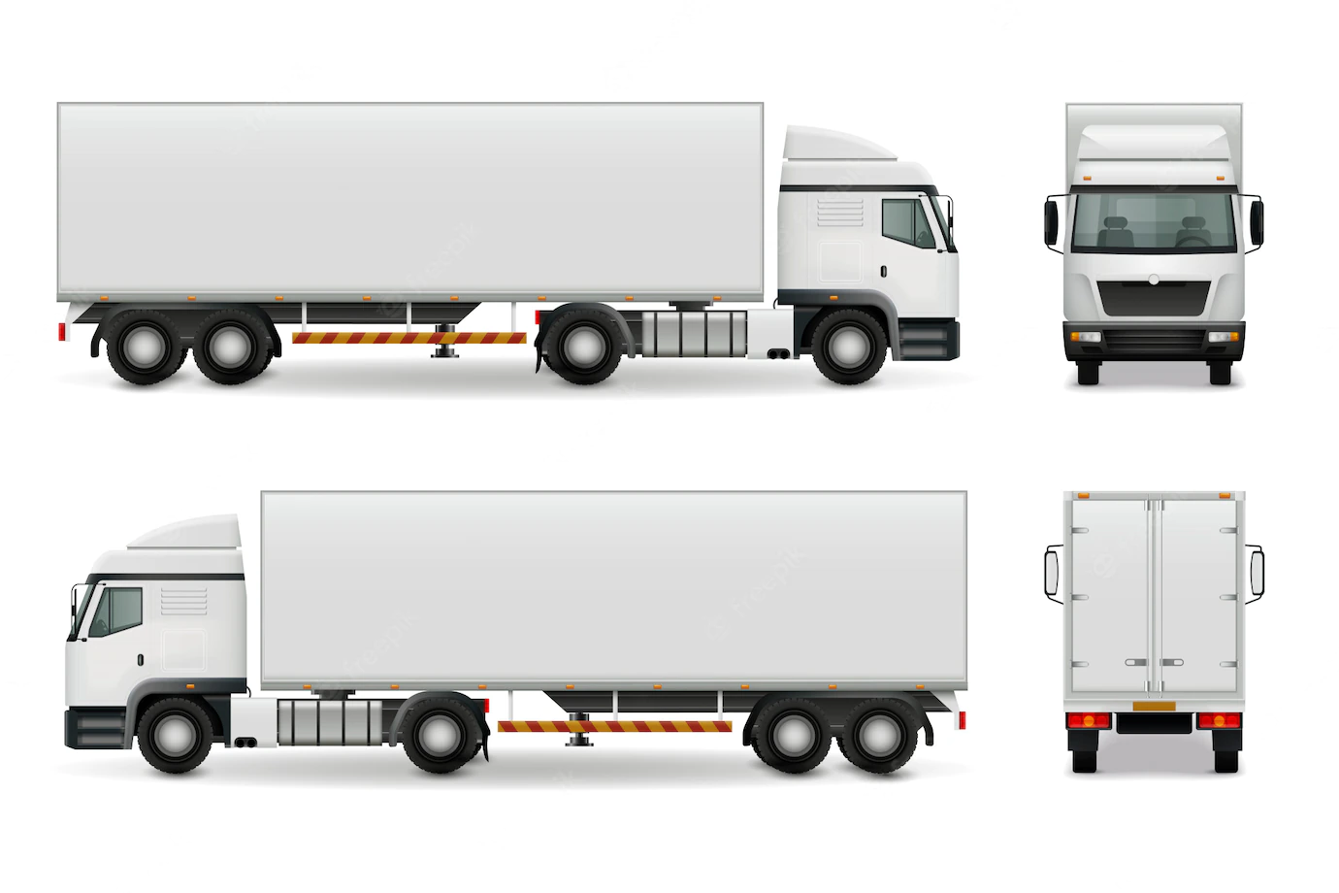
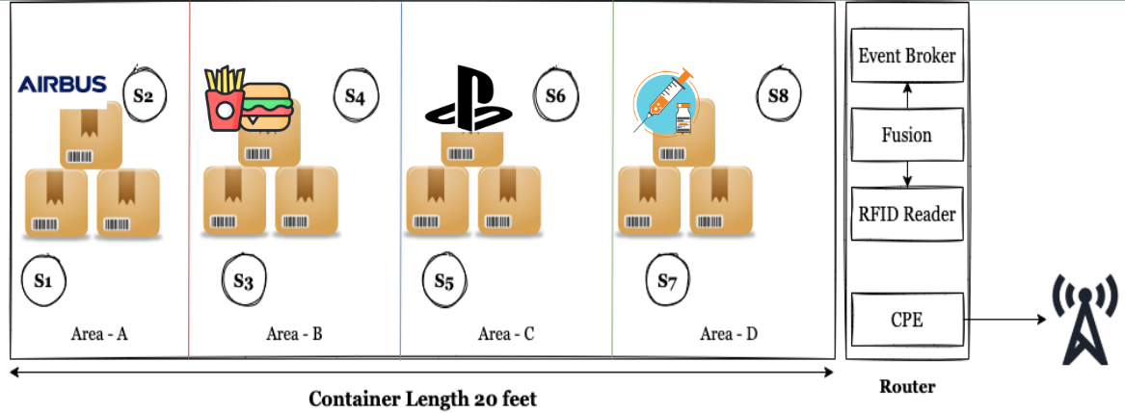
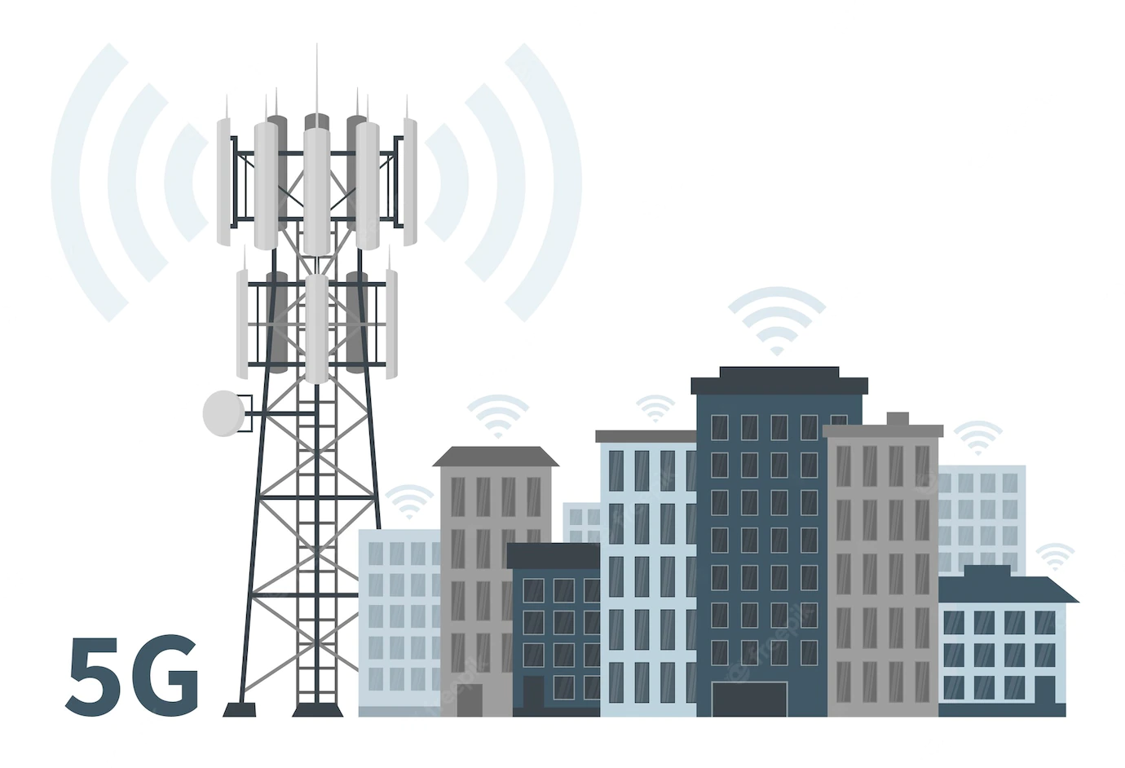





User-Driven Innovation: Use Case Overview

Slide 7

User-Driven Innovation: Addressing Real Barriers for the Sector
Location Accuracy using traditional GPS is usually between 10 to 40 meters
Centimeter Location Tracking
Manual Scanning of goods occupy 25% of logistics operations
Wireless scanning of more than 1000 products per container
Existing solutions monitor hourly location and condition data
Millisecond data of container location and internal light levels, temperature, vibrations.
Issue #1 enabling smart solutions
Issue #2
Theft detection
Data analytics and AI models for the logistics sector
What will happen with the workforce?

Slide 8
The Future
Network-Centric: Internet
Device-Centric: 5G
Human-Centric?
Devices are becoming the main users of the network,
  By 2030 the number of internet connected devices will reach 500 B- 59x more than the predicted world population
What will be the role of humans in the service delivery chain?
  Co-creation of future connectivity and services with the end users
  Collective Intelligence= human + machines + infrastructure
  Behavioral science, neuroscience, sociotechnical principles and social practices as the foundation for the design of future networks (responsible innovation, security, sustainability, inclusion, privacy, trust…)

Slide 9
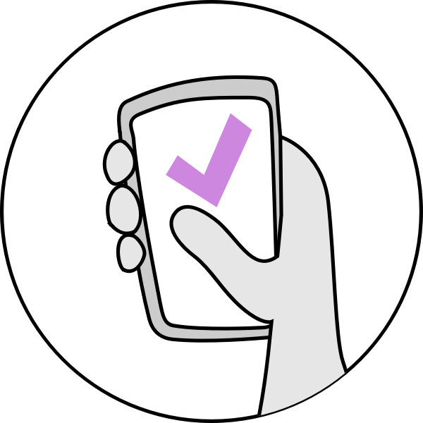

Why is this Important? A bit of context
World population: 7.9 billion
5.1 billion
4.2 billion

Slide 10
The Future: A Holographic Society
More devices, much more data, richer experiences and in particular immersive multi-sensory experiences and digital twins of future systems.
The next generation of mobile networks (Next G) seem likely to be driven by a set of expectations of the immersive living, cyber-physical convergence, Internet of Senses.
More people will spend even more of their lives immersed in virtual worlds that will become in many respects indistinguishable to the physical world.
This will allow geographically distant participants to enjoy realistic, spatially-aware experiences that seamlessly blend virtual content in a user’s physical world and empowers billions of users to feel more connected with each other.
We want to create a cyber-physical environment to be available to all and improve the quality of life.

Slide 11




A Cyber-Physical Continuum
Human-Centric
Models
The physical world of digital connectivity, sensing, data and real world experiences
Cognitive and Communication
Capacity
Physical World
Digital World
Digital representation of physical world scenarios
Real Time
Programmable
Intelligent
Iterative

Slide 12
The Future: A Holographic Society
What are the implications to the underlying connectivity infrastructure and services; technology for user devices; innovative content creation and distribution?
A Holographic Society will not be an application that runs on top of existing infrastructure. It’s the next iteration of the network infrastructure that supports real-time experiences
Delivering a Holographic Society will require step-change innovations in network architectures and underlying technologies

Slide 13


Key Drivers for Future Network Research
Technologies
Key Focus for Network Research
Limitless Connectivity
Seamless, resilient, adaptive
Sustainability
Communication and networking as an enabler
for net zero
Cyber-Physical Continuum
Trustworthiness
Trusted communication and computing for
industry and society
Realistic, engaged, inclusive, fair
Automation and
Autonomy
Cloud & Edge
Low
energy
technologies
Security
AI
New ways of
interaction

Slide 14
Network Requirements
Reducing latency to low of ms and towards 100’s μs
Deterministic latency
Symmetric high capacity bandwidth over long distances - Overall speed of networks more than 1 Tbps peak data rate
Network coverage-connecting the unconnected
Security assurances and resilience (dependability, availability, reliability)
Openness and interoperability
Autonomy-Self composition and self-optimisation
Networked Sensing
Privacy and trust
Consistent quality of experience
Zero carbon footprint

Slide 15









Key Technologies
Open hardware/interfaces
Higher reliance on open hardware platforms, open-source and open interfaces
Native Security
Cyber and physical layer
Integrated AI
Widespread use of AI in cognitive and data-driven networks,
Intelligent spectrum management
New Hardware
Generic HW acceleration,
RIS and Meta surfaces,
New high throughput fibre and associated amplifiers (e.g., Hollow Core)
Cell-free massive MIMO, Holographic radio, Ultrafast switches,
heavily integrated components and subsystems
Quantum
network,
computing,
sensing
Spectrum
THz, sub-THz and optical (infrared and visible light)
Infrastructure evolution
Convergence (wireless, optical, satellite, computing, sensing, control),
Distributed, resilient, self-composable
Continuous evolution
Fast evolution of network SW and app development,
blockchain and distributed ledger technologies, Digital Twins
Cloud & Edgification
Continued cloudification for cost/efficiency and horizontal scaling,
Federated and Split Edge computing

Slide 16
A holistic approach to build resilience in the global economy and society

Slide 17
From KPIs to KVIs
Data rates
&
traffic capacity
Service availability
Low Latency
Energy
Service adaptability
Sustainability
KPIs
KVIs
Location accuracy
Coverage
Inclusion and equity
Trusted
#No of devices
Security and privacy

Slide 18
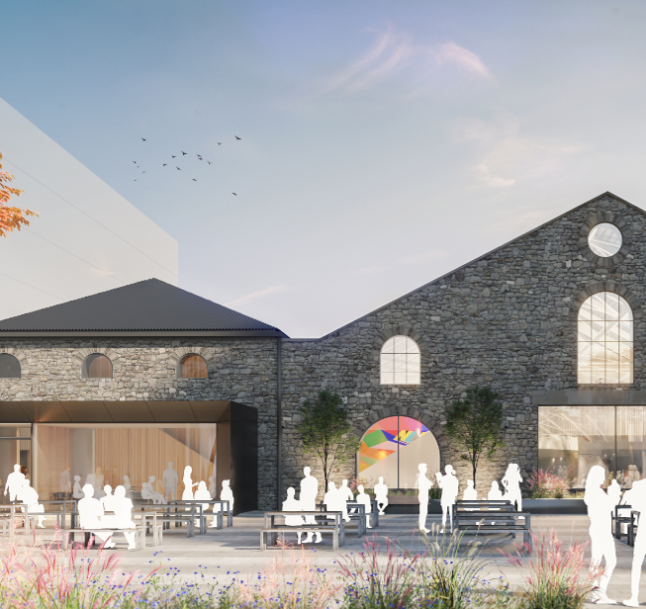
Bristol Digital Futures Institute: Taking the Challenge
We need to create new knowledge and understanding of how technologies and societies shape network innovation together
We need to establish sociotechnical methodologies for creating and evaluating new network technologies against values that consider inclusiveness and sustainability.
This demands new ways of working: across disciplines, with partners from all sectors, collaborating in facilities and spaces designed to support this ecosystem

Slide 19
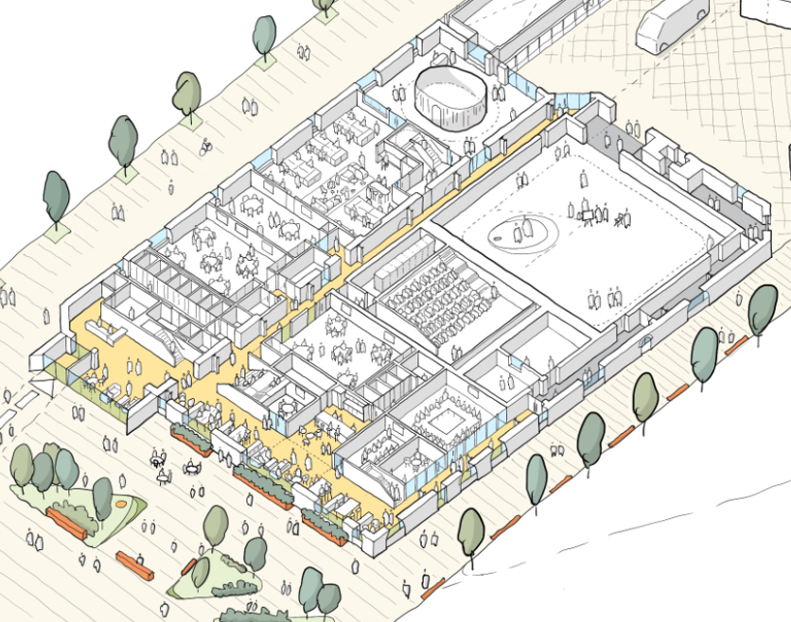
BDFI: Our New Research Facilities
Specialist Facilities:
Reality Emulator
Neutral Lab
Instrumented Auditorium
Digital Health Node
Cyber Suite
Net-zero platform
Timeline to fully integrated facilities
Phase 1 - Retort House opening June 2022
Phase 2 - Coal Shed opening April 2023
Phase 3 - CM 1 opening Q4 2025

Slide 20
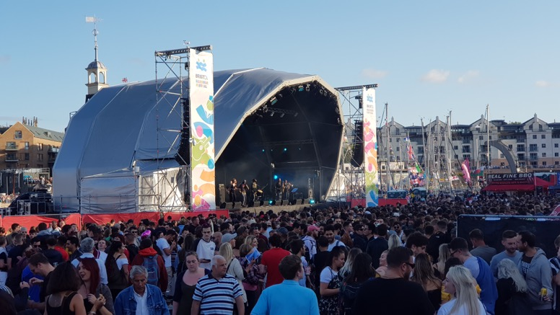
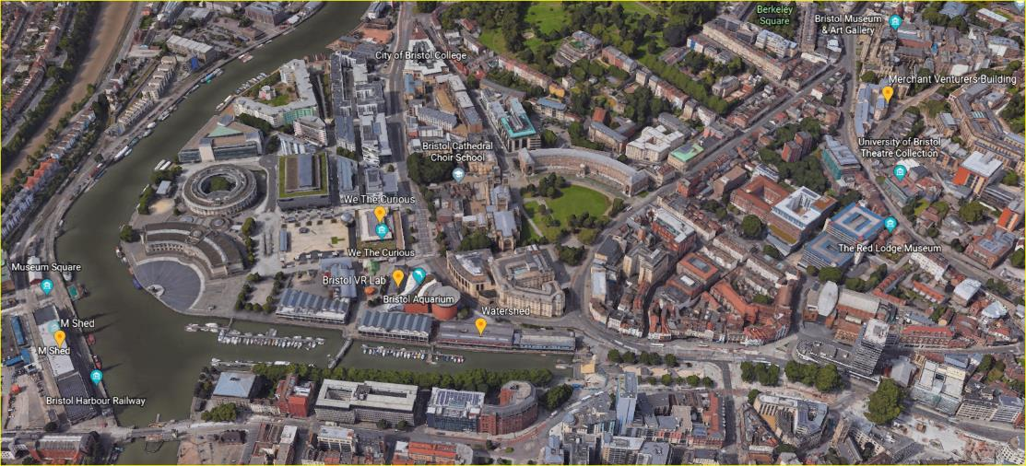
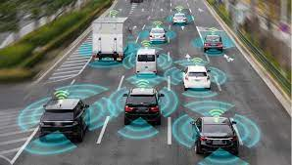
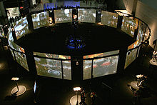
Reality Emulator: An Advanced Digital Twin for Futures Network Research
Collaboratory: Applications, Tools, Solutions, Policies, Regulation
Energy Substation, Renewable Energy Batteries, Energy Monitoring/Management
Iterative
Virtual Production:
Data Analysis/Scaling
AI/ML, training
Software-Hardware co-design
Security
Protocol Design
6G Emulation
Scenarios’ creation
Immersive Experiences
(Users)
Physical Testbeds
Digital Model
Real Data
Digital Model Creation
Services
Laboratories
IoT Platforms
Fibre and Radio assets
Cloud and MEC
Packet cores
Open-Source SW Platforms
Open RAN and 6G hosting
Continuous evolution and optimization
(pre-trained ML models)
Multi-user
Multi-purpose
Interactive
Multisensory
Iterative
DC, Cloud
Data Platforms
Programmable Hardware
Optical Interconnect/Switching
Hosting Research Hardware: New Fibre, Neuromorphic, Quantum…

Slide 21
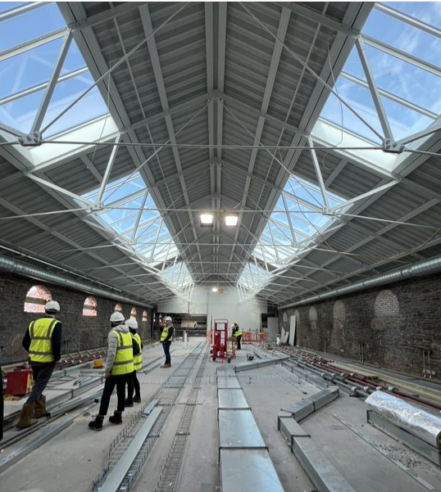
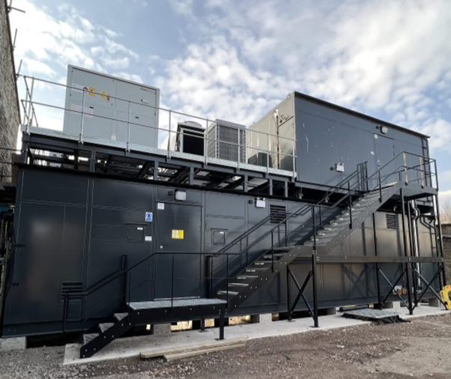
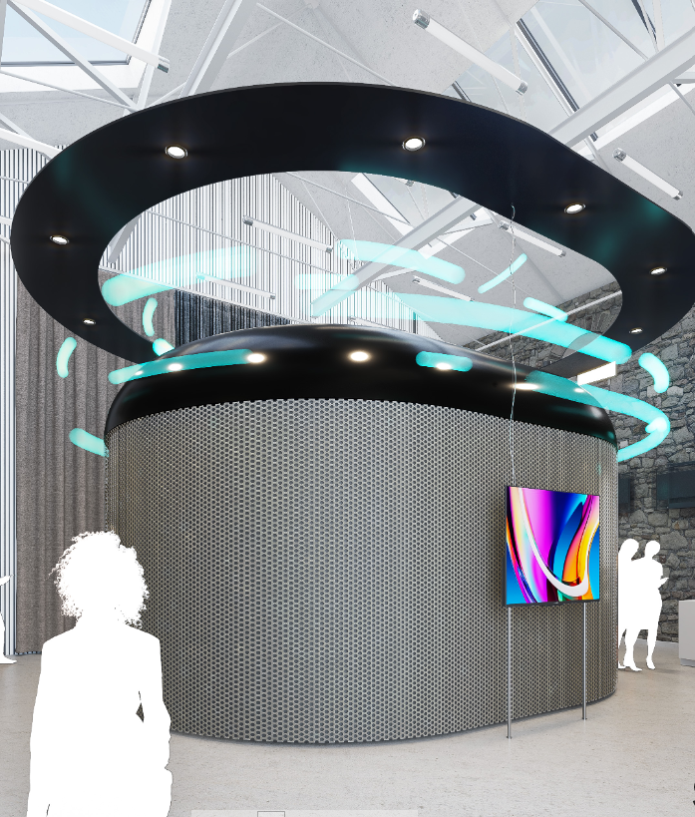
Building the Foundations: Facilities Phase 1
Labs Data Centre Immersive Facility
Phase 1 opening end of June 2022

Slide 22
Multiple use-cases
Multisensory XR experiences
Industry 5.0
Defence
City planning
Our rail station (Temple Meads)
Media, gaming , collaborative creative arts
Education and training
The future of health
Connected robotics and autonomous systems including transport
Tourism
The future of work
Commerce in the virtual world
…

Slide 23
Desired Outcomes
A dynamic digital twin with synchronous real-time updates
Co-design, co-creation methodologies
Improved cooperation and interaction
Convergence architectures for sensing, computing, energy and communications
Cyber security threat landscape– with insights on how this conceptualization changes depending on the architectures and technologies involved
Carbon emissions management
New business opportunities and models
Policy, regulation, standards

Slide 24
Summary: Building the Case for Socio-digital Innovation for 6G
Design of future technologies, network and service architectures at scale
Co-creation with the end users: participatory, experience-driven innovation
Address security, net zero carbon emission for Telecoms- Responsible Innovation
Addressing societal challenges: privacy, digital inclusion, diversity, etc.

Slide 25




Thank you
dimitra.simeonidou@bristol.ac.uk

