Slide 1
New Physical Layer Paradigm for Future Systems:
Moving away from orthogonality to save energy and bandwidth
Professor Izzat Darwazeh
Director of UCL Institute of Communications and Connected Systems (ICCS)
University College London, UK
WWRF 47
Bristol June 2022

Slide 2
“New” Physical Layer Paradigm for Future Systems:
Moving away from orthogonality to save energy and bandwidth
Professor Izzat Darwazeh
Director of UCL Institute of Communications and Connected Systems (ICCS)
University College London, UK
MAP-tele Workshop
University of the Minho-Braga-September 2021

Slide 3
Why does radio/modulation change from generation to generation?
We would like radio signals that can carry all the information, maintaining data quality , integrity and security in smallest possible bandwidth and lowest possible energy using simplest equipment.
Use: think of 1G, GSM, UMTS and then LTE and 5G
Data rate: kb/s to Gb/s
Bandwidth and radio
Signal quality and errors:
  Channel physics: delay spread, environment, user speed
  Channel use: noise and interference
Equipment, energy and complexity

Slide 4
Why does radio/modulation change from generation to generation?
We would like radio signals that can carry all the information, maintaining data quality , integrity and security in smallest possible bandwidth and lowest possible energy using simplest equipment.
FM GMSK CDMA/QAM OFDM/QAM
Use: think of 1G, GSM, UMTS and then LTE and 5G
Data rate: kb/s to Gb/s
Bandwidth and radio
Radio signals and specterum make all the difference

Slide 5
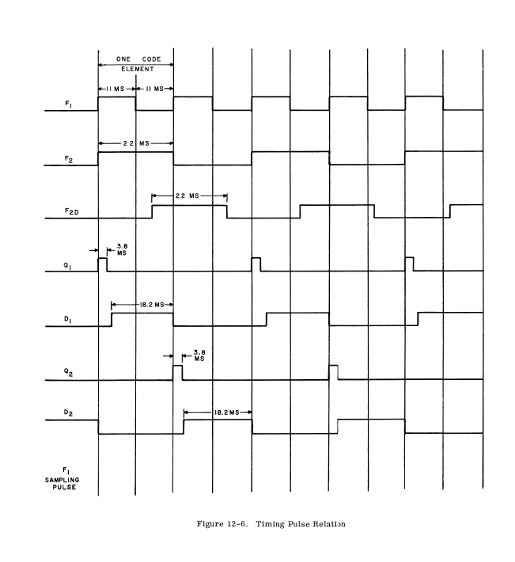
OFDM concept has not changed since 1958!!
A binary bit stream is divided into N-binary bit streams.
Bit duration is extended from T_{b} to N x T_{b}
What does this do to the spectrum?
Each of the N sub-streams modulates a sinusoidal carrier known as (sub-carrier)
The carriers are at different frequencies and are separated by
Δf = 1/N x T_{b}
The sub-streams are added together and transmitted

Slide 6
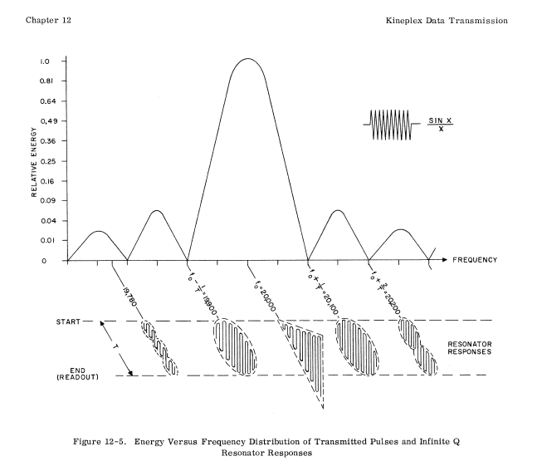
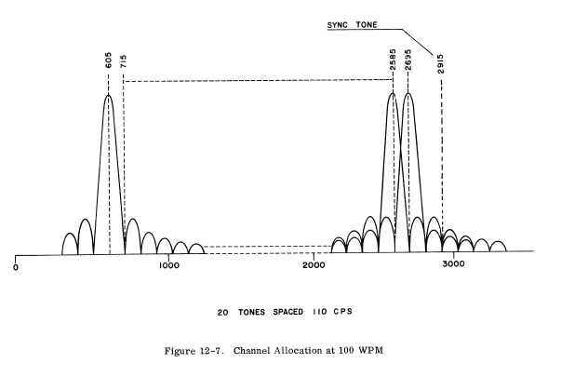
The concept has not changed since 1958!!
Total BW 2090 + 110 = 2200 Hz
20 sub-carriers
Sub-carrier separation = 110 Hz
= 1/18.2 ms
This is an FSK system, but a special one!!

Slide 7
OFDM circa 1959
R. Mosier and R. Clabaugh, Kineplex, a bandwidth efficient binary transmission system, AIEE Proceedings, Vol. 76, January 1958

Slide 8
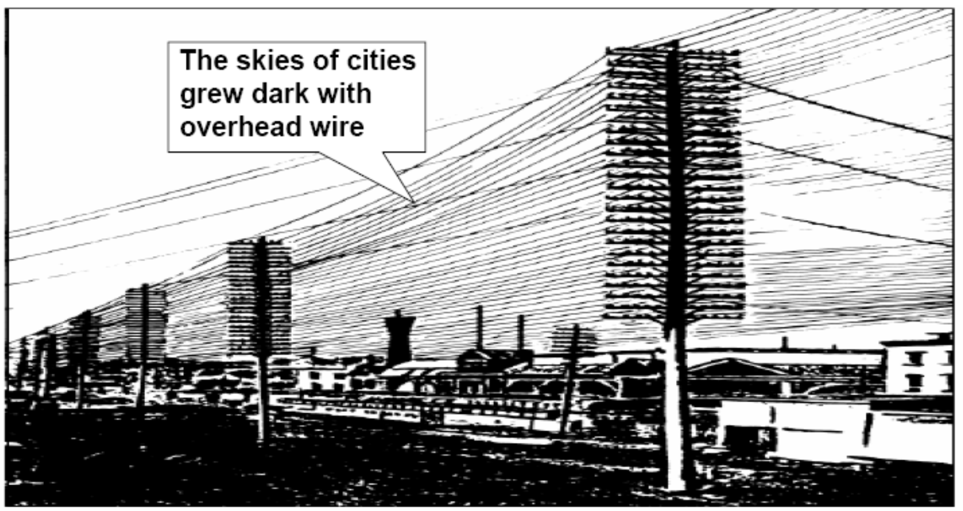
Parallel Communications methods are not new!!

Slide 9
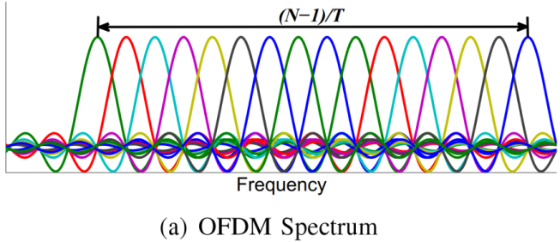
Orthogonal FDM

Slide 10
LTE and 5GNR
Where else is OFDM used?
System | Transform Size | Number Carriers | Channel Spacing kHz | Bandwidth MHz | Sample Rate MHz | Symbol Duration μsec | Data Rate Mbits/s
HyperLAN/2 | 64 | 52 4 | 312.5 | 16.25 | 20 | 3.2 0.8 | 6-54
802.11a | 64 | 52 4 | 312.5 | 16.56 | 20 | 3.2 0.8 | 6-54
DVB-T | 2048 1024 | 1712 842 | 4.464 | 7.643 | 9.174 | 224 | 0.68-14.92
DAB | 2048 8192 | 1536 | 1.00 | 1.536 | 2.048 | 24/48/96 msec | 3.072
ADSL | 256 (down) 64 (up) | 36-127 7-28 | 4.3125 | 1.104 | 1.104 | 231.9 | 0.64-8.192

Slide 11
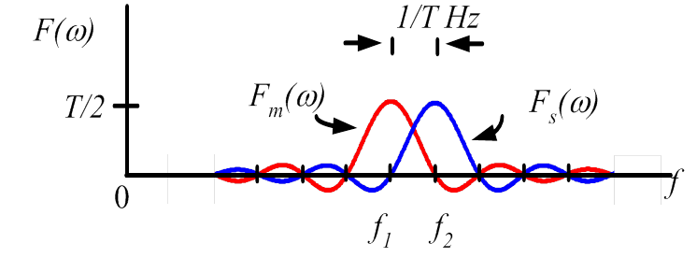
Minimum Shift Keying
(Basis of GSM signals)
Used in GSM

Slide 12
Think of something in between

Slide 13
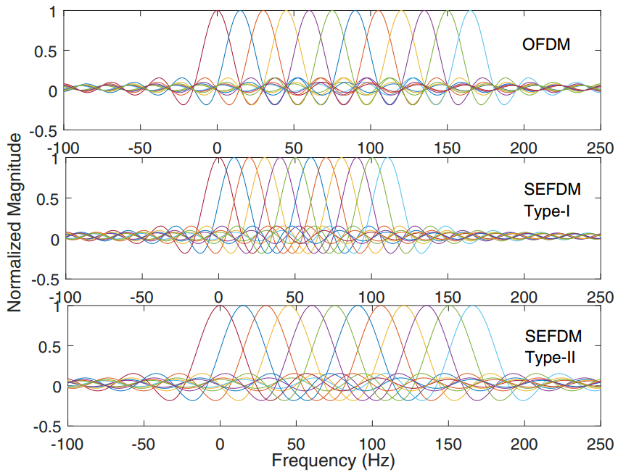
The non-orthogonal signal waveform
OFDM-no saving
Bandwidth saving
Connection increase
Data rate increase
OFDM (12 sub-carriers, data rate is 𝑅𝑏).
SEFDM Type-I (12 sub-carriers, bandwidth compression factor 𝛼=0.67, data rate is 𝑅𝑏).
SEFDM Type-II (12 sub-carriers, bandwidth compression factor 𝛼=0.67, data rate is 1.5𝑅𝑏).

Slide 14
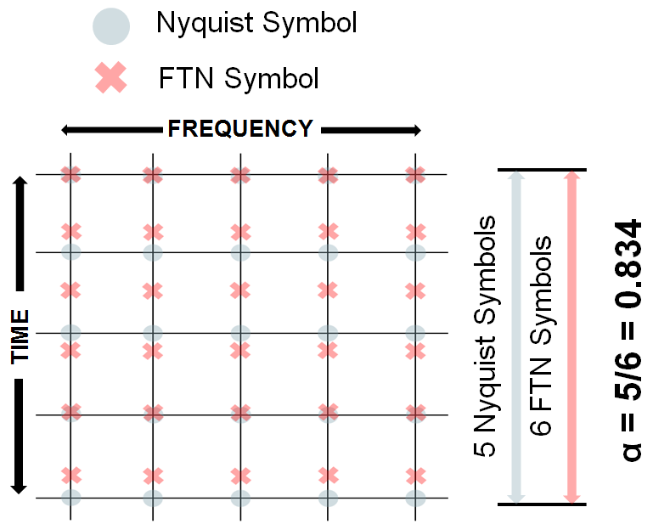
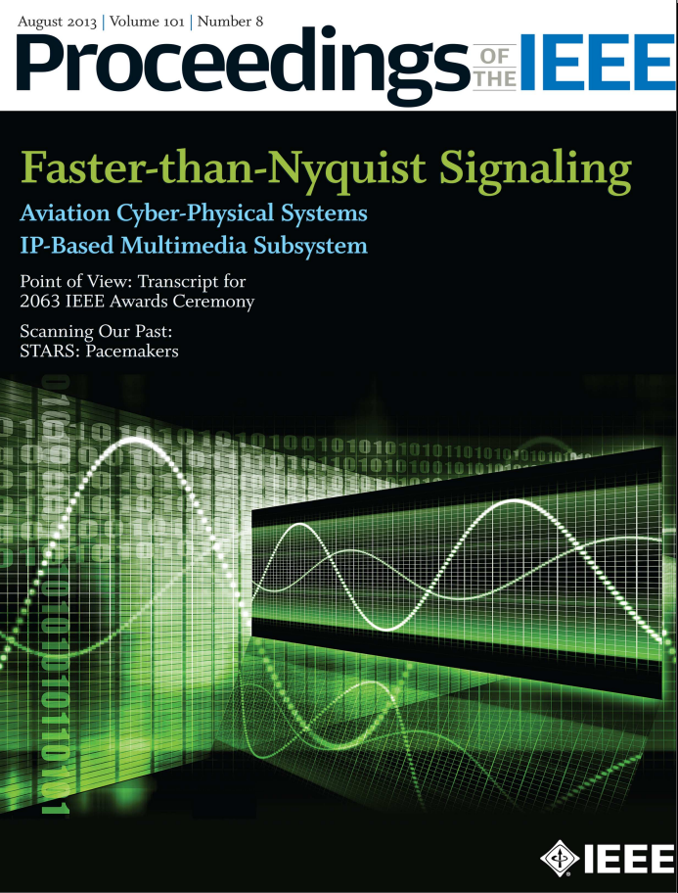
Mutistream Faster Than Nyquist (FTN)
(D. Dasalukunte, F. Rusek, and V. Owall, “An iterative decoder for multicarrier faster-than-Nyquist signaling systems,” in Communications (ICC), 2010 IEEE International Conference on, May 2010, pp. 1–5)
FTN: increase spectral efficiency by transmitting data faster than Nyquist criterion.

Slide 15
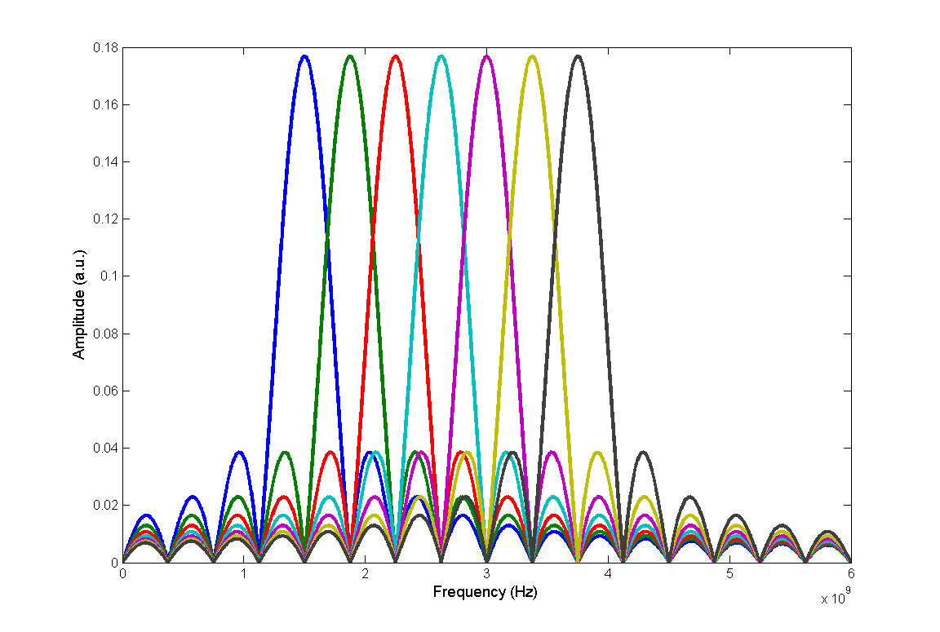
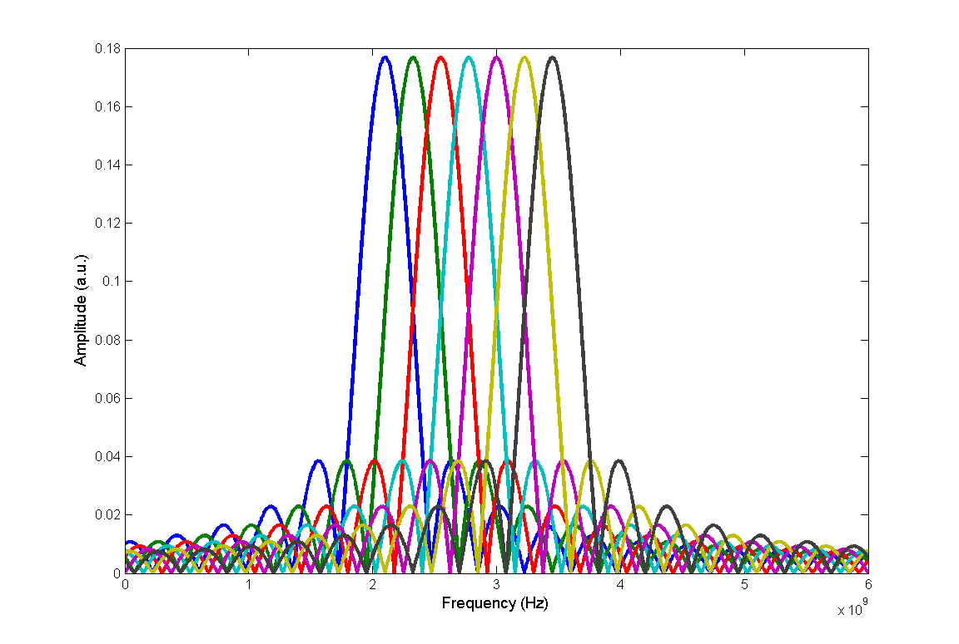
SEFDM: Spectrally Efficient FDM
Bandwidth Saving vs. ICI
Modulation: OFDM
Total QPSK symbol rate: B Baud (Symbol/s)
Modulation: SEFDM
Total QPSK symbol rate: B Baud (Symbol/s)
Bandwidth ≈ B Hz
No ICI
Bandwidth ≈ α∙B Hz, 0<α<1
With ICI

Slide 16
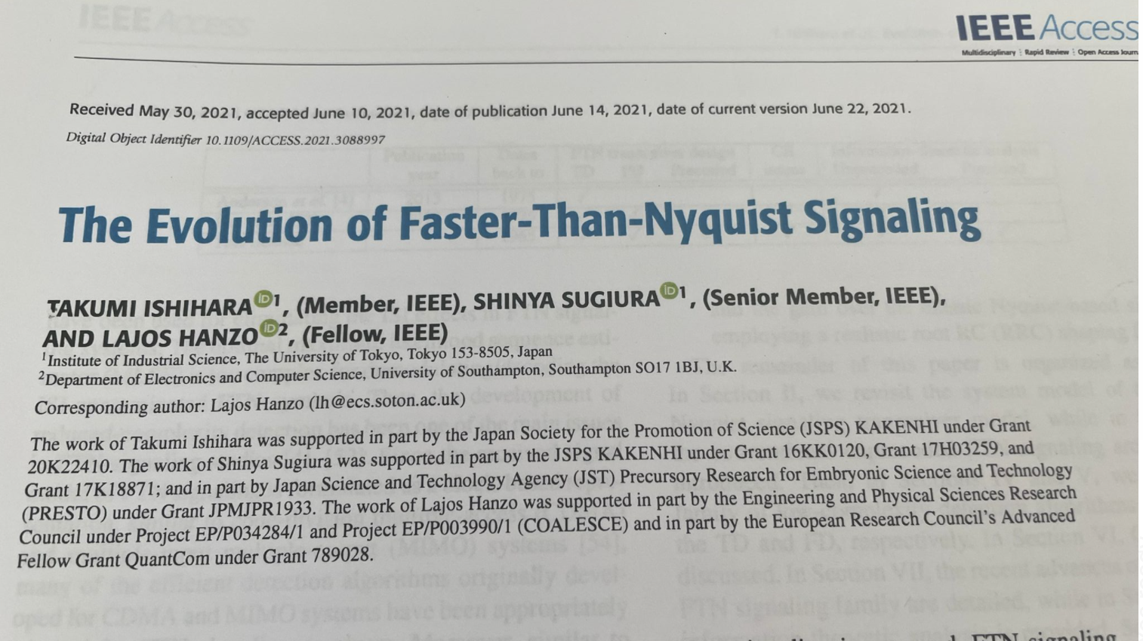
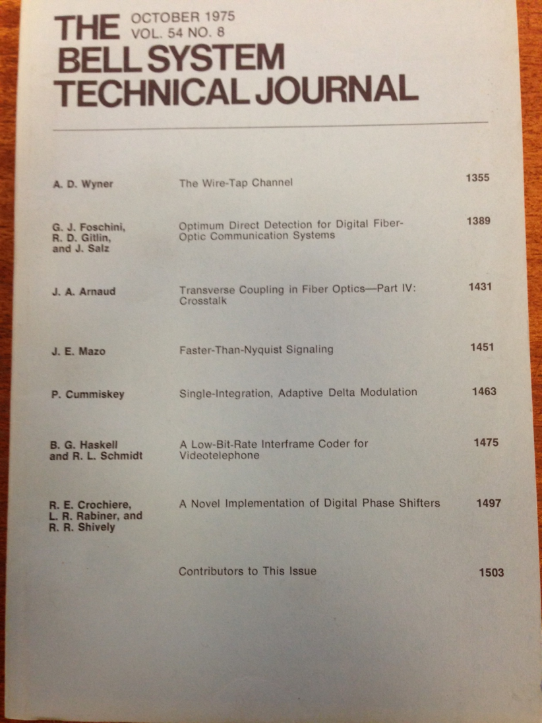
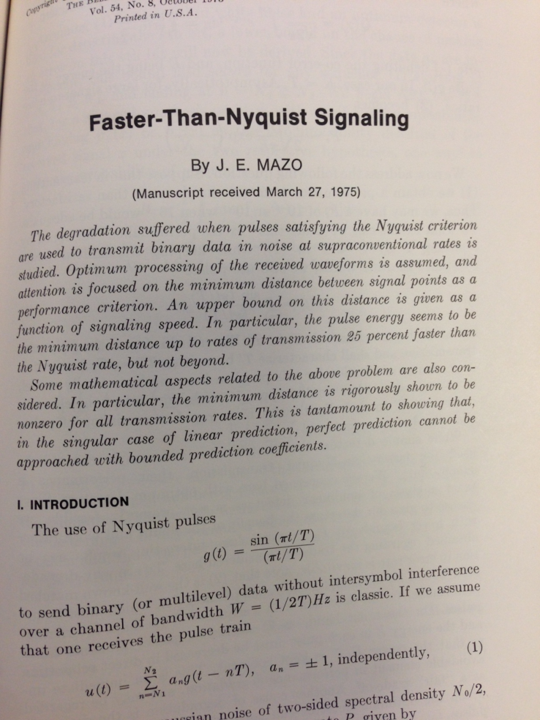
And in 1975…

Slide 17
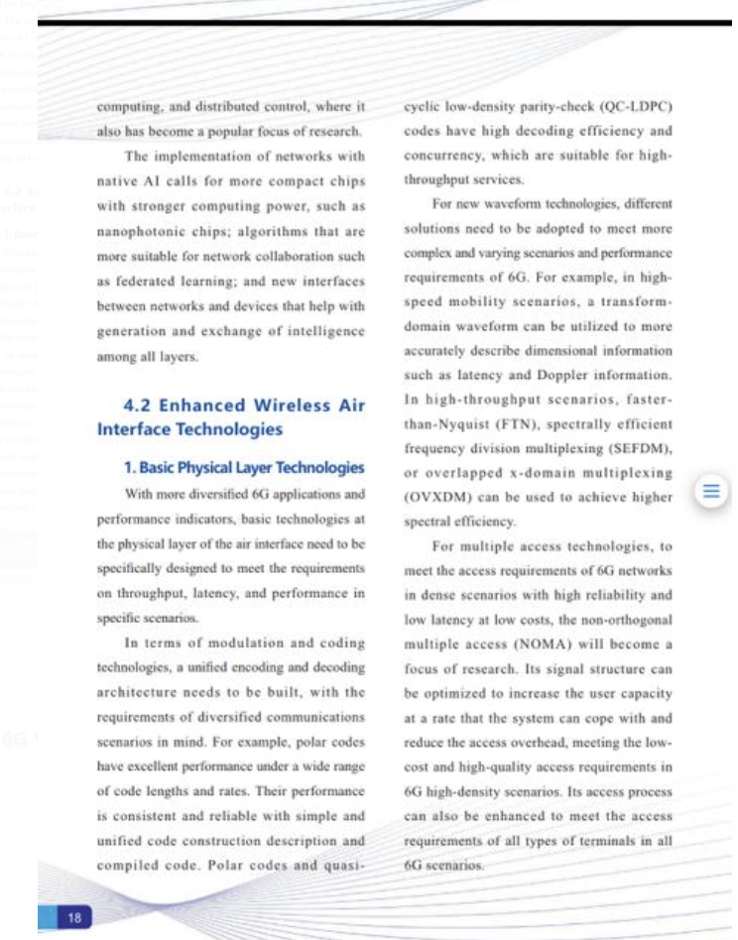
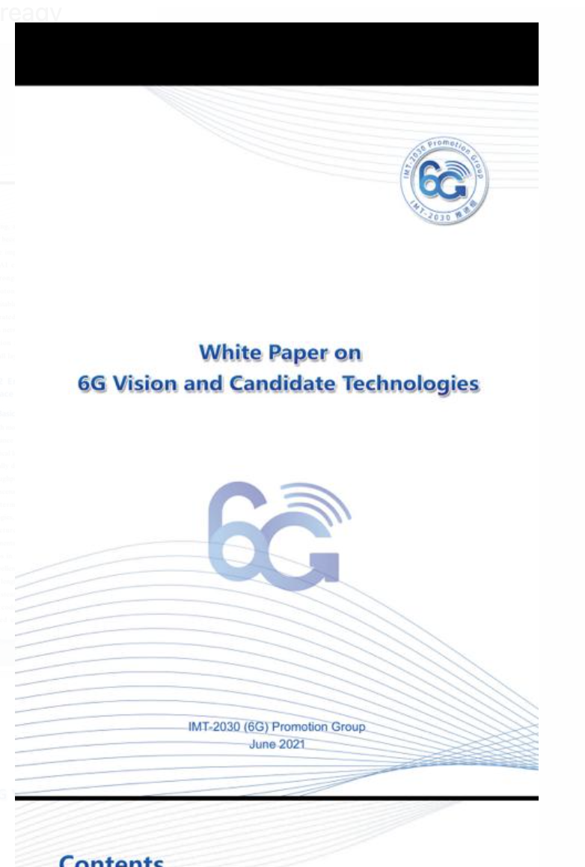
IMT 2030

Slide 18
Challenges
Does it work over different media (wireless and optical)?
Can it be made? SDR techniques; FPGAs; ICs
Practical problems?
Signal generation
Signal detection
Channel estimation
RF engineering, Amplifiers and mm-wave
Synchronisation
Frequency and phase offsets
Coding and FEC
Interference cancellation
Fit within existing standard waveforms and frames
Offer advantages over existing systems in real environments

Slide 19
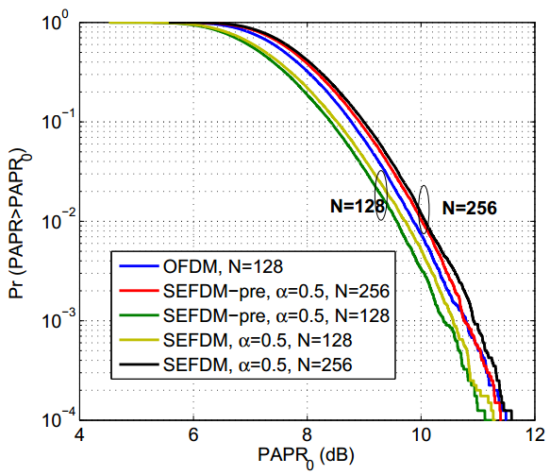
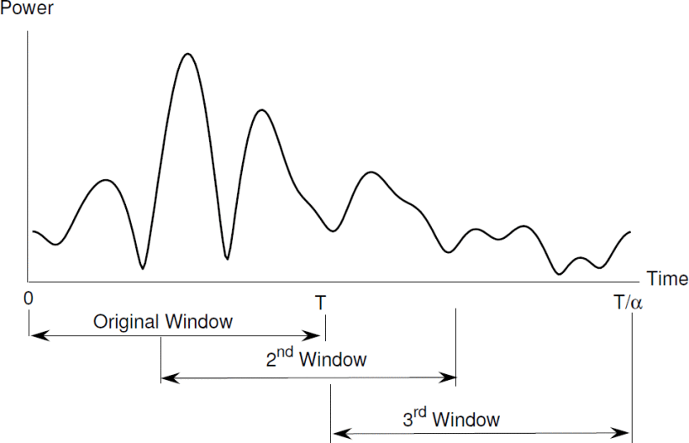
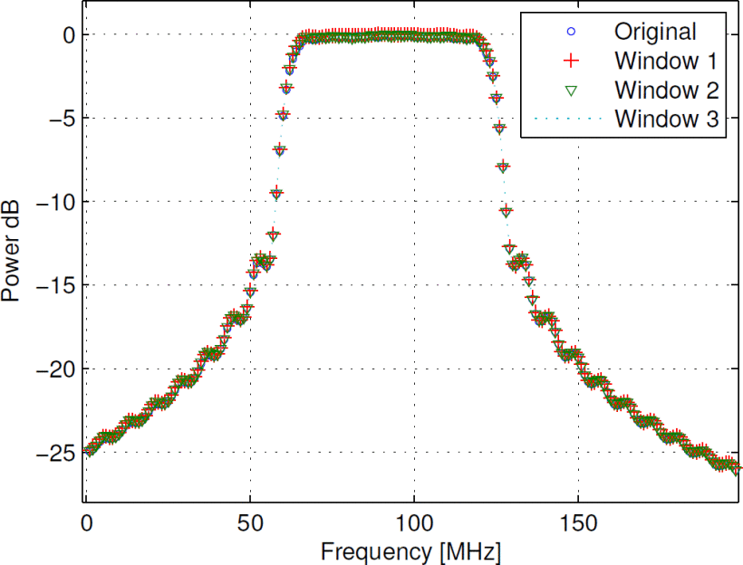
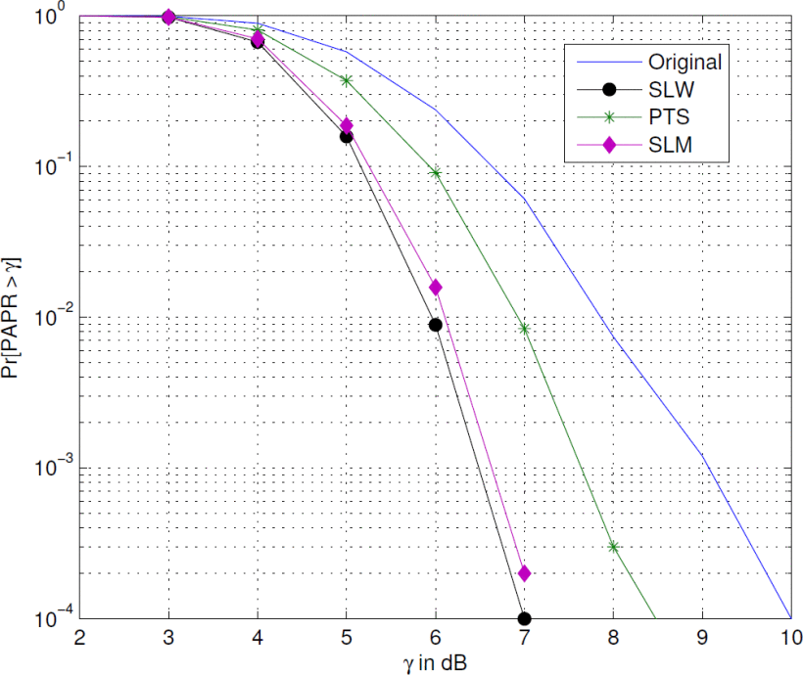
PAPR advantage
Safa Isam and Izzat Darwazeh “Peak to average power ratio reduction in spectrally efficient FDM systems” 18th International Conference on Telecommunications, 2011
Notes:
Abstract:Spectrally efficient FDM (SEFDM) systems are new and attractive multicarrier systems that can significantly enhance spectral utilization. However, as a multicarrier system SEFDM is prone to high peak to average power ratio (PAPR). In this work we present for the first time a study of the PAPR in SEFDM systems. We explore the performance of standard PAPR reduction techniques and propose a novel PAPR reduction algorithm, based on sliding a time window across an extended SEFDM symbol period, therefore termed the SLiding Window (SLW) PAPR reduction technique. Numerical simulations confirm this new technique efficacy in PAPR reduction and show no side effects. Furthermore, a complete transmitter that employs SLW is proposed based on the SEFDM IDFT transmitter. SLW shows remarkable PAPR reduction with no spectral spreading or Bit Error Rate (BER) compromises at a much reduced complexity when compared to standard Partial Transmit Sequence (PTS) and Selective Mapping (SLM) PAPR reduction techniques.

Slide 20
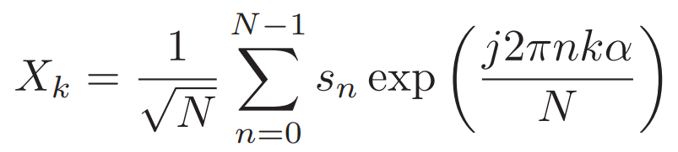
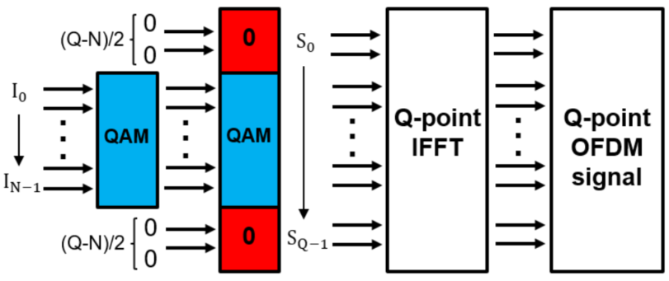
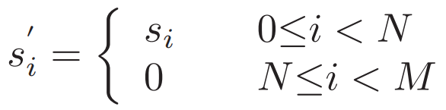
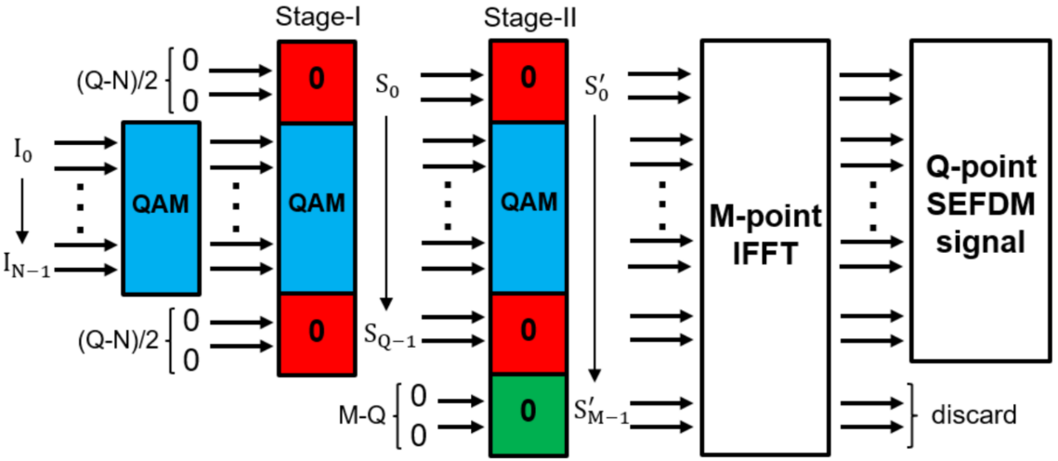
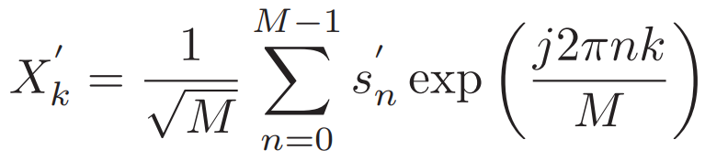
Simple signal generation using IFFT
SEFDM signal generation
Similar to OFDM signal generation
Padding zeros
→
OFDM
→
SEFDM
(SigGen-I)
Truncate to N samples
IFFT is applicable to SEFDM

Slide 21
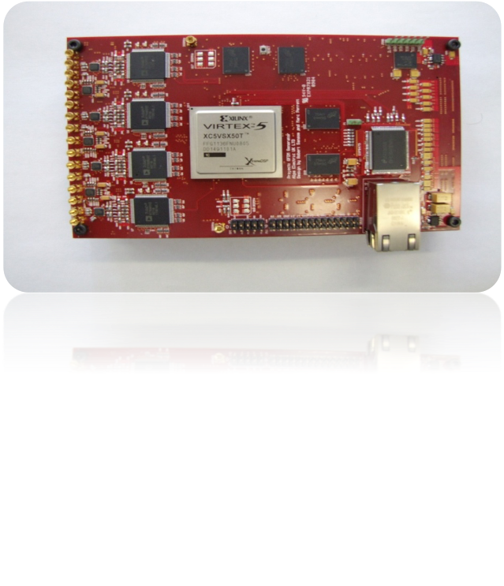
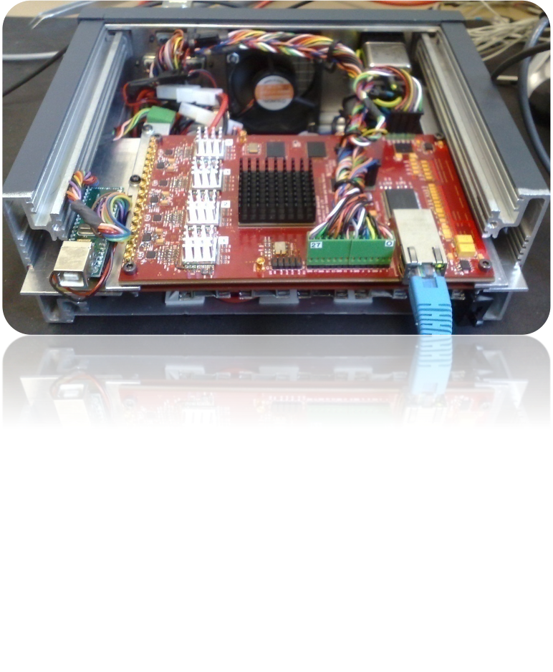
Customized Hardware Transmitter
DAC’s
FPGA
DDR RAM
Metric | Value
Analogue Bandwidth with buffering PER DAC (8 in total) | 150MHz
DAC Resolution | 16-Bit
Max SNR | 106dB
Max sample length/DAC | 300mS
Live streaming – 1 DAC Analogue bandwidth | 31.25MHz
Live streaming – 4 DAC Analogue Bandwidth | 7.125MHz
SPI
Power PCB
Ethernet
M R Perrett and I Darwazeh “Flexible hardware architecture of SEFDM transmitters with real-time non-orthogonal adjustment” 18th International Conference on Telecommunications, 2011, pp.369-374.
Notes:
SPI: Serial Peripheral Interface

Slide 22
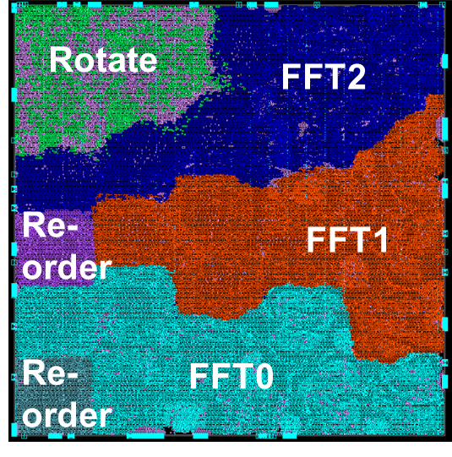
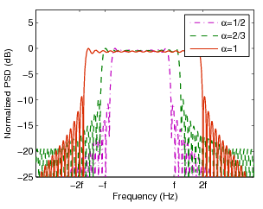
VLSI Transmitter Implementation
[1 ]. P. Whatmough, M. Perrett, S. Isam, and I. Darwazeh, “VLSI architecture for a reconfigurable spectrally efficient FDM baseband transmitter,” IEEE Transactions on Circuits and Systems I: , vol. 59, no. 5, pp. 1107 –1118, may 2012.
1mm
Reconfigurable SEFDM modulator
32nm CMOS process
Throughput of 250 Mbps to 750 Mbps for QPSK – 64QAM

Slide 23
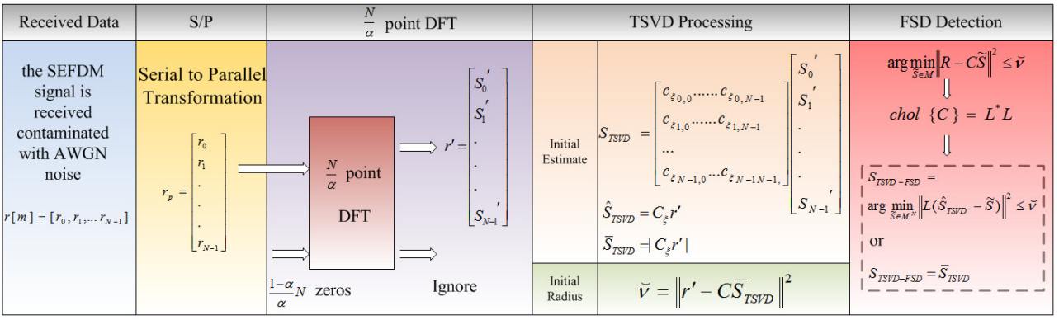
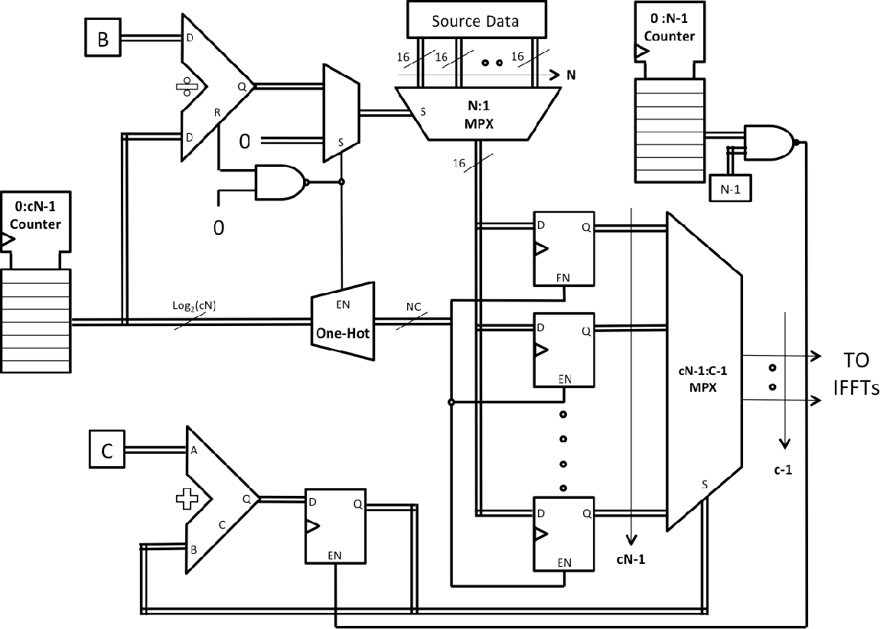
FPGA Implementation of Real-Time Detectors
Operation block diagram of TSVD-FSD
T. Xu, R. C. Grammenos, and I. Darwazeh, “FPGA implementations of real-time detectors for a spectrally efficient FDM system,” in Telecommunications (ICT), 2013 20th International Conference on, 2013, pp. 1–5.

Slide 24
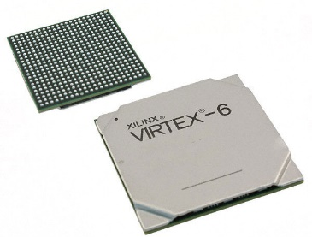
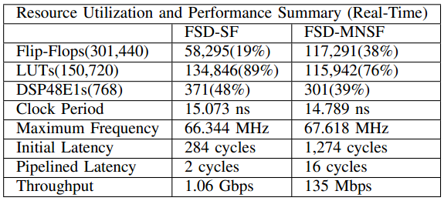
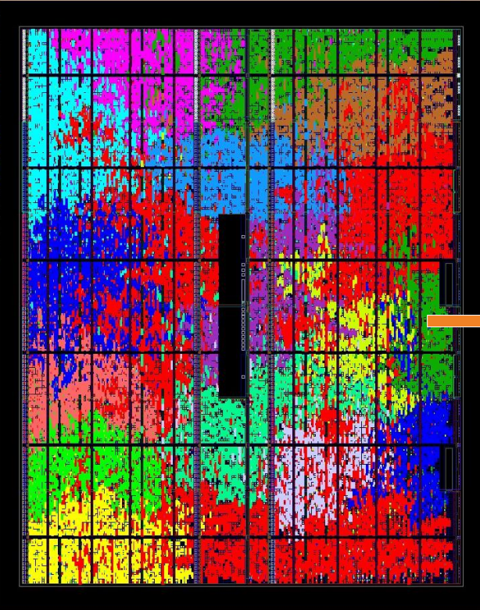
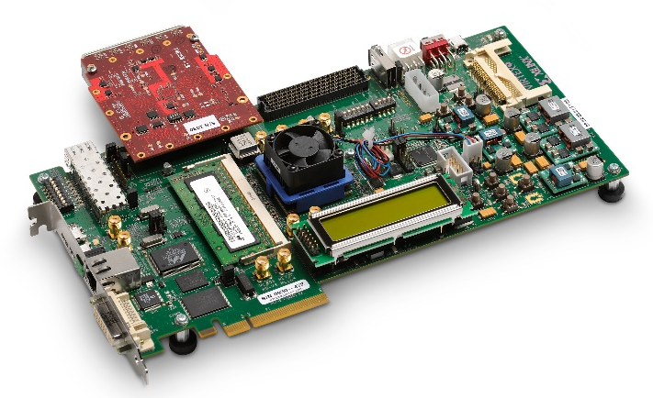
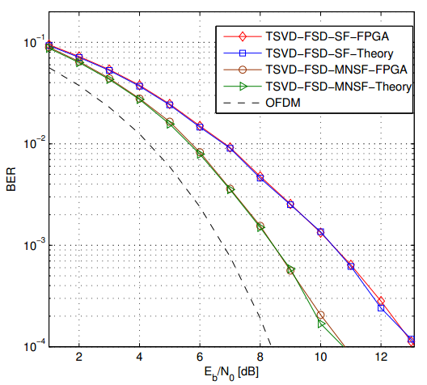
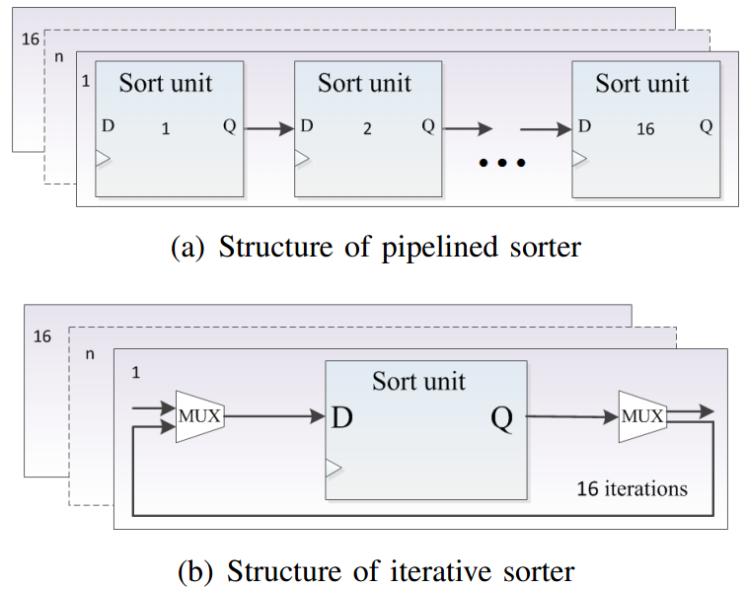
BER performance of the TSVD-FSD-SF and TSVD-FSD-MNSF detector for 4QAM-SEFDM system with α=0.8,N=16,TW=16.
FPGA Implementations of Real-Time Detectors
Virtex-6 FPGA
Occupied resource map

Slide 25
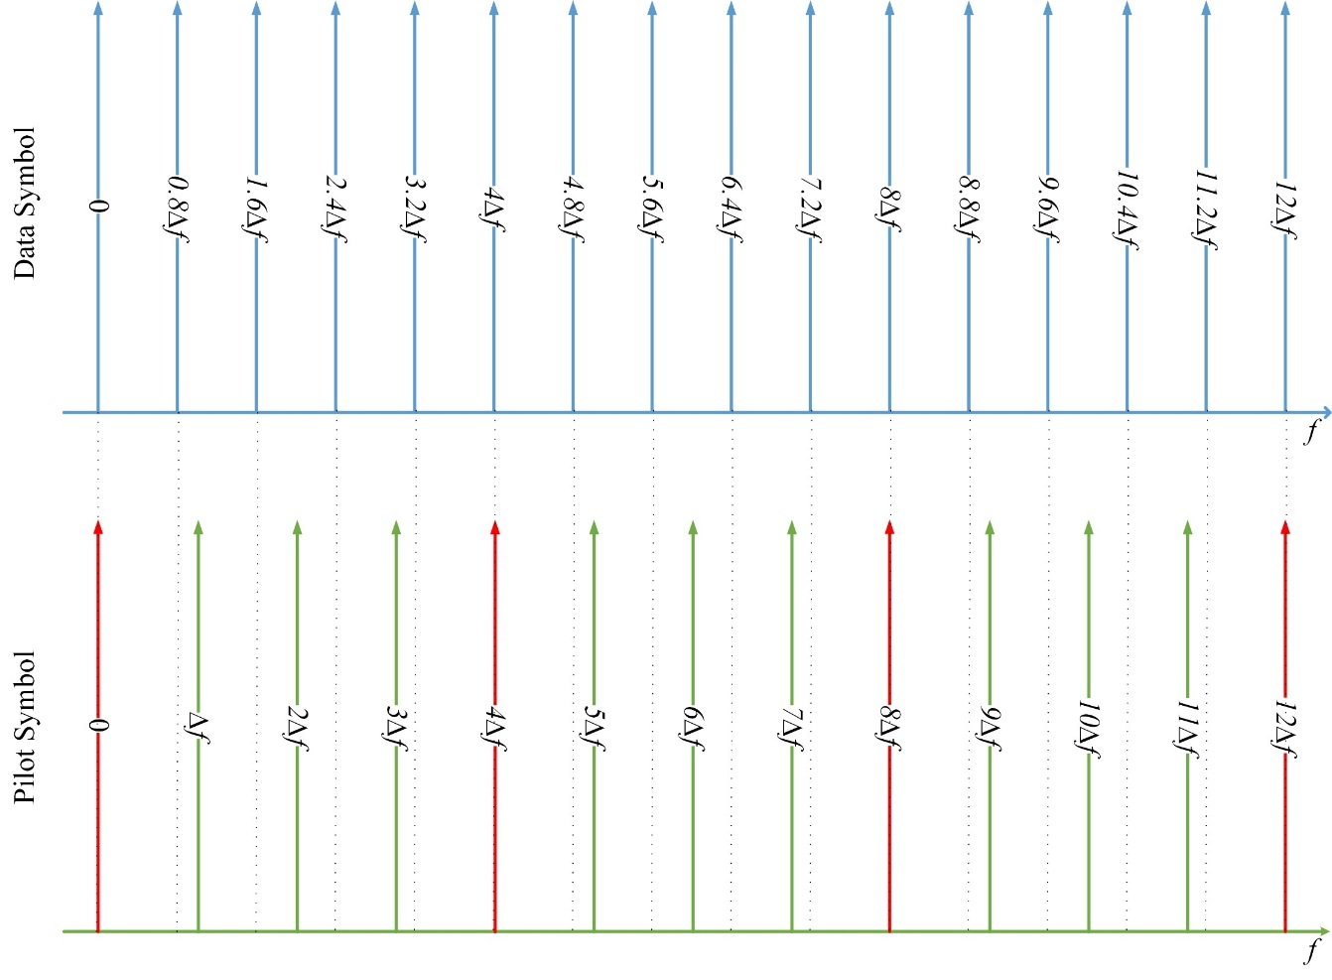
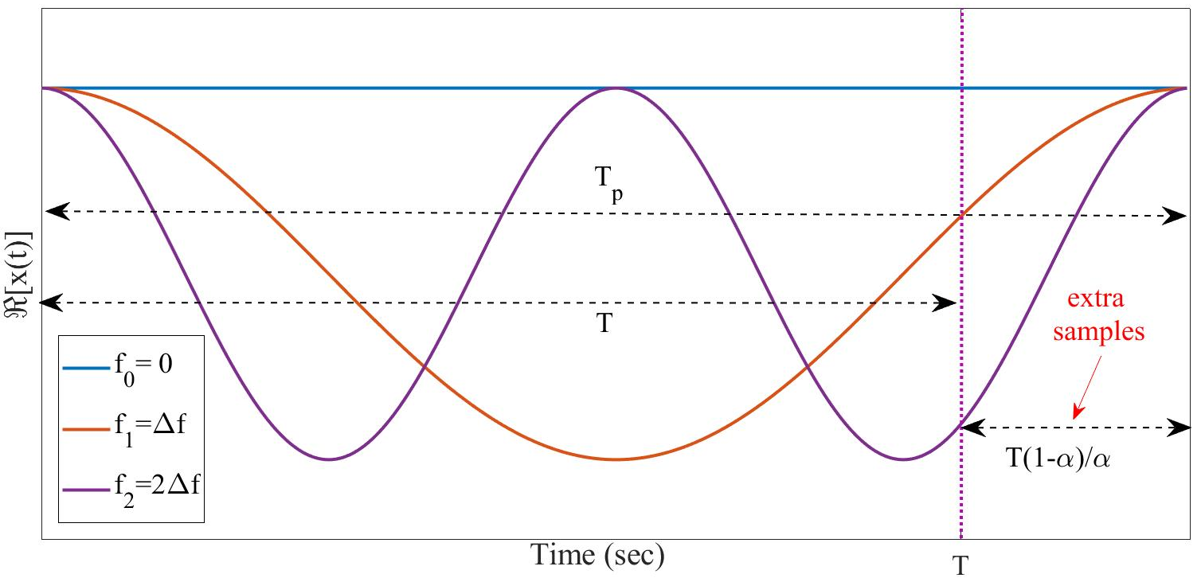
Channel Estimation: OFDM Pilots in SEFDM signals
(a) Time domain
(b) Frequency domain

Slide 26
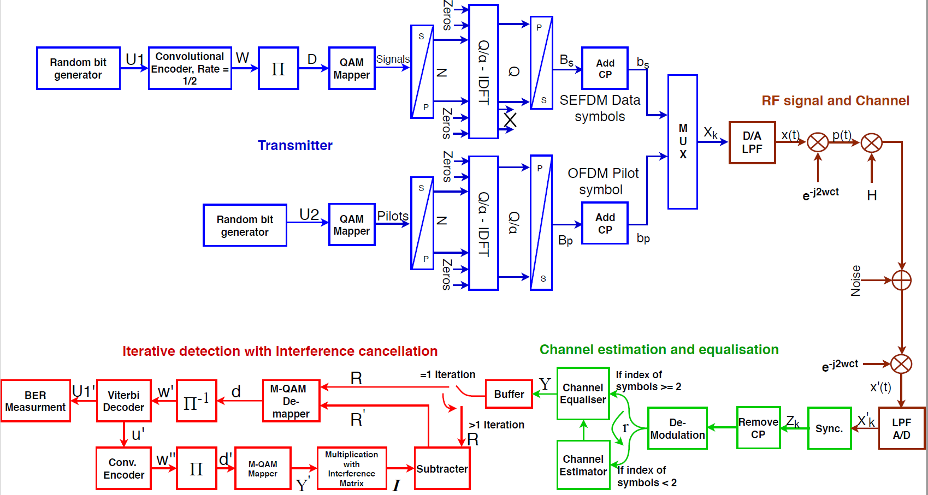
Implementation of real-time SEFDM system
OFDM pilot for channel estimation
Realistic channel and noise using channel emulator
A Pipeline design architecture for SEFDM iterative decoder
Real-time SEFDM using SDR platform (LabVIEW & USRP)
Ozan, Waseem, et al. “Experimental Evaluation of Channel Estimation and Equalisation in Non-Orthogonal FDM Systems." In 2018 11th International Symposium on CSNDSP, IEEE, 2018.
Ozan, Waseem, P. A. Haigh, B. Tan, and I. Darwazeh. “Experimental SEFDM pipelined iterative detection architecture with improved throughput." In 2018 IEEE 87th Vehicular Technology Conference (VTC Spring), pp. 1-5. IEEE, 2018.
Ozan, Waseem, H. Ghannam, P. A. Haigh, and I. Darwazeh. “Experimental implementation of real-time non-orthogonal multi-carrier systems in a realistic fading channel." In Radio and Wireless Symposium (RWS), IEEE, 2018.
Ozan, Waseem, R. Grammenos, H. Ghannam, P. A. Haigh, and I. Darwazeh. “Real-Time SEFDM Transceiver for 5G Systems and Beyond." Personal, Indoor, and Mobile Radio Communications (PIMRC), 2017 IEEE 28th Annual International Symposium on. IEEE, 2017.

Slide 27
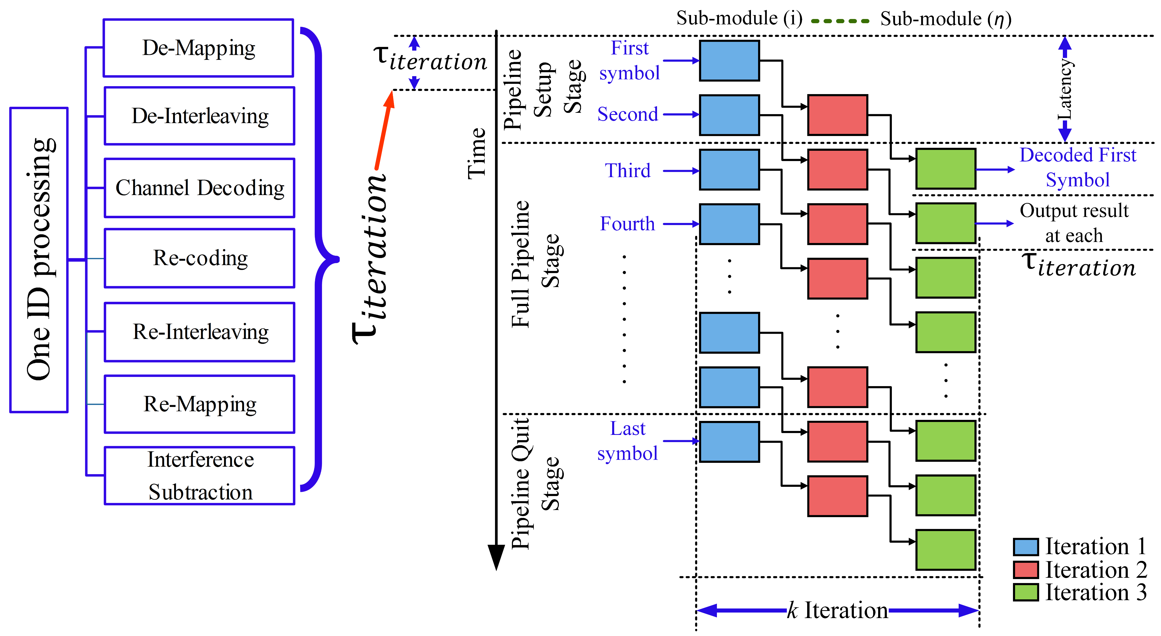
Implementation of real-time SEFDM system
Receiver Pipeline architecture for SEFDM system

Slide 28
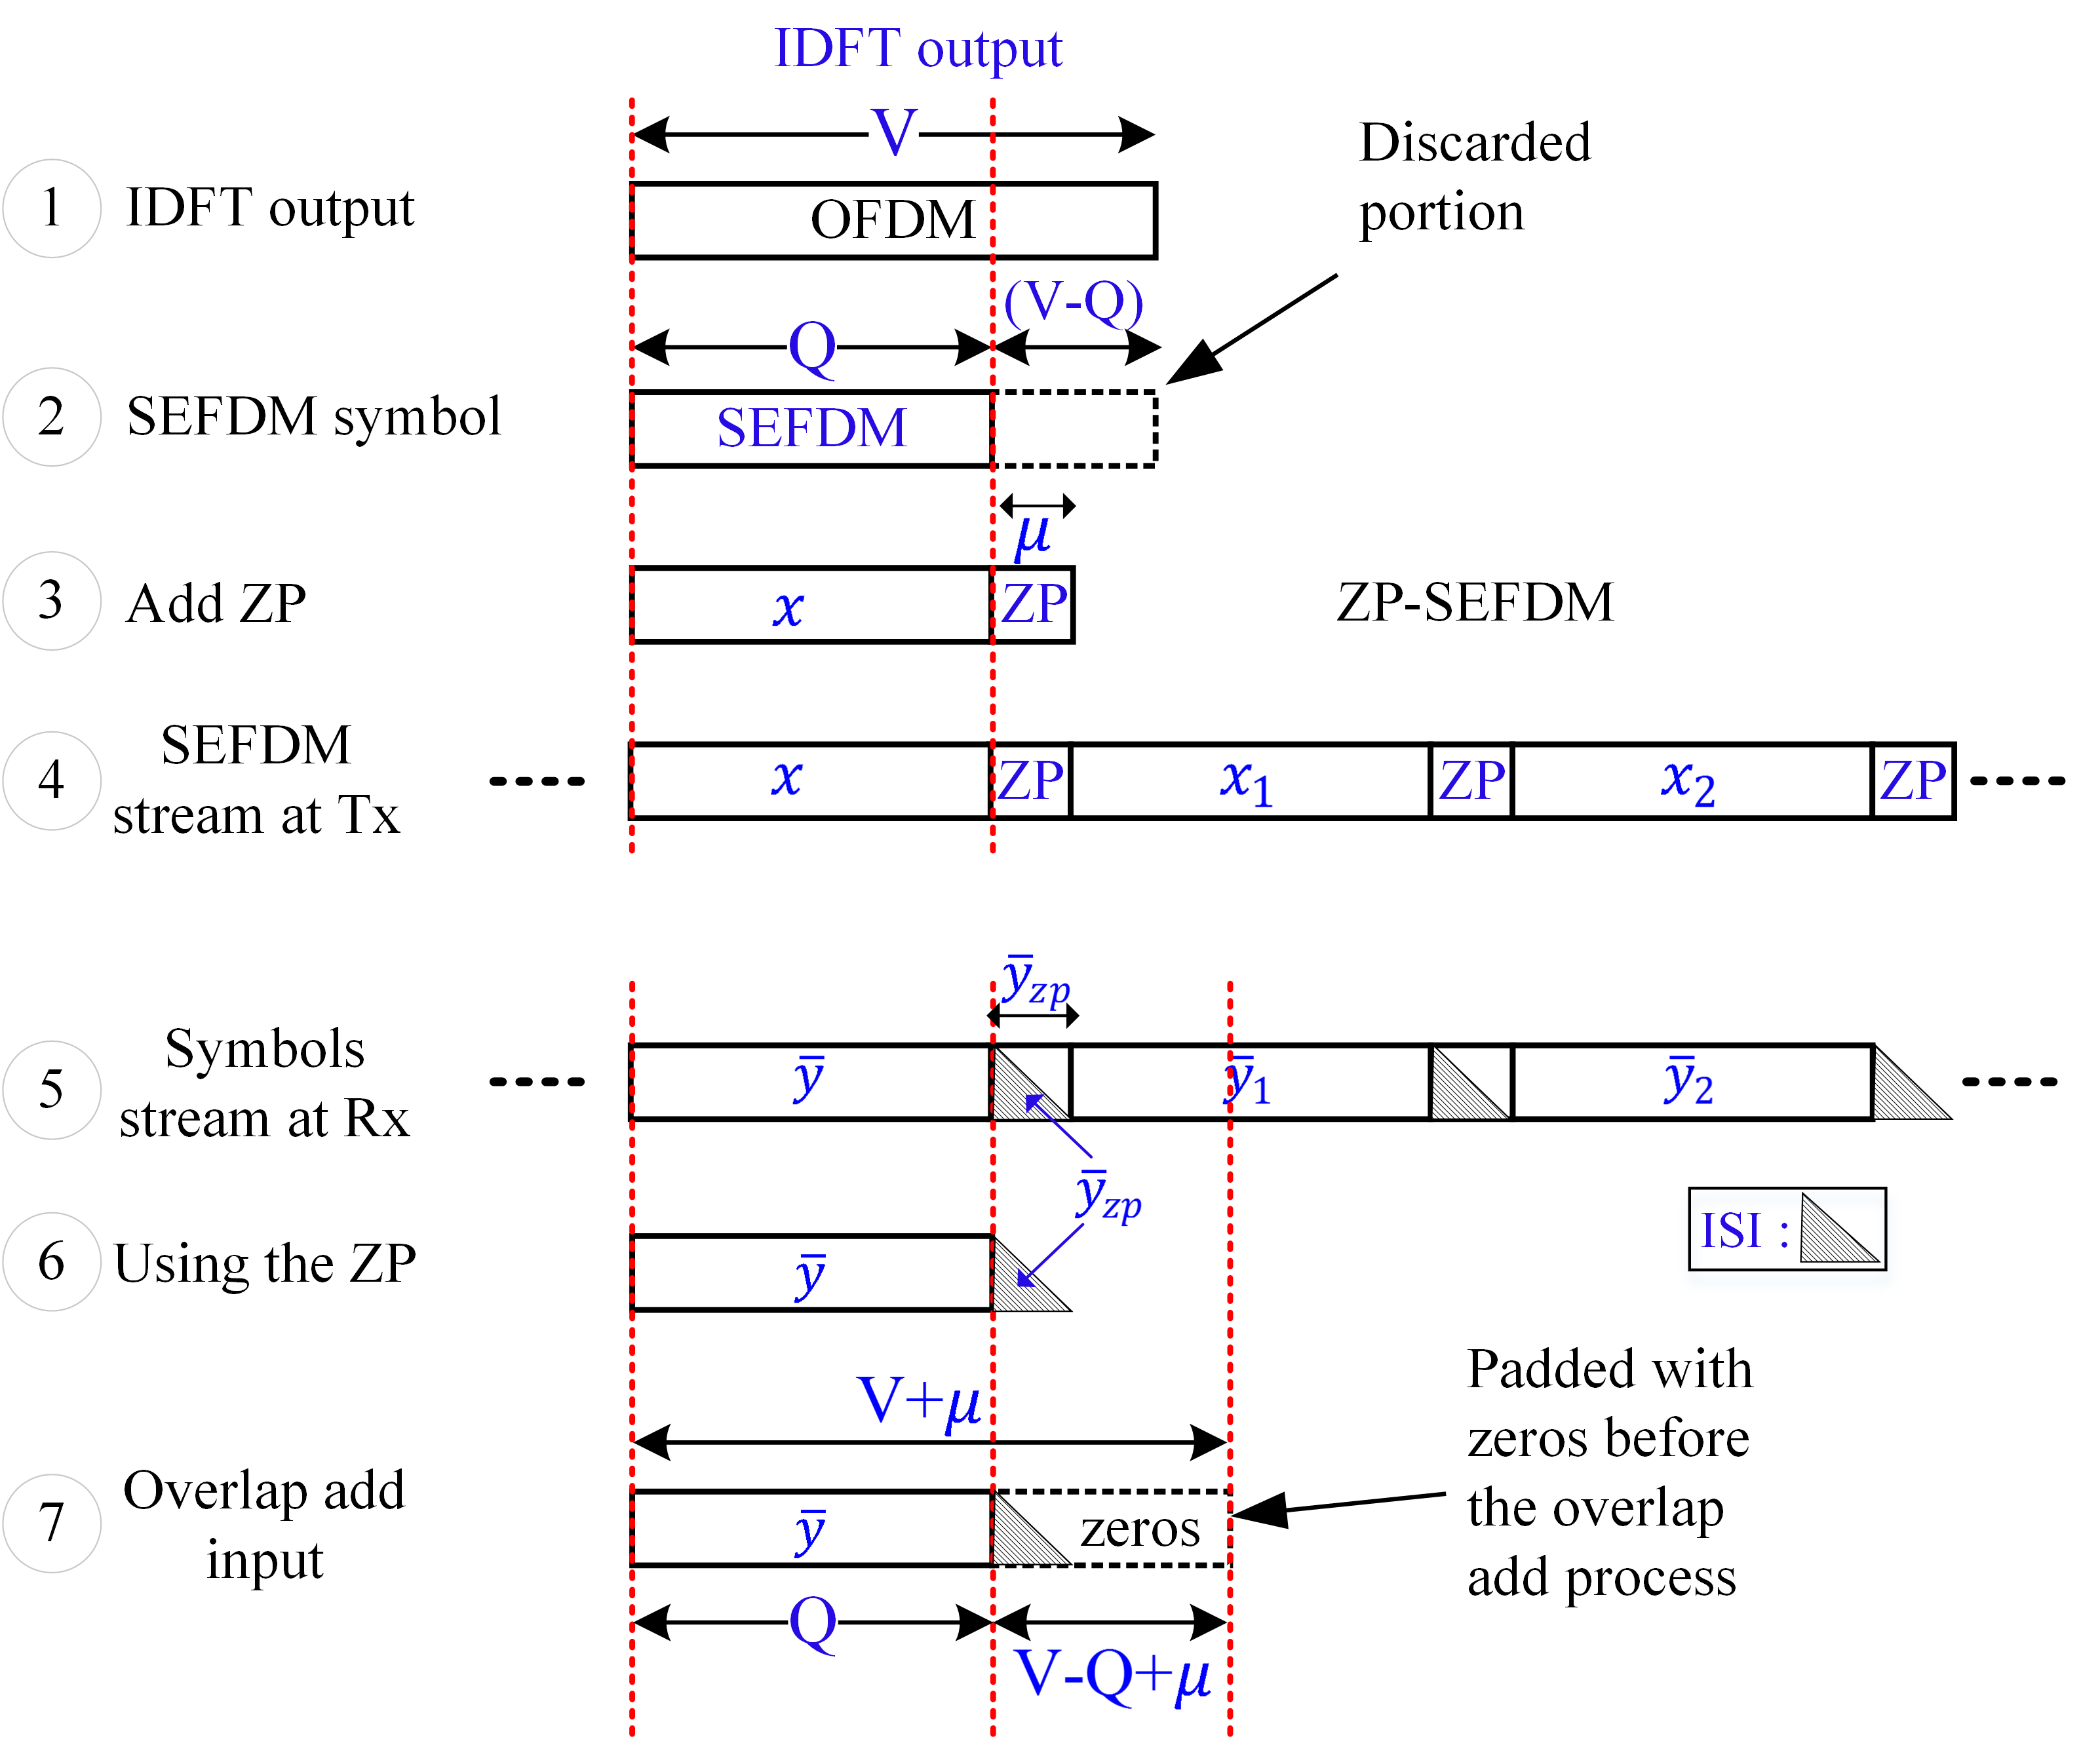
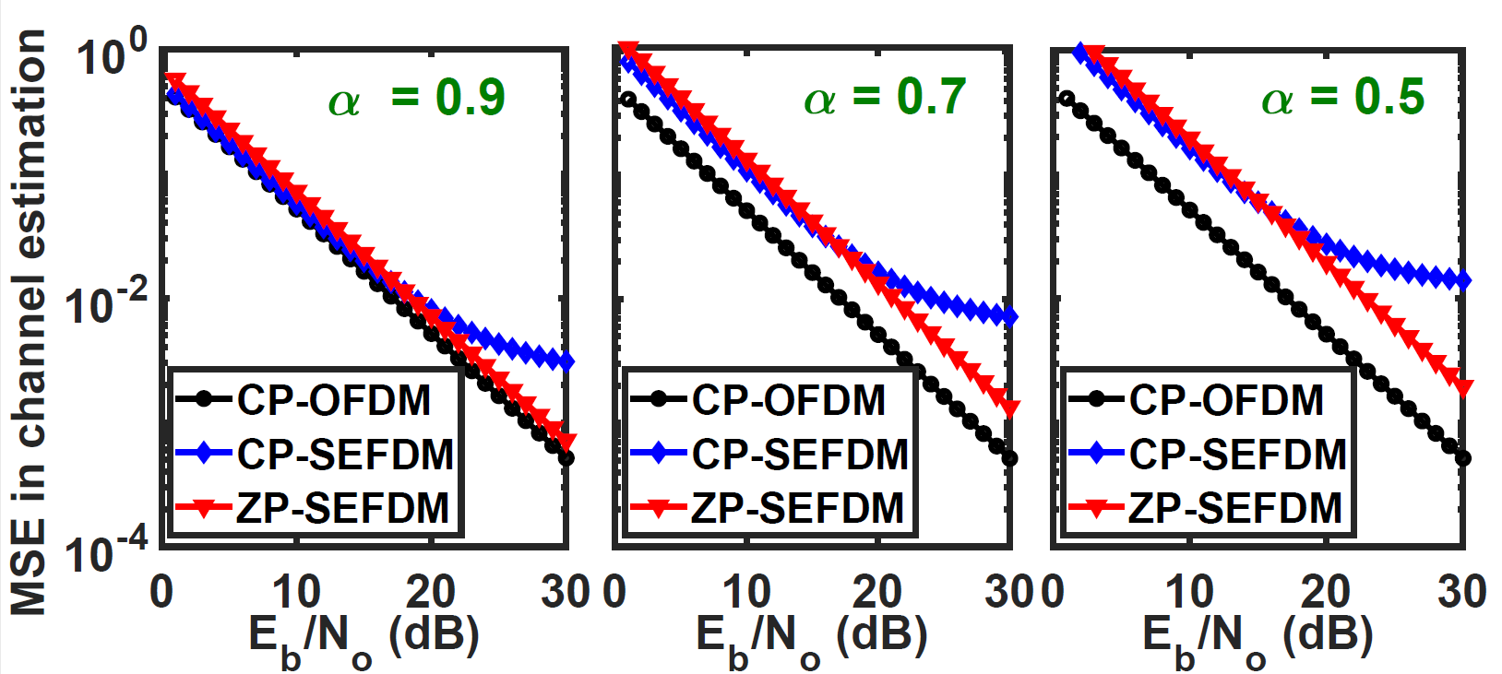
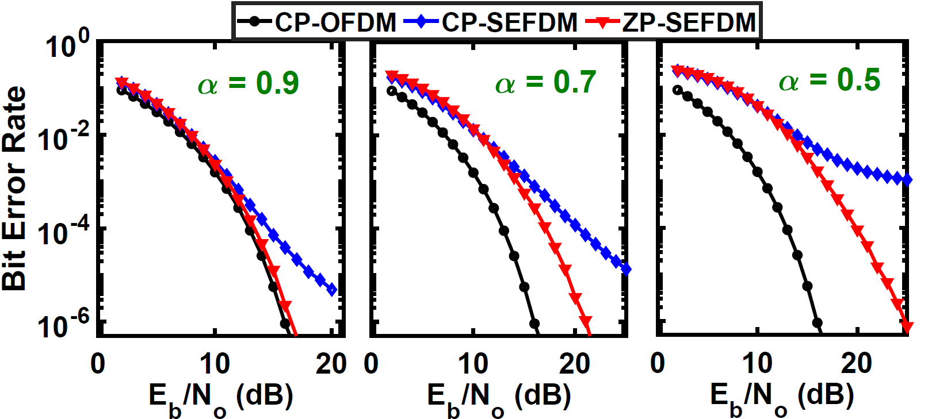
Introduction of zero padding in SEFDM systems
Ozan, Waseem, R. Grammenos, and I. Darwazeh. “Zero Padding or Cyclic Prefix: Evaluation for Non Orthogonal Signals.“ IEEE Communication Letters. IEEE, 2020.

Slide 29
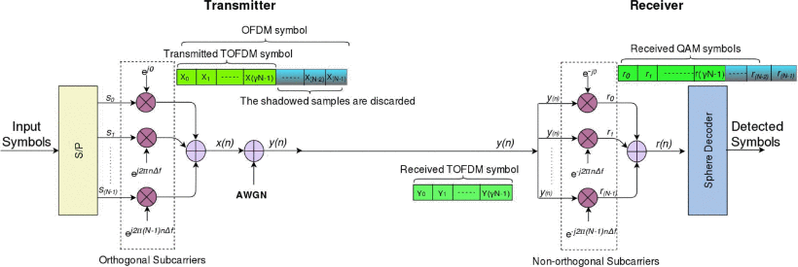
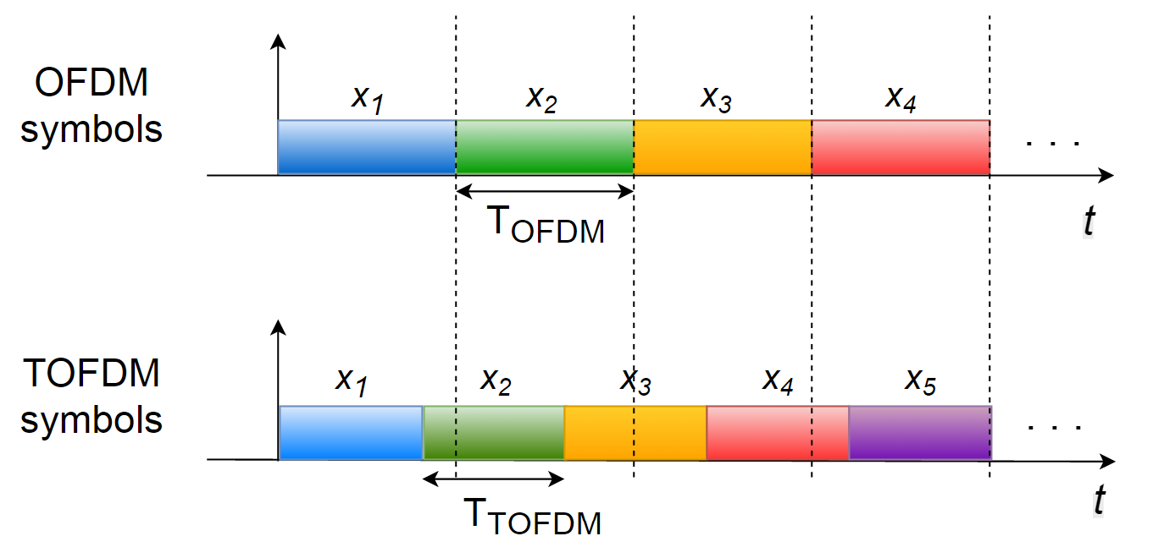
Can be viewed as truncated time domain signals
Advantages in WiFi environments with high interference

Slide 30
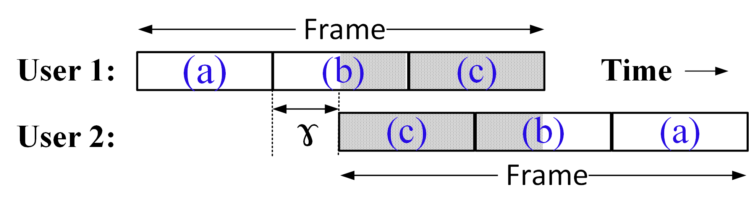
Contribution #4 (1/2): Introduction of PSR to Operate Interfering Wireless Networks in Collision Environments
Developed the TOFDM concept to operate the current 802.11a,g systems successfully in collision environment
Presented a new receiver design termed Partial Symbol Recovery (PSR)
PSR: treats non- and partially-overlapping OFDM symbols differently
Designed and implemented the PSR receiver on WARP SDR platform
Region (a): Collision-free
Region (b): Two partially-overlapping symbols
Region (c): Completely overlapping symbols

Slide 31
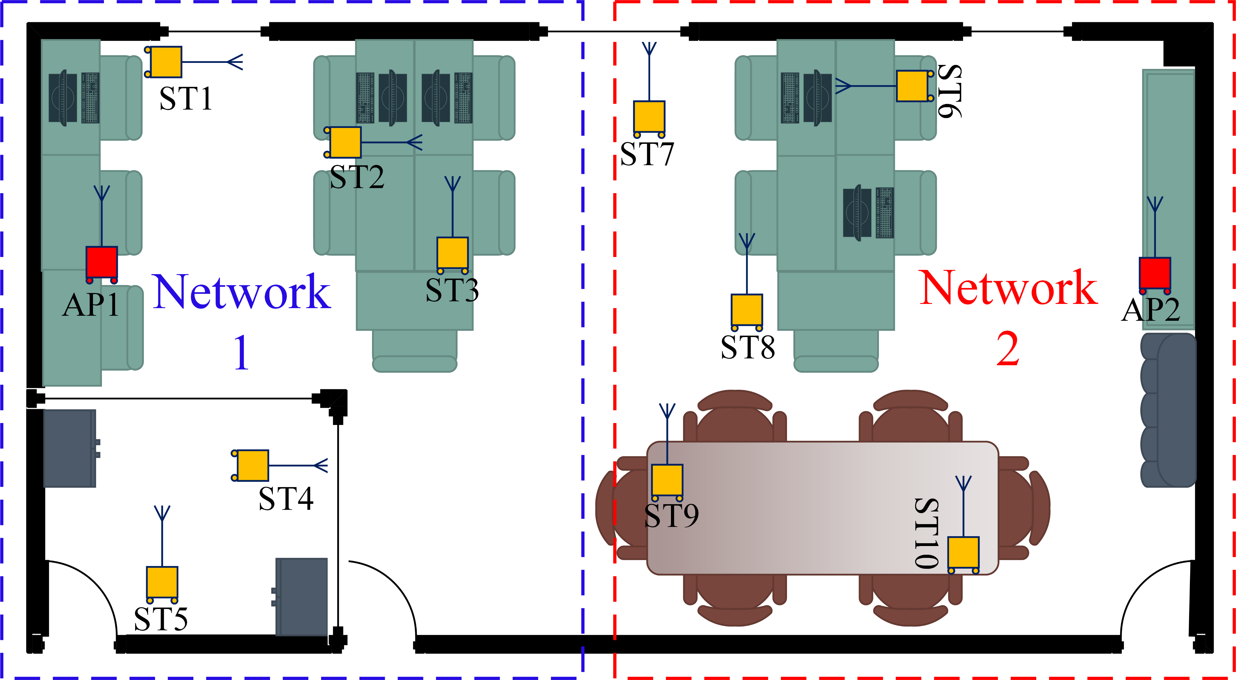
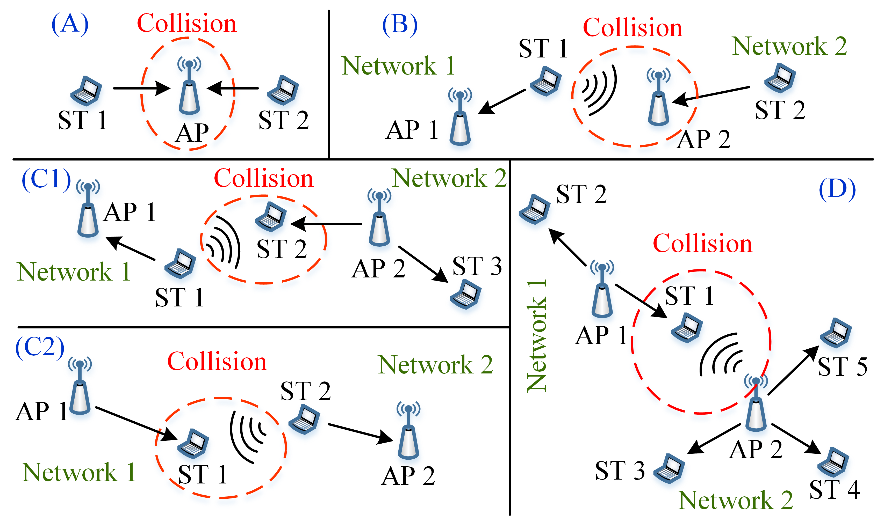
Networks in Collision Environments
Evaluated in 12-node SDR
Non-line-of-sight environment
Two-user data rate region, PSR operates beyond the SIC rate region
Decoding capability, on average 59% and 25% for BPSK and QPSK
Throughput performance, an enhancement of up to 21%
Retransmission performance, a reduction of up to 80%
Ozan, Waseem, I. Darwazeh, and K. Jamieson. “Shifting Perspective to Operate Interfering Wireless Networks Beyond Capacity.“ IEEE/ACM Transaction on Networking, IEEE/ACM, 2020. (under review)

Slide 32
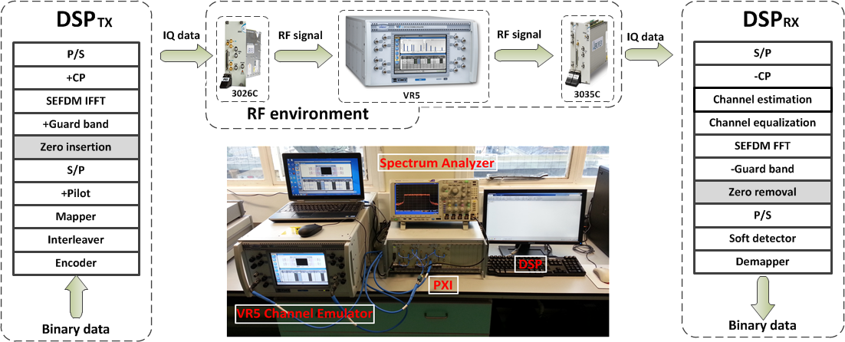
Wireless
[1]. T. Xu and I. Darwazeh, “Bandwidth compressed carrier aggregation,” in IEEE ICC 2015 - Workshop on 5G & Beyond - Enabling Technologies and Applications (ICC’15 - Workshops 23), London, United Kingdom, Jun. 2015, pp. 1107–1112.
[2]. T. Xu and I. Darwazeh, “Practical Implementation of Bandwidth Compressed Carrier Aggregation in a Realistic Fading Channel,” IEEE Transactions on Vehicular Technology, Vol 65, Issue 5, May 2017
[3]. T. Xu and I. Darwazeh, “Nyquist-SEFDM: Pulse Shaped Sub-Carriers with Frequency Spacing Below
the Symbol Rate,” in Wireless Communications and Networking Conference (WCNC), IEEE, 2016.
The above experiment testbed is applicable to two scenarios:
LTE: Single band SEFDM (excluding zero insertion)
LTE-A: Carrier aggregation SEFDM (including zero insertion)
Notes:
This practical idea is submitted to ICC 2015 workshop. 3026C is signal generator; 3035C is digitizer; 3010 is clock; VR5 is channel emulator.
We implemented two systems, one is a single band LTE-SEFDM, the other one is the LTE-Advanced carrier aggregation (CA)-SEFDM system. Both systems can reuse the above experimental setup except for the zero insertion module. This module is designed only for CA-SEFDM due to the protection band between adjacent component carriers (CC)

Slide 33










Wireless: LTE format
A static frequency selective channel is emulated.
Time-domain channel estimation and equalization
Channel Equalization
Channel Equalization
OFDM
SEFDM
α=0.8
Notes:
System specification is shown in the first table.
A static frequency selective channel is configured in the right table.
The top middle figure shows frame structure and resource grid structure.
Spectrum and constellation are measured at 36 dB.
One reference of time-domain channel estimation; constellation before and after channel equalization for OFDM and SEFDM (a=0.8); a time-domain channel estimation and equalization is shown above.
The unit of x-axis is MHz. The bottom left figure is OFDM (the bandwidth is 18.015 MHz), the bottom right is SEFDM (the bandwidth is 18.015*0.8=14.412 MHz).

Slide 34





OFDM
18 MHz
α = 0.8
14.4 MHz
α = 0.6
10.8 MHz
Experimental picture transmission by using SEFDM signal (Eb/No=25 dB).
Notes:
Image transmission through the predefined static frequency selective channel.
The right figures are practical spectra obtained from a spectrum analyzer. It should be noted that a normal spectrum is employed in Turbo-SEFDM system. It is different with B-SEFDM.

Slide 35






Realistic channel (ETU70) measurements
No channel
ETU70-01
The number of NB-IoT sub-carriers is 12 with each occupying 15 kHz and overall bandwidth is 180 kHz (one resource block).
For such a narrow band signal, frequency selective in one resource block exists.
ETU70-02

Slide 36



Wireless: LTE
(a). Performance of different Turbo-SEFDM systems with various levels of bandwidth compressions in the RF environment with frequency selective channel. v is the number of iterations.
(b). Throughput of different Turbo-SEFDM systems computed based on the BER information in Fig (a) and system specifications. v is the number of iterations.
(c). CCDF of PAPR for SEFDM and OFDM systems modulated with 4QAM symbols.
Notes:
Throughput is calculated based on BER information and system specifications on page 20. we remove useless information like pilot symbols, CP, DC part, guard band and coding redundancy.

Slide 37


SEFDM signal waveform
T. Xu and I. Darwazeh, “Transmission experiment of bandwidth compressed carrier aggregation in a realistic fading channel,” IEEE Transactions on Vehicular Technology, vol. 66, no. 5, pp. 4087–4097, May 2017.

Slide 38


SEFDM with carrier aggregation)
Realistic LTE defined multipath fading channel with 5 kHz Doppler spread is used.
Seven signal bands are aggregated in CA-SEFDM while five for CA-OFDM in the same bandwidth.
40% more data can be delivered using the CA-SEFDM scheme.
Data rates:
LTE: 50 Mbit/s
SEFDM: 70 Mbit/s
(a). Performance of different CA-SEFDM systems in the condition of real RF environment with the LTE EPA5 fading channel.
(b). Effective spectral efficiency (bit/s/Hz) of different CA-SEFDM systems computed based on the BER information and the system specifications.

Slide 39



Reconfigurable IFFT to Generate SEFDM 5G NR Signals
H. Ghannam and I. Darwazeh. A Proposal for Scalable 5G New Radio Frames with Enhanced Throughput. In IEEE 89th Vehicular Technology Conference (Spring), Kuala Lumpur, April 2019.

Slide 40

Block Error Rate of Coexisting system employing LDPC
Figure 9: BLER performance for the coexisting systems in three scenarios using LDPC coding, N = 12, coding rate 1/3
Xinyue Liu;Tongyang Xu and Izzat Darwazeh,
“Coexistence of Orthogonal and Non-orthogonal Multicarrier Signals in Beyond 5G Scenarios
2020 2nd 6G Wireless Summit (6G SUMMIT),

Slide 41

Complex modulation and probabilistic shaped SEFDM
Use of ML on 5G-like signals to design signal, modulation and constellation

Slide 42

Same bandwidth but higher rate, probabilistic shaping improves efficiency
X. Liu etal, Spectrally Efficient FDM System with Probabilistic Shaping, submitted to VTC fall (in May 2021)

Slide 43

Fast-OFDM signal waveform
A simple format, half the bandwidth and IoT applications and for VLC
M. R. D. Rodrigues and I. Darwazeh, “Fast OFDM: A proposal for doubling the data rate of OFDM schemes” Proceedings of the IEEE/IEE International Conference on Telecommunications (ICT 2002), vol. 3, pp. 484-487, Beijing, China, June 2002. (invited paper)
T. Xu and I. Darwazeh, “Non-orthogonal narrowband Internet of Things: A design for saving bandwidth and doubling the number of connected devices,” IEEE Internet of Things Journal, vol. 5, no. 3, pp. 2120–2129, Jun. 2018.
P. A. Haigh, A. Burton, Z. Ghassemlooy, I. Darwazeh, “Visible Light Communications: Simplified Co-Equalisation of Fast OFDM in a Multiple-Input Multiple-Output Configuration”, International Telecommunications Conference (ICT), April 2019, Hanoi-Vietnam.

Slide 44


Direct Detection Optical-SEFDM
→ Bandwidth compression of electrical spectrum saves protection gap in optical spectrum
Electrical spectrum
Optical spectrum
I. Darwazeh, T. Xu, T. Gui, Y. Bao, and Z. Li, “Optical SEFDM system; bandwidth saving using non-orthogonal sub-carriers,” Photonics Technology Letters, IEEE, vol. 26, no. 4, pp. 352–355, Feb 2014

Slide 45




Direct Detection Optical-SEFDM
→ World first practical nonorthogonal system experiment (2013)
B2B
80 km
Data rate = 10 Gbit/s.
Modulation: 4QAM, 8QAM
Number of subcarrier = 16.
Cyclic prefix: 1/16
Bandwidth compression factor α= 0.7, 0.75, 0.80, 0.9 and 1.
4QAM-SEFDM (SE=2.86 bit/s/Hz) outperforms 8QAM-OFDM (SE=3 bit/s/Hz) by 1.6 dB

Slide 46
SEFDM over optical channels
[1]. D. Nopchinda, T. Xu, R. Maher, B. Thomsen, and I. Darwazeh, ”Dual polarization coherent optical
spectrally efficient frequency division multiplexing,” Photonics Technology Letters, IEEE, vol. 28, no. 1,
pp. 83–86, Jan 2016.
Experimental setup of PDM-CO-SEFDM transmission system
Notes:
A detailed description of the experiment setup is referred to the un-submitted CO-SEFDM PTL paper.

Slide 47


Optical: Coherent
50% bit rate increase
3.5dB power penalty
24 Gbit/s 4QAM
BER as a function of OSNR, B2B (left) and 80 km link
D. Nopchinda, T. Xu, R. Maher, B. Thomsen, and I. Darwazeh, “Dual polarization coherent optical spectrally efficient frequency division multiplexing,” IEEE Photonics Technology Letters, vol. 28, no. 1, pp. 83–86, Jan 2016.

Slide 48




60 GHz Millimeter Wave Communication
60 GHz parabolic antennas have 30 dBi gain; and 3 dB beamwidth of 3.1◦ are employed.
A 30 dB gain high power amplifier (HPA) at the transmitter and a 30 dB gain low noise amplifier (LNA) at the receiver.
Transmission distances from few cm to 3 metres.
T. Xu, S. Mikroulis, J. E. Mitchell, and I. Darwazeh, “Bandwidth compressed waveform for 60-GHz millimeter-wave radio over fiber experiment,” Journal of Lightwave Technology, vol. 34, no. 14, pp. 3458–3465, July 2016.

Slide 49


Experimental results for the 60 GHz mm-wave SEFDM-2
BER measurements
Iteration study
Within the same bandwidth, bit rate can be increased by up to 67%.
4QAM α=0.67 outperforms the 8QAM OFDM have the same spectral efficiency. SEFDM has with 1 dB performance gain.
The 4QAM α=0.6 outperforms the 8QAM OFDM in both spectral efficiency and BER performance.
OFDM: no iteration.
SEFDM: at least one iteration.

Slide 50

Experimental results for the mm-wave SEFDM-3
Bit rate (Gbit/s) measurements
SEFDM results in better throughput in both net and gross bit rates.
Gross bit rate: Achievable non-error bits per second including overhead.
Net bit rate: Achievable non-error bits per second without overhead.
A lower order modulation format 4QAM shows higher bit rate than a higher order format 8QAM over the same bandwidth.

Slide 51



SEFDM Signals Transmission over the E-band
H. Ghannam, D. Nopchinda, M. Gavell, H. Zirath, and I. Darwazeh. Experimental Demonstration of Spectrally Efficient Frequency Division Multiplexing Transmissions at E-Band. IEEE Transactions on Microwave Theory and Techniques, 67(5):1911–1923, March 2019.

Slide 52





Broadband Amplifiers with 200 GHz + BW
K. Eriksson, I. Darwazeh and H. Zirath, " InP DHBT Distributed Amplifiers With Up to 235-GHz Bandwidth", IEEE Transactions on Microwave Theory and Techniques, Vol. 63, Issue 4, pp. 1334-1341, April 2015.

Slide 53




Wireless: E-band (82-68 GHz)
UCL Collaboration with Chalmers University and Gotmic-Sweden
8 Gbit/s and BW reduced from 4 GHz to 2.67 GHz
Notes:
A detailed description of the experiment setup is referred to the un-submitted CO-SEFDM PTL paper.

Slide 54
60 GHz mm-wave Radio Over Fiber SEFDM
[1]. S. Mikroulis, T. Xu, J. E. Mitchell and I. Darwazeh, ”First demonstration of a spectrally efficient FDM radio over fiber system topology for beyond 4G cellular networking,” in Networks and Optical Communications - (NOC), 2015 20th European Conference on, Jun. 2015, pp. 1–5.
[2]. S. Mikroulis, T. Xu, and I. Darwazeh, “Practical demonstration of spectrally efficient FDM millimeter-wave radio over fiber systems for 5G cellular networking,” in Proc. SPIE, vol. 9772, 2016, pp. 97 720I– 1–97 720I–8.
[3]. T. Xu, S. Mikroulis, J. E. Mitchell and I. Darwazeh, ” Bandwidth Compressed Waveform for 60 GHz
Millimeter-Wave Radio over Fiber Experiment,” Lightwave Technology, Journal of. 2016.
85 GHz mm-wave SEFDM
Experimental Demonstration of Spectrally Efficient Frequency Division Multiplexing Transmissions at E-Band Hedaia Ghannam;Dhecha Nopchinda;Marcus Gavell;Herbert Zirath;Izzat Darwazeh IEEE Transactions on Microwave Theory and Techniques Year: 2019 | Volume: 67, Issue: 5

Slide 55



Half-Sinc signal waveform
T. Xu and I. Darwazeh, “Half-Sinc Waveform Design for Narrowband IoT,” in IEEE 29th Annual International Symposium on Personal, Indoor, and Mobile Radio Communications (PIMRC), Bologna, Italy, Sept. 2018, pp. 600–601.

Slide 56






Neural Network Topology Design
T. Xu, T. Xu, and I.Darwazeh, “Deep learning for interference cancellation in non-orthogonal signal based optical communication systems,” in IEEE Progress in Electromagnetics Research Symposium – Spring (PIERS), Toyama, Japan, Aug. 2018, pp. 241–248. (invited).
Conventional Detector Resource Map
Possible AI Detector Resource Map
Evolution

Slide 57


Neural network prototyping on a SDR platform
Principle of neural network training and detection
→Neural network weight compression
T. Xu and I. Darwazeh, “Design and prototyping of neural network compression for non-orthogonal IoT signals,” in 2019 IEEE Wireless Communications and Networking Conference (WCNC) (IEEE WCNC 2019), Marrakech, Morocco, Apr. 2019.

Slide 58






MU-MIMO Precoding and Prototyping Platform
Architecture of precoding MU-MIMO systems
one-stage precoding MU-MIMO-OFDM
Frame and resource block structure for each antenna. One frame consists of 20 time slots and the first time slot is the overhead including SRS for downlink antenna spatial CSI estimation, which is used for space precoding at the transmitter. The locations of overhead from different antennas are staggered to avoid interference
T. Xu, C. Masouros, and I. Darwazeh, “Waveform and space precoding for next generation downlink narrowband IoT,” IEEE Internet of Things Journal, vol. 6, no. 3, pp. 5097–5107, Jun. 2019.

Slide 59

Two-Stage Precoding
Methods are available for the waveform and MIMO precoding:
Zero Forcing Precoding (ZF)
MMSE precoding (MMSE)
Singular Value Reconstruction (SVR)
Constructive Interference Precoding (CI)
Waveform precoding can use offline precoding matrix
MIMO precoding has to use online feedback CSI
Balance of precoding performance and processing speed
World-first CI-MIMO-SEFDM system demo
T. Xu, F. Liu, A, Li, C. Masouros, and I. Darwazeh, “Constructive Interference Precoding for Reliable Non-Orthogonal IoT Signaling,” IEEE International Conference on Computer Communications (IEEE INFOCOM 2019), Paris, France, Apr. 2019, pp. 590–595.

Slide 60


Hybrid analogue digital multi-user MIMO beamforming
T. Xu, C. Masouros, and I. Darwazeh, “Design and Prototyping of Hybrid Analogue Digital Multiuser MIMO Beamforming for Non-Orthogonal Signals,” IEEE Internet of Things Journal, vol. 7, no. 3, pp. 1872-1883, Mar. 2020

Slide 61




Coexistence of waveforms
T. Xu and I. Darwazeh, “Experimental over-the-air testing for coexistence of 4G and a spectrally efficient non-orthogonal signal,” in IEEE 28th Annual International Symposium on Personal, Indoor, and Mobile Radio Communications (PIMRC), Montreal, QC, Canada, Oct. 2017, pp. 1–5.

Slide 62
Coexistence of orthogonal and non-orthogonal signals
Spectral Efficiency Improvement
Increase bit rate:
FTN
Reduce BW or increase bit rate
SEFDM
Coexistence advantage:
FBMC, GFDM, UFMC
Coexistence
Non-Orthogonal
signalling
FTN
Orthogonal signalling
OFDM
FBMC
SEFDM
GFDM
…
SEFDM
Data rate improvement
Bandwidth saving
Similar signal generation with OFDM
Easy integration in existing communication systems
UFMC

Slide 63
Broadband Amplifiers with 200 GHz + BW
K. Eriksson, I. Darwazeh and H. Zirath, " InP DHBT Distributed Amplifiers With Up to 235-GHz Bandwidth", IEEE Transactions on Microwave Theory and Techniques, Vol. 63, Issue 4, pp. 1334-1341, April 2015.

Slide 64
Challenges
Does it work over different media (wireless and optical)?
Can it be made? SDR techniques; FPGAs; ICs
Practical problems?
Signal generation
Signal detection
Channel estimation
Amplifiers
Synchronisation
Frequency and phase offsets
Fit within existing standard waveforms and frames
Offer advantages over existing systems in real environments
A simple conclusion SEFDM:
Increase bit rate by up to 70% with power penalty (2-4 dB)
Or
Reduce transmission power for the same bit rate (up to 2 dB)
UK work started in 2003 now followed by 20+ groups worldwide and might be one of the comms standard modulation formats

Slide 65

Acknowledgment
Funding: EPSRC, Leverhulme, Cisco, ARM, NEC-Japan and Europe, Huawei
University College London-past
Dr Hedaia Ghannam
Dr Waseem Ozan
Dr Dimitrios Karampatsis
Dr Kai Li
Dr Ioannis Kanaras
Dr Safa Isam Ahmed
Dr Marcus Perrett
Dr Arsenia Chorti
Dr Paul Whatmough
Dr Spiros Mikroulis
Dr Benn Thomsen
Dr Paul Haigh
External collaboration
Professor Kyle Jamieson
Princeton University-USA
Professor Herbert Zirath
Chalmers University-Sweden
Professor Z Ghassemlooy
Northumbria University
Professor Farokh Marvesti
Sharif University-Iran
University College London
Dr Tongyang Xu
Ms Xinyue Liu
Professor Miguel Rodrigues
Dr Dhecha Nopchinda
Dr Ryan Grammenos
Professor John Mitchell
CSNDSP 2018

