Slide 1
On the design of a Native Zero-touch 6G architecture
Navdeep Uniyal, Juan Parra-Ullauri, Sharday Olowu, Anderson Bravalheri, Xenofon Vasilakos, Reza Nejabati, Dimitra Simeonidou
21/06/2022
Funded by: H2020 European Project 5GASP (grant agreement No. 101016448).

Slide 2
6G Paradigms and technologies
Autonomous Systems
From secure communication to trustworthy platform
From manually controlled to learning networks
From physical and digital worlds to a cyber-physical continuum
Intent-based Management
Explainable and trustworthy AI
From data management to data ownership
From predefined services to flexible user centricity
From data links to services beyond communication
Data-driven architecture
*adapted from Ericsson white paper on ‘6G connecting a cyber-physical world
https://www.ericsson.com/4927de/assets/local/reports-papers/white-papers/6g--connecting-a-cyber-physical-world.pdf

Slide 3
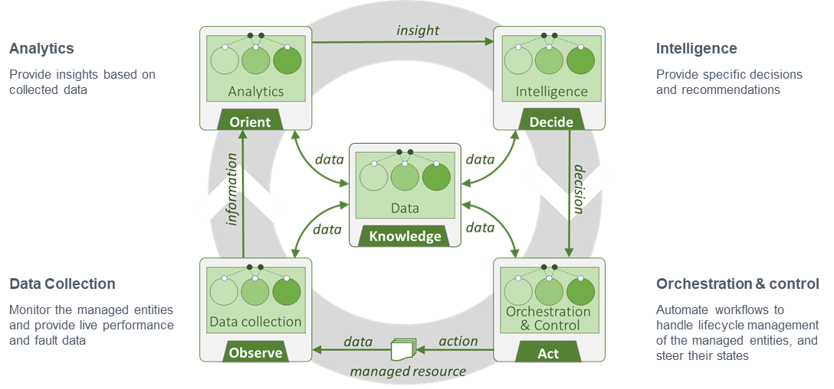
Technology enablers: our view
Intelligence central to the 6g ecosystem
6G architectures could be designed to:
  Inherently support the non-IP technologies like Information Centric Networks (ICN).
  Leverage existing TCP/IP technologies like Multi-Path TCP.
  Support peer-to-peer and ad-hoc networks.
    By delegating control to the edge/extreme edge nodes.
Would lead to:
  The possibility of increasing the available bandwidth over the available access network(s).
  Increasing fault tolerance and network robustness.
  Increased security and seamless mobility.
  Reduced latency for the fast changing and latency sensitive applications.
    E.g. Multi-player FPS games.
© etsi.org

Slide 4


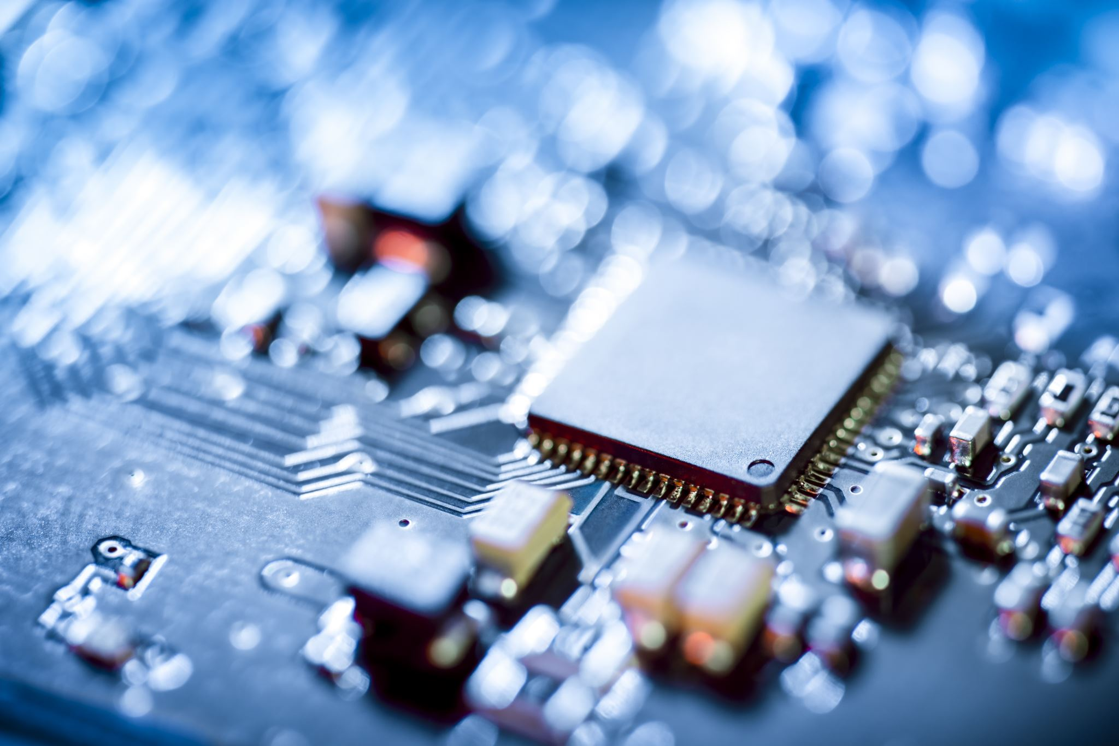
Gaps and challenges
Training data requirements.
  Large amount of data is required.
Long deployment cycles of ML models.
Computational limitations at the edge/extreme edge nodes.
Existing networks do not inherently support intelligence.
Interconnection between the ZSM components.
Data gathering
Training
Evaluation
Deployment
Model creation

Slide 5
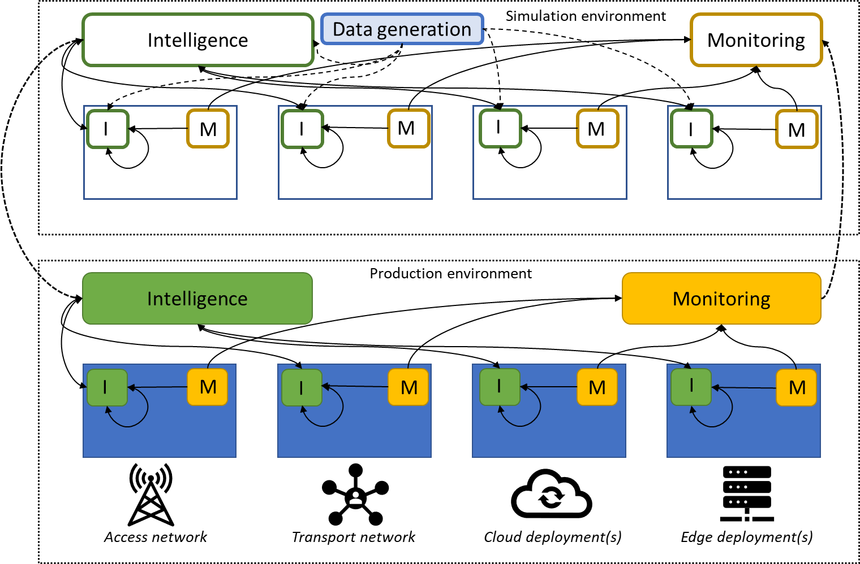
ZSM CCL with integrated simulation
Proposed Solution:
Replication of the production environment in simulation.
  Quick and large data generation.
  Parallel development of updated ML models.
Closed Integration of the environments.
  Continuous update/correction to the environment parameters.
  Regular update to the production monitoring data.

Slide 6
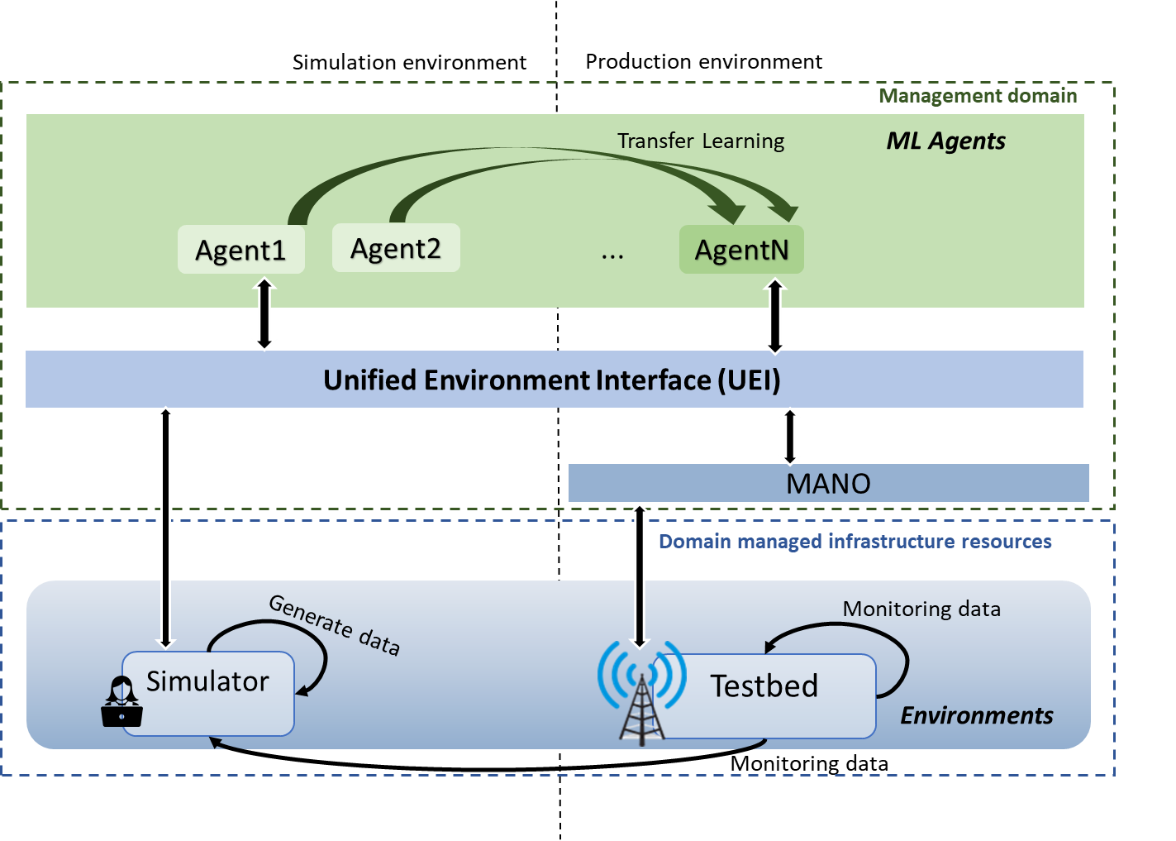
Unified Environment Interface
Standard API to leverage ML model integration , training and refinement.
  E.g. OpenAI-Gym
ZSM view:
  Management domain- Domain and cross-domain automation.
  Environments – Simulations, emulations, testbeds, production etc.
Unified Environment Interface:
  Unifies the environments and the ML framework
  Unifies the complete ecosystem of:
    Simulators/Emulators
    Testbed/Production setup
Notes:
Management domain: actions and observations occur here
Environments: include simulations, emulations, or real scenarios ( testbeds, production env etc.)

Slide 7
Unified Environment Interface
Training data
Observations
Actions
States
Simulation / Emulation
U E I
ML Framework
predictions
Data
Testbed / Production env
updates
MANO
Monitoring data

Slide 8
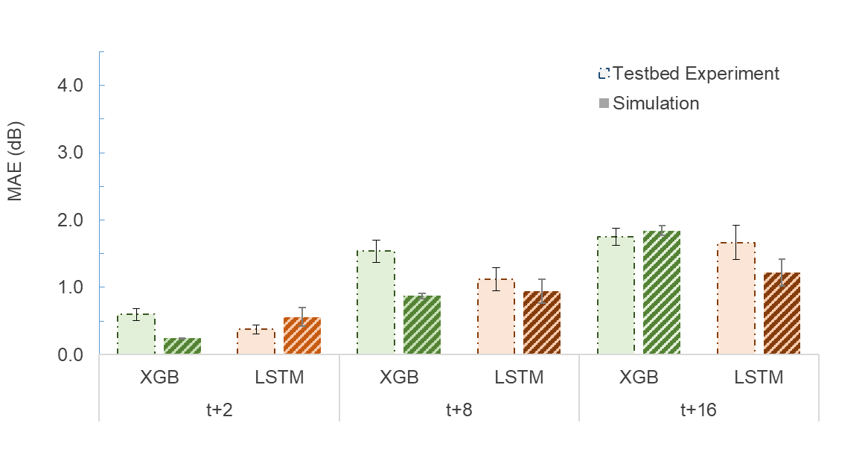
Experiment: Transfer Learning
Custom Simulator based Transfer Learning
Simulator with the testbed configurations.
Predict → Signal strength and serving cell
  2s, 8s, 16s in the future.
Trained neural networks in the simulator with data from the random path generation.
Transferred the trained models to the testbed environment.
N. Uniyal, A. Bravalheri, X. Vasilakos, R. Nejabati, D. Simeonidou, W. Featherstone, S. Wu, and D. Warren, “Intelligent mobile handover prediction for zero downtime edge application mobility,” in 2021 IEEE. Global Communications Conference (GLOBECOM). IEEE, 2021, pp.1–6.

Slide 9
Experiment: NS3 with OpenAIGym

Slide 10




Future works
UEI
Simulation environment (NS3)
ML Framework
Testbed/Production environment
MANO
Sim
Prod

Slide 11
Thank you

