Slide 1


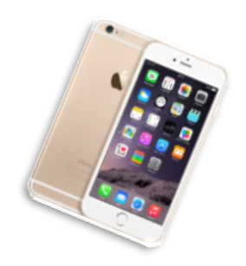
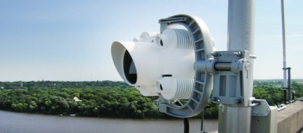
Dengke Wang
KAUST, CTL
WWRF-47
High GF coding in Frequency Hopping for Direct-to-Space IoT System

Slide 2
Outlines
Motivation
  Overview of Internet of Things in 5G beyond and 6G
  Non-Terrestrial Networks(NTN)
  Frequency Hopping Spread Spectrum
High GF Coding Frequency Hopping(HiGFC-FH) design
  FH with high GF
  System model
Analytic model
  Modified collision model
  Error rate analysis
Key results
Conclusion
Notes:
As the increase of the IoT devices，
it is estimated to deploy more than 80 billion iot devices before 2025.
those device trend to spread around the whole world,
not only improve our daily life in dense city,
but also provide services in rural or remote region.
however, current ceil networks can not cover them,
and about 3,4 people are unconneted with internet till now.
.Thus in our view, the next Gs should be also
about "connecting the unconnected"
...in order to offer these often economically
and socially isolated 3 to 4 billion who are
unconnected/underconnected
to experience the transformative benefits
that come with connectivity, from enjoying remote
health and education services,
to smart farming, to access to real-time
financial services….and eventually new potential jobs
and economical opportunities
satellites always cover a much larger footpint than ground base station, thus,
Satellite communication is a potential solution
for the global connection in the next decade.
However, servicing such many users will make the network very crowded,
and will remarkly reduce the network performance.
To solve this bottleneck, a lot of leading IoT companies adjust and extend
their low-power-wide-area-network to suit this challenge.
One most attractive technology is frequency hopping modulation
that can highly increase the network immunity for inteference.
This work aims to investigate a further enhancement of FH by
derive a packet-level in high GF.

Slide 3
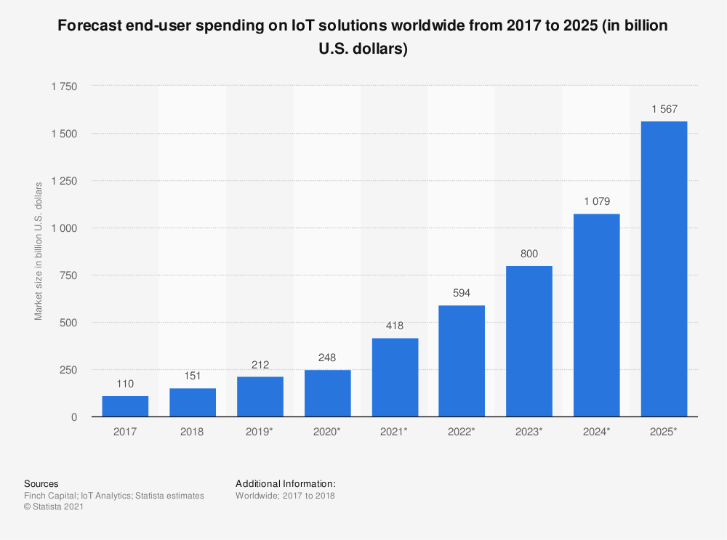
Motivation
With over 20 billion connected devices in 2020;
By 2025 there will be
more than 30 billion active IoT devices;
The IoT market is expected to reach 1567 billion US dollars
M. Vaezi, A. Azari, S. R. Khosravirad, M. Shirvanimoghaddam, M. M. Azari, D. Chasaki, and P. Popovski, “Cellular, wide-area,
and non-terrestrial IoT: A survey on 5g advances and the road towards 6G,” IEEE Communications Surveys & Tutorials, 2022.
Notes:
Billions of these IoT devices already exist around the world and this number will keep growing in coming years. in 2020, there are already 20billion connected devices, and the number might increase to 30 biliion by 2025, and The market size is expected to exceed 1500 billion .

Slide 4
Motivation
High throughput
Large data volumes
Low latency
Use cases:
enhanced mobile broadband (eMBB)
ultra-reliable low-latency communications (URLLC)
massive Machine-type communications (mMTC)
KPI
High Reliability
High availability
Industrial protocols
Synchronization
Low latency
Low-cost, low-energy
Small volumes of data
Massive deployment
Extreme coverage
“Cellular IoT evolution for industry digitalization,” 2019,https://www.ericsson.com/en/reports-and-papers/white-papers/cellular-iot-evolution-for-industry-digitalization.
Notes:
those massive devices also request some new demand for current networks, For different use cases, there are various key performance
indicator (KPI) ..
such as::
It is worth mentioning that, despite challenging
requirements, only a subset of use cases are
addressable by current 5G KPIs, and sixth-generation (6G)
still has much work to do.

Slide 5



Motivation
Solutions for Massive IoT (mIoT) or mMTC?
Low Power Wide Area Networks (LPWANs):
Low-cost, low-energy
Small volumes of data
Extreme coverage
Massive deployment
Low cost
Small payload
Wide area or long-range
Notes:
Massive IoT (mIoT), is a type of IoT, that supports massive Machine-type communication,
What technologies might be used for the solution of miot.
A kind of Potential solutions for mIoT is LPWAN, whose products can be used for data collection purposes, where massive low-power sensors are used to read the temperature, pressure, etc.
The features of LPWAN is:
Which is highly overlapped with our demands.

Slide 6
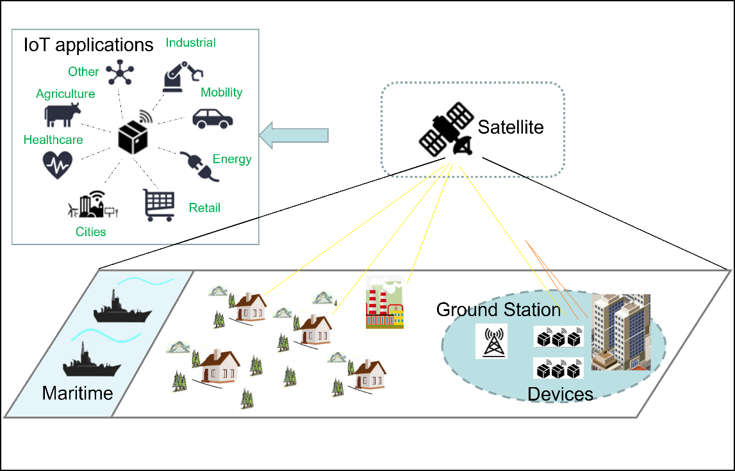
Motivation
Solutions for Massive IoT (mIoT) or mMTC?
Challenges 1: Coverage Solution: Satellite communication
Range>100km
Range~30km
Terrestrial networks
Non-Terrestrial Networks
(UAV,HAPs, Satellite)
Notes:
One main challenge is that Those new coming
devices are widely deployed in rural
and other remote areas. However, truly global coverage of
telecommunication which needs more than 100km transmission range, cannot be realized by current networks, whose service areas are less than 30 km.
Non-Terrestrial
Networks (NTNs) such as unmanned aerial vehicle (UAV),
high altitude platform (HAP) and satellites, which have
unique advantages in filling the loophole of the terrestrial
network by providing ultra-wide coverage and are able to
realize global coverage.
Besides, LEO satellite has been proved to provide ultra service coverage with IoT device .

Slide 7
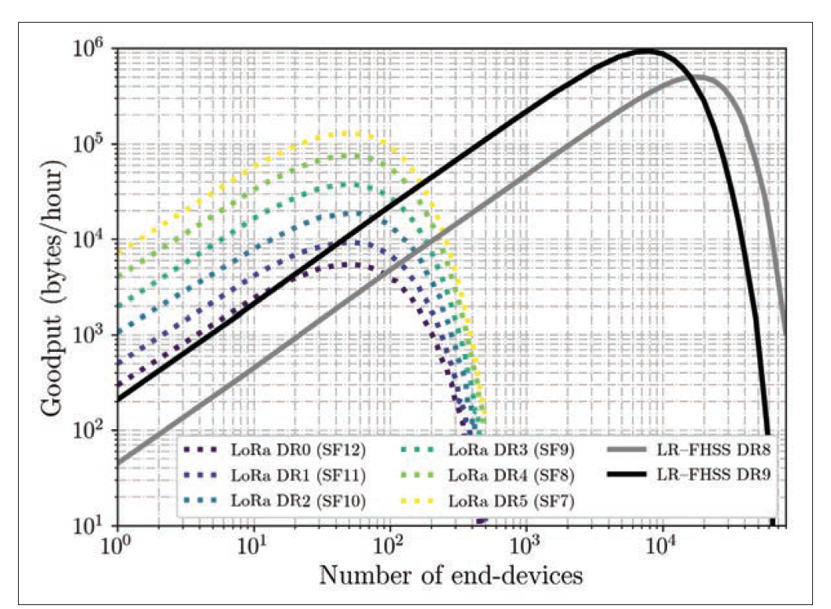
Motivation
Solutions for Massive IoT (mIoT) or mMTC?
Challenges 2: Solution:
Collision Frequency Hopping Spread Spectrum(FHSS)
 | t1 | t2
User1
User2
User3
1.G. Boquet, P. Tuset-Peiró, F. Adelantado, T. Watteyne, and X. Vilajosana, “LR-FHSS: Overview and performance analysis,” IEEE Communications Magazine, vol. 59, no. 3, pp. 30–36, 2021.
2.SX1261/62/ LR1110, Application Note: LR-FHSS System Performance
Notes:
Other Drawbacks or challenge of current LPWAN is the collision issue in uplink, particularly in dense deployments
since performance is severely limited by duty-cycle regulations and the use of simple medium access
control (MAC) protocols. The collision probability will be very high.
In this sense, LoRa/ Sigfox and NB-IoT has announced their
extension of the physical layer by using FHSS
hopping spread spectrum. The extension is
motivated by emerging use cases with increasingly
larger and denser network deployments, including
satellite-scale LoRaWAN networks. Its main goal
is to increase network capacity and robustness based on current devices without hardware replacement.
A clear improvement can be found in two figures provided by researchers and company reports from goodput or packet error rate.

Slide 8
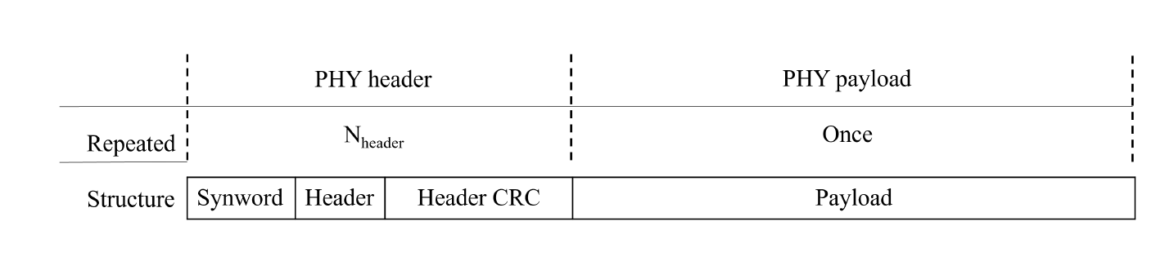
System model
Packet structure
Notes:
A general packet structure for FH system is shown in Fig.1, which
is composed of physical layer (PHY) headers, and the
payload part. (1) The header part consists of several
redundant physical headers, which are transmitted inde
pendently at each frequencies to improve the modulation
robustness of the in-band interferer. Each PHY header
contains the same information about a SyncWord, which
is used to synchronize and locate coming signals, and
cyclic redundancy check (CRC) to judge whether the
header was successfully received. In ’Header’, it includes
all the necessary information to decode the payload part
correctly, such as payload length, code rate, hopping
pattern, and so on. This part should always be the
indivisible whole. they drive convolutional
coding with a fixed code rate 1 over 2
to enhance the performance
(2)Payload
part contains the transmission information bits. Similarly,
convolutional coding with customized code rate is used
in LR-FHSS but here we use coding method in high GF, like RS codes to enhance the system.

Slide 9
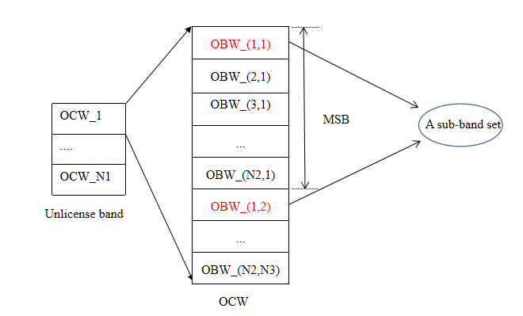
System model
Frequency partition
The frequency distribution structure in LR-FHSS:
Operating Channel Width(OCW):
137kHz
Occupied Band Width(OBW):
488Hz
minimum separation band (MSB):
3.9kHz
Notes:
Frequency hopping modulation should follow regional
regulations, which splits the whole frequency band into
several sub-bands to carry header and payload informa
tion. We focus on the fast frequency hopping that is similar
to LR-FHSS, whose technical information is now limited
and can just be got from [12] and [31]. In the following,
we summarize and adjust the critical aspects of LR-FHSS
in frequency resource. To be clear and straightforward,
this procedure can be divided into three layers, which
can be seen in Fig.2. a. Transmitted signal is working
at the unlicensed band as most of the other LPWAN
does and is defined by different region regulations such
as 868–870 MHz band in EU; b. The whole frequency
band is further divided into several OCW channels, which
is also depending on the local frequency regulations; c.
each OCW is then subsplited into hop-level with a small
bandwidth, named OBW channels or a frequency slot
which are ultra-narrow and can be used in long-range
satellite communication. Note that the hopping pattern4
Fig. 3. Coverage geometry for satellite
should also follow the minimum separation band (MSB)
between the sub-channels used for transmitting sequential
hops. As a result, each device randomly chooses a sub
channel(OBW) from one sub-band set.

Slide 10
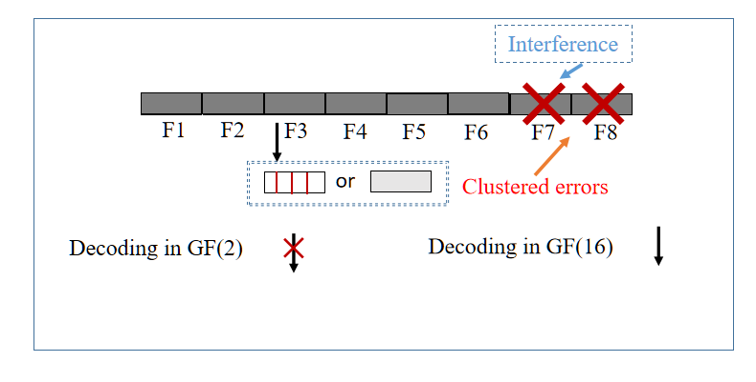
High GF Coding Frequency Hopping(HiGFC-FH) design
Correcting coding concept in FH-SS random access protocol:
GF(2) vs. GF(16), Where each white block denotes a bit, and a gray block denotes a symbol with a length of 4 bits.
Notes:
We have 16 bits to be
transmitted. Those are first encoded into codeword a in
GF(2) or B in GF(16). Those codewords divided into
several frames of 4 bits or one symbol are then past a
binary phase shift keying (BPSK), and transmitted at
each frequency subband, such as F1 ∼ F8. Usually, their
signals suffers interference over the Erasure channel at dif
ferent frequency. Although all of them have a probability
of escaping collision, some error cluster appears, which
is different from communication without FH-SS where
random errors have the same probability to appear in
each hop. As a result, we have high probability to lose all
bits/symbols at F7 and F8. For GF(2) decoder, codeword
a can not be decoded without error since maximum eight
failing bits might be beyond the correct capacity. However,
GF(16) decoder can correct two symbol errors from the
six correct symbols successfully.

Slide 11
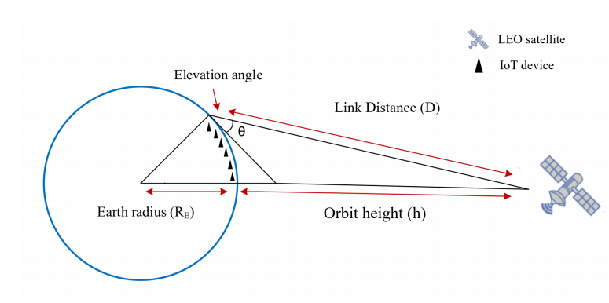


System model
System structure
$$θε[θmin,90]$$
Notes:
We consider an uplink DtS communication network,
where IoT devices directly send their data to the gateway
on a LEO satellite, as shown in this figure. IoT devices
are then uniformly distributed in a scope, which is a
reduced footpoint of satellite θmin need to
be large enough to makes device satisfy the line of sight
(LoS) condition to make sure that the transmitted signal
is visible to the receiver.

Slide 12
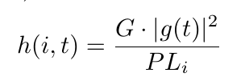
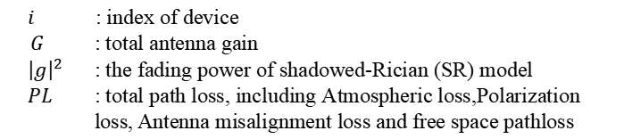
System model
Channel model
$i$ : index of device
$G$ : total antenna gain
${ \left|g\right|}^{2}$ : the fading power of shadowed-Rician (SR) model
$PL$ : total path loss, including Atmospheric loss,Polarization loss, Antenna misalignment loss and free space pathloss
Notes:
Frequency hopping modulation should follow regional
regulations, which splits the whole frequency band into
several sub-bands to carry header and payload informa
tion. We focus on the fast frequency hopping that is similar
to LR-FHSS, whose technical information is now limited
and can just be got from [12] and [31]. In the following,
we summarize and adjust the critical aspects of LR-FHSS
in frequency resource. To be clear and straightforward,
this procedure can be divided into three layers, which
can be seen in Fig.2. a. Transmitted signal is working
at the unlicensed band as most of the other LPWAN
does and is defined by different region regulations such
as 868–870 MHz band in EU; b. The whole frequency
band is further divided into several OCW channels, which
is also depending on the local frequency regulations; c.
each OCW is then subsplited into hop-level with a small
bandwidth, named OBW channels or a frequency slot
which are ultra-narrow and can be used in long-range
satellite communication. Note that the hopping pattern4
Fig. 3. Coverage geometry for satellite
should also follow the minimum separation band (MSB)
between the sub-channels used for transmitting sequential
hops. As a result, each device randomly chooses a sub
channel(OBW) from one sub-band set.

Slide 13

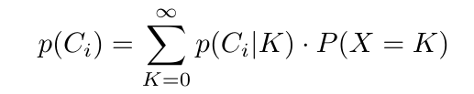


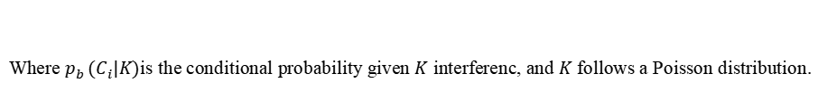
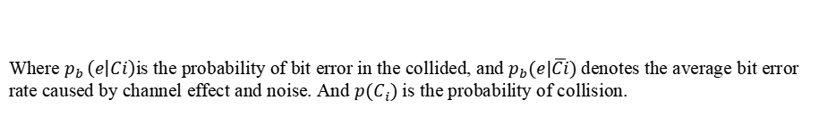
Analysis model
Modified collision model
Where $p_{b }\left(e | Ci\right)$is the probability of bit error in the collided, and $p_{b}(e|\overline{Ci})$denotes the average bit error rate caused by channel effect and noise. And $p(C_{i})$is the probability of collision.
Where $p_{b }(C_{i}|K)$is the conditional probability given $K$ interferenc, and $K$ follows a Poisson distribution.
Where $p_{h}$is the average hit probability.
Notes:
The general collision model just consider the effect of interference, which means that when both time and frequency overlap happens, we lose both packet,
But in our model, they are suffering both interference and noise, so blocks also have a probability of losing their information.
More details of ph is ignored here

Slide 14
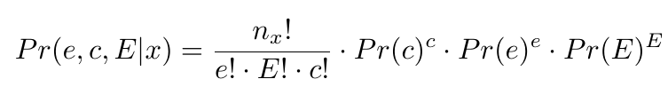
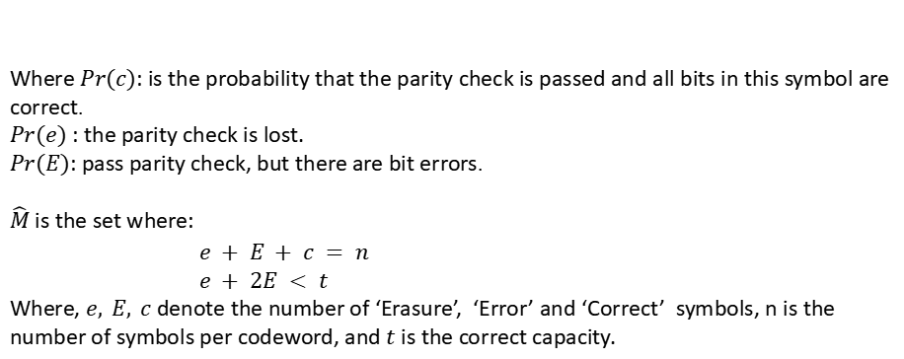
Analysis model
Probability of Codeword Error Rate
Where $Pr(c)$: is the probability that the parity check is passed and all bits in this symbol are correct.
$Pr(e)$ : the parity check is lost.
$Pr(E)$: pass parity check, but there are bit errors.
$\hat{M}$ is the set where:
$e + E + c = n$
$e + 2E < t$
Where, $e, E, c$denote the number of ‘Erasure’, ‘Error’ and ‘Correct’ symbols, n is the number of symbols per codeword, and $t$ is the correct capacity.
Notes:
The general collision model just consider the effect of interference, which means that when both time and frequency overlap happens, we lose both packet,
But in our model, they are suffering both interference and noise, so blocks also have a probability of losing their information.
More details of ph is ignored here

Slide 15
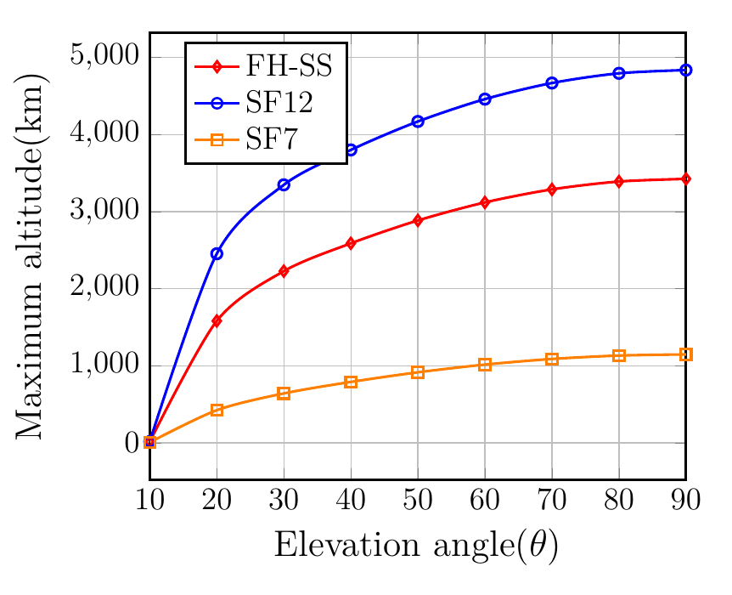
Key Results
Sensitivity of SF7, SF12 and FHSS:
-127, -140 and -137 dBm
Notes:
Maximum altitude vs. elevation angle for different configurations in LoRa, where SF denotes the Spreading factor. The sensitivity is -127, -140, -137 dBm for SF7, SF12 with 125kHz bandwidth and FHSS, respectively.
FH shows an acceptable performance between normal LoRa configurations, and if elevation angle is larger than 30degrees, the satelite can be deployed at a very high altitude like 2000km.
Given h = 150 km, and the device number is 100, the BER at different elevation angles is showed in the right figure,

Slide 16
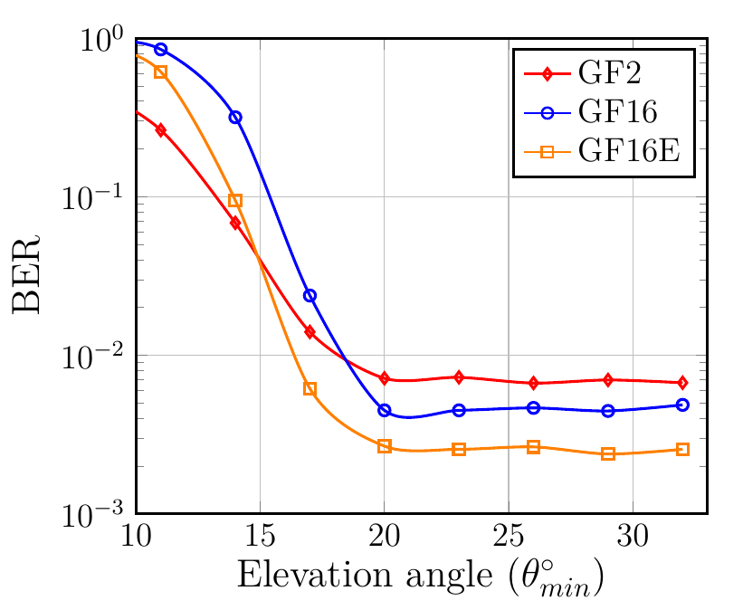
Key Results
θ_{min} < 15,
BER(2) < BER(16)
15 < θ_{min} < 20,
BER(2) > BER(16)
3. θ_{min} > 20,
the noise error is negligible
BCH(15,5,6) for GF(2) , and RS(15,5,10) for GF(16)
Altitude of satellite: 150km
Device number: 100
Notes:
The result is showed in Fig, \ac{BER} is high when $\theta$ is small than $15^\circ$, which denotes a vast coverage area of the satellite. In this case, the devices located at the edge suffer a terrible even non-line of sight condition, and those packets have a high probability of being lost. As a result, the error happens randomly rather due to noise than in the burst, and \ac{GF}(2) is better than others to correct the random errors. With the elevation angle $\theta$ increases, the coverage area decreases, but errors tend to appear in the burst caused by interference, then coding in \ac{GF}(16) shows the better performance. When $\theta$ is larger than about $20^\circ$, the random error rate is very low, and \ac{GF}(16)E becomes the best choice.

Slide 17
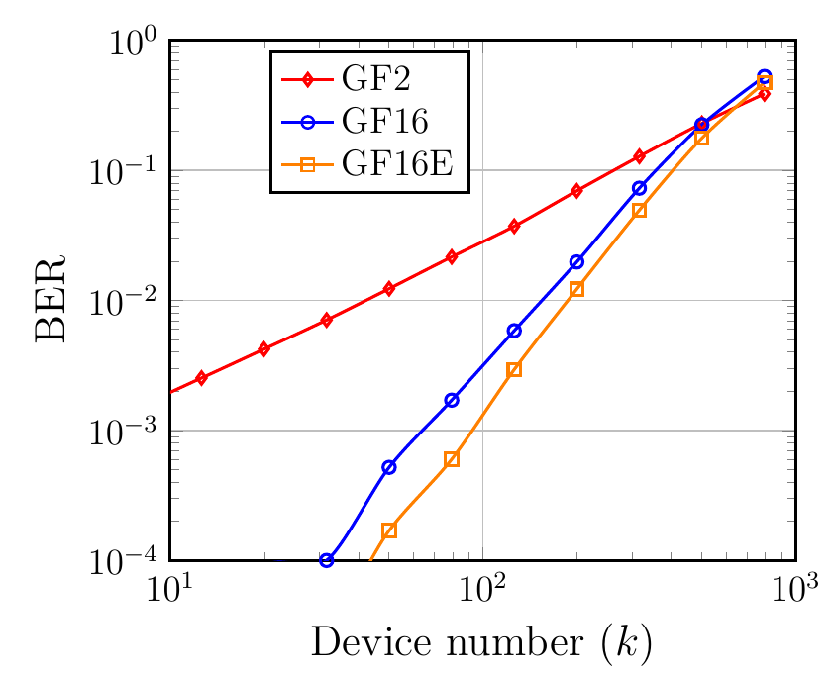
Key Results
When BER is low, such as BER is about 10^-4,
Device number:
N(16E) > N(16) > N(2)
BCH(15,5,6) for GF(2) , and RS(15,5,10) for GF(16)
Altitude of satellite: 150km
Range: 100km
Notes:
when BER is low to satisfy the demand for
communication quality. Keep BER to be 10^4
, GF(16) can hold more than 30 devices while GF(2) can
not hold 10 devices. Moreover, GF(16)E can serve another
14 more devices than GF(16). As predicted, if the number
of devices increases to a large scale, such as 800 devices,
then the characteristic of clustered error in FH-SS would
disappear, and coding in GF(2) would become the best
choice.
The results showed that the system with a
more significant number of frequency subbands has a
lower BER, but this modification costs more frequency
resources.

Slide 18
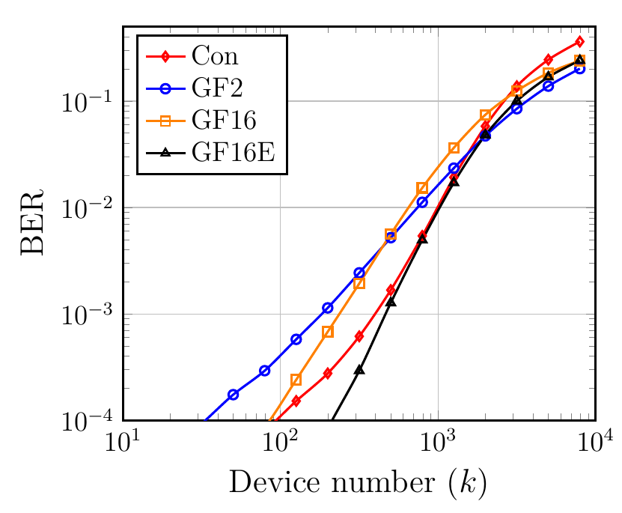
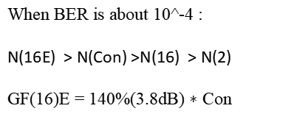
Key Results
When BER is about 10^-4 :
N(16E) > N(Con) >N(16) > N(2)
GF(16)E = 140%(3.8dB) $∗$ Con
Simulation beyond collision model,
BCH(15,5,6) for GF(2) , and RS(15,5,10) for GF(16)
Altitude of satellite: 150km
Range: 100km
Notes:
We then use a simulation where the interference affects
the overlapped part rather than the whole hop to validate
the performance beyond the collision model and the .
Other configurations are the same. All trends are the
same as the theoretical results in Fig.10. The result is
shown in Fig.17 when BER is above 10^-4
. GF16E, which denotes the design with erasure detection in high GF(16),
still shows the best performance. Specifically, GF16E can
contain six times the device capacity of GF(2) and 3.8dB
or 140% more devices over convolutional code.

Slide 19
Conclusions
1. A new system design is particularly promising for DtS mMTC to improve the performance with FH-SS modulation.
2. An analytical model based on a modified collision model and a simulation are proposed for the proposed designs.
3. Our results show that the proposed system design can support larger scale DtS networks. The high GF coding with erasure design outperforms the binary coding like BCH and convolutional coding used in LR-FHSS.

Slide 20
Thanks
Thanks!

